Slide 1
Causes why some students don’t play sports
By: Sanad/Ghazi/Yazan

Slide 2
Introduction
We did a survey and we did interviews asking them questions like what are the causes that you don’t like to play sports and how can you solve this issue, then we will collect all the answers and solutions and then send them to the school so that the school will do what their students asked for.

Slide 3
Causes why some students don’t play sports in school
Causes
How to solve the causes
There are no swimming pools and a lot of students prefer to swim
There is not enough equipment so that everyone can enjoy playing sports
If there is a deaf student and in the P.E class the teacher decides to start a race the deaf students will not realize that the race has started until everyone has already started to run
Build a swimming pool that the students can swim in
buy enough equipment
the teacher should do a sign when the race starts instead of just saying “Run”

Slide 4
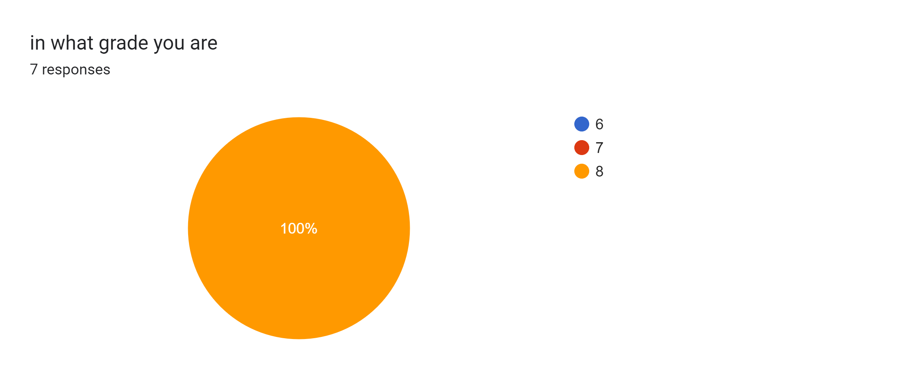
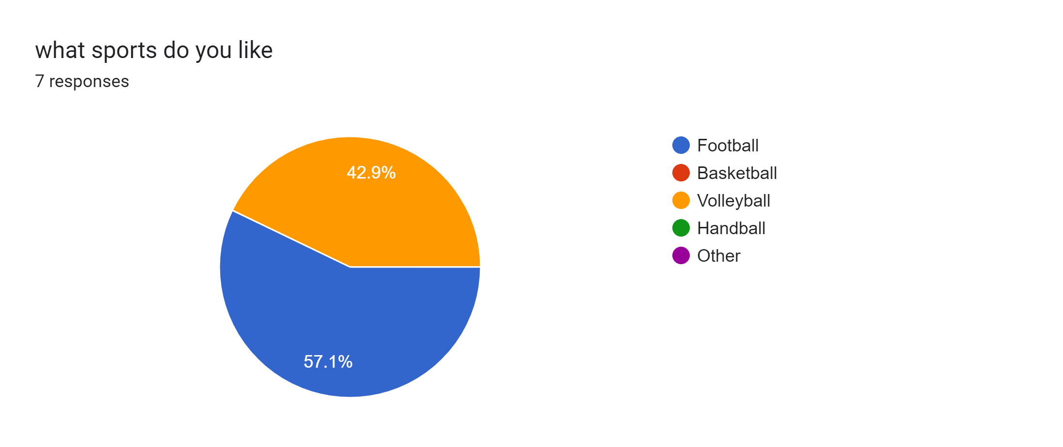
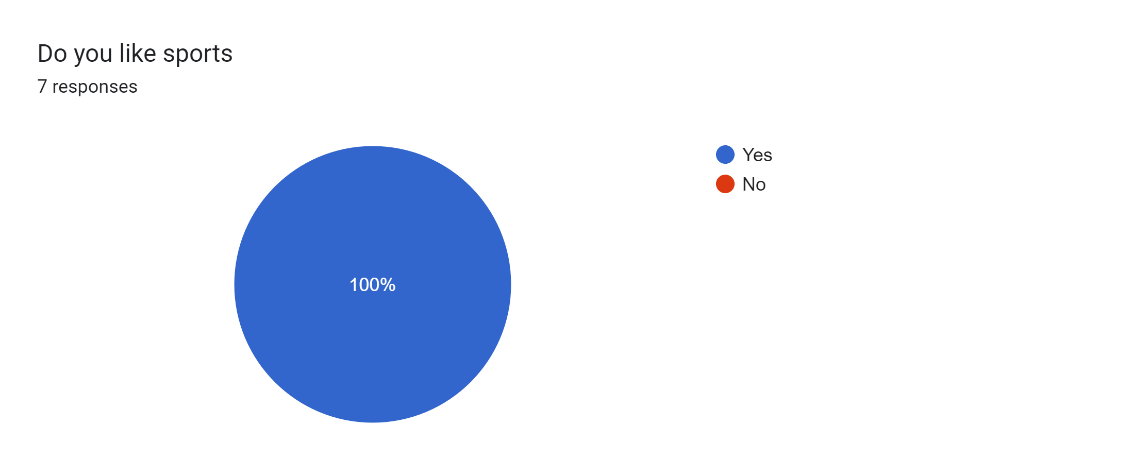
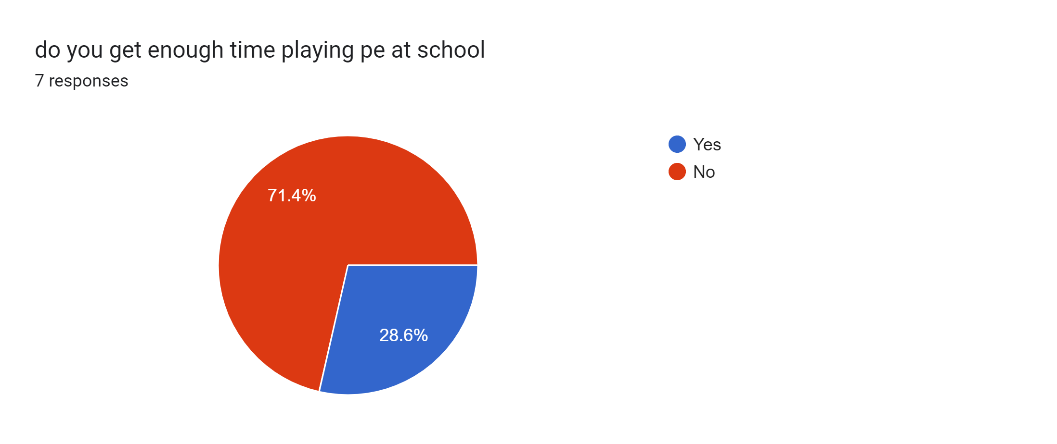

Slide 6
https://docs.google.com/forms/d/e/1FAIpQLSclTHo_p5ZSjPxuYG79AFYElckxKgakJVY2xqyrN4KRCuFX5A/viewform?usp=sf_link

