Slide 1
Survey & Interviews
Work of students Naya Al-Qamhawi, Dalia Al-Ahwal and Noor Saba

Slide 2
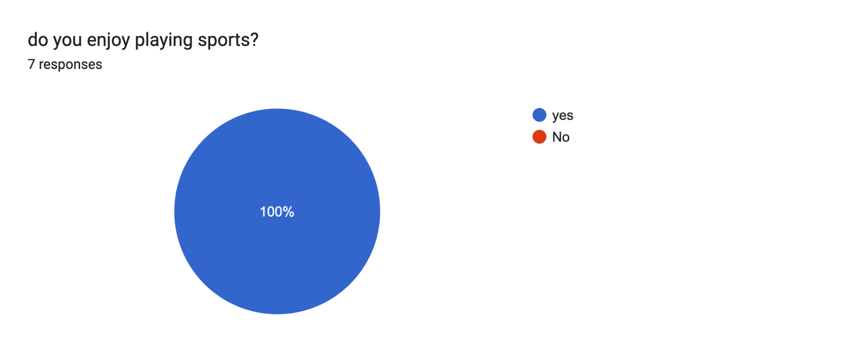
We asked a group of NOS students, section (6-8), a series of question about their thoughts on sports in general, and the school sports department in hopes of compiling some data about their overall opinions on it.
Here are the results we drew :
1-

Slide 3
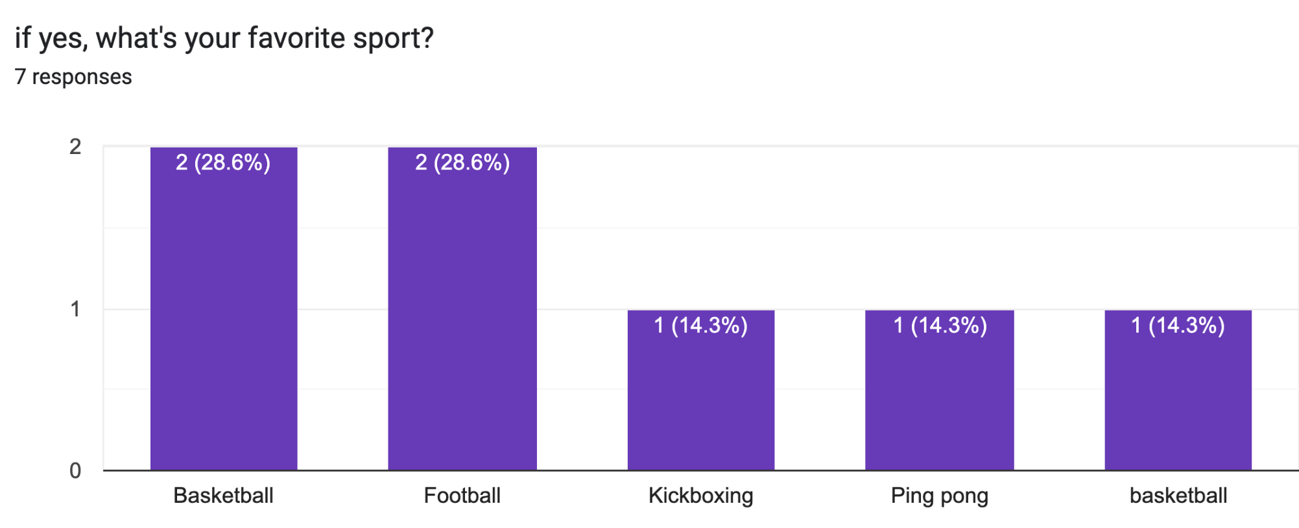
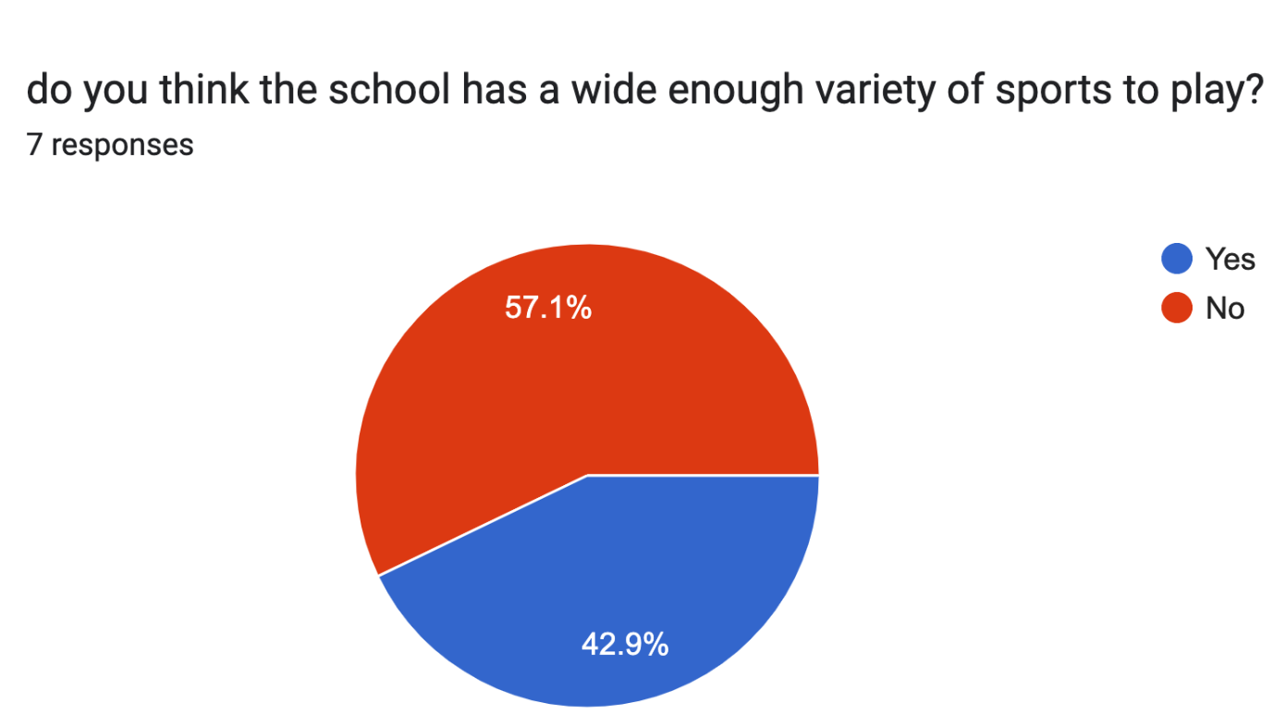
2-
3-

Slide 4
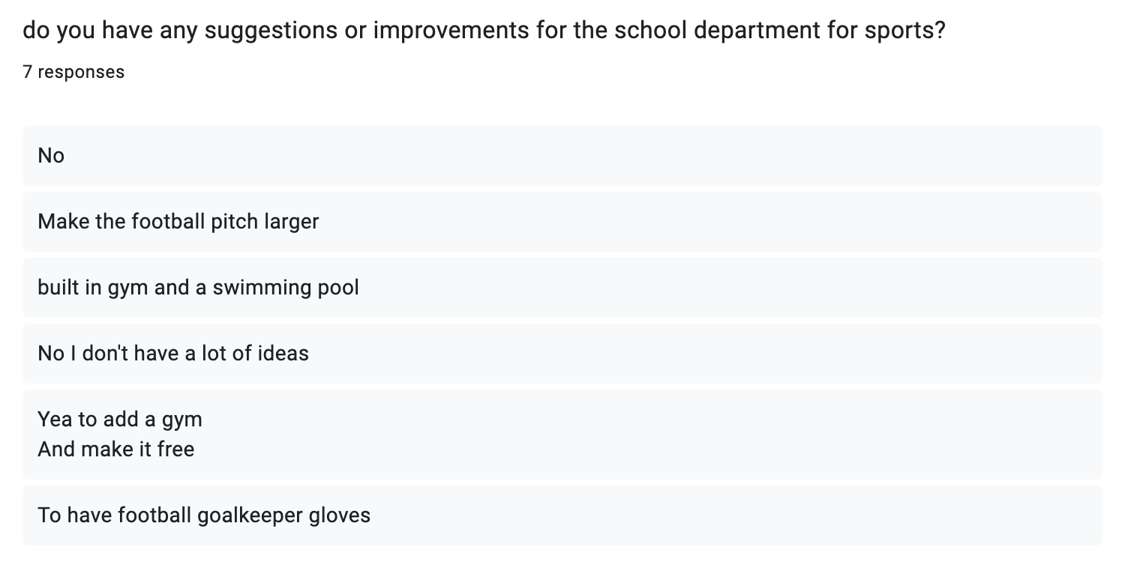
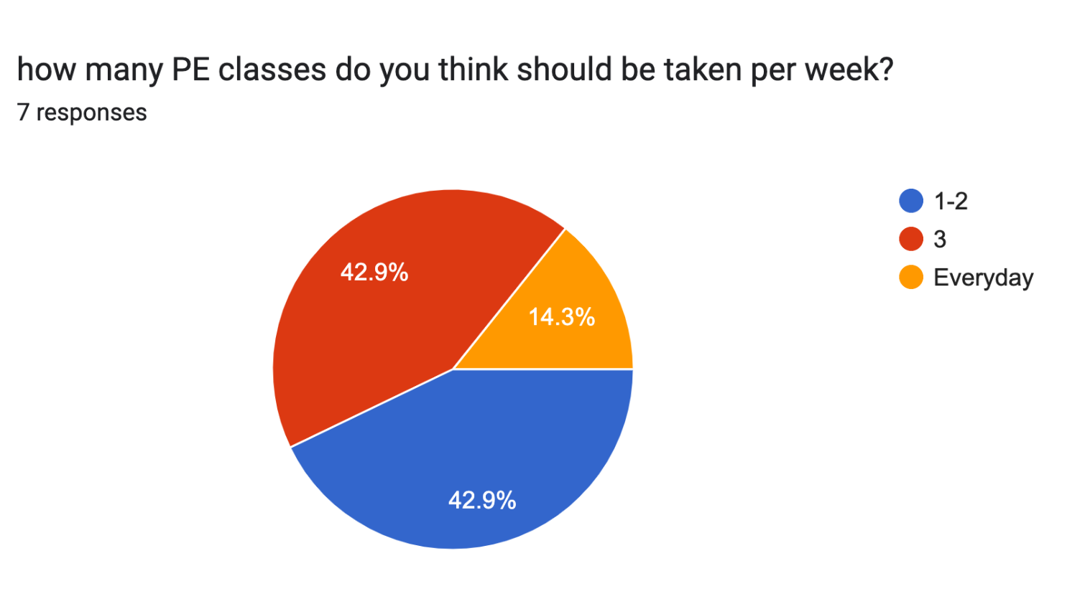
4-
5-

Slide 5
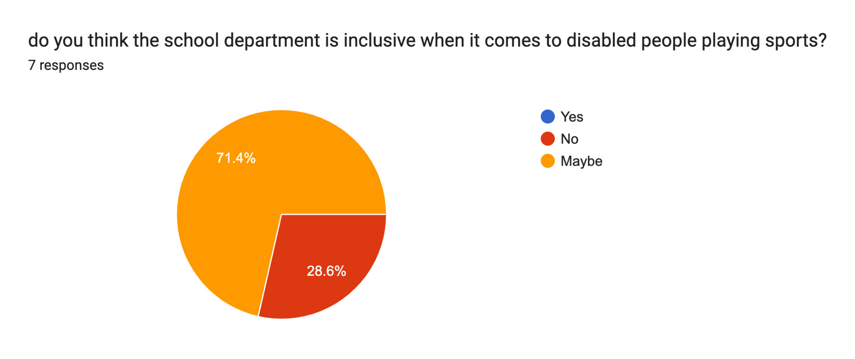
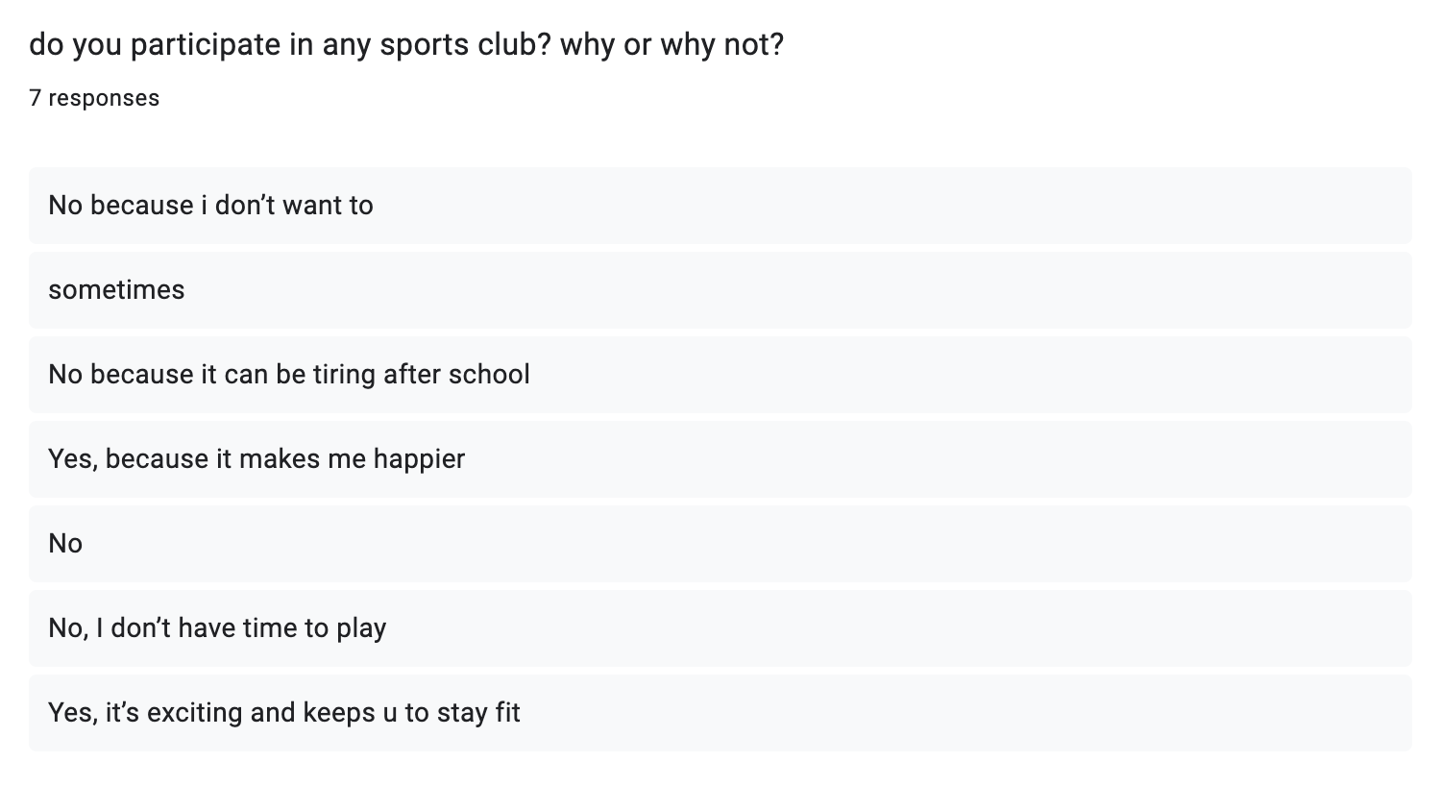
-6
7-

Slide 6
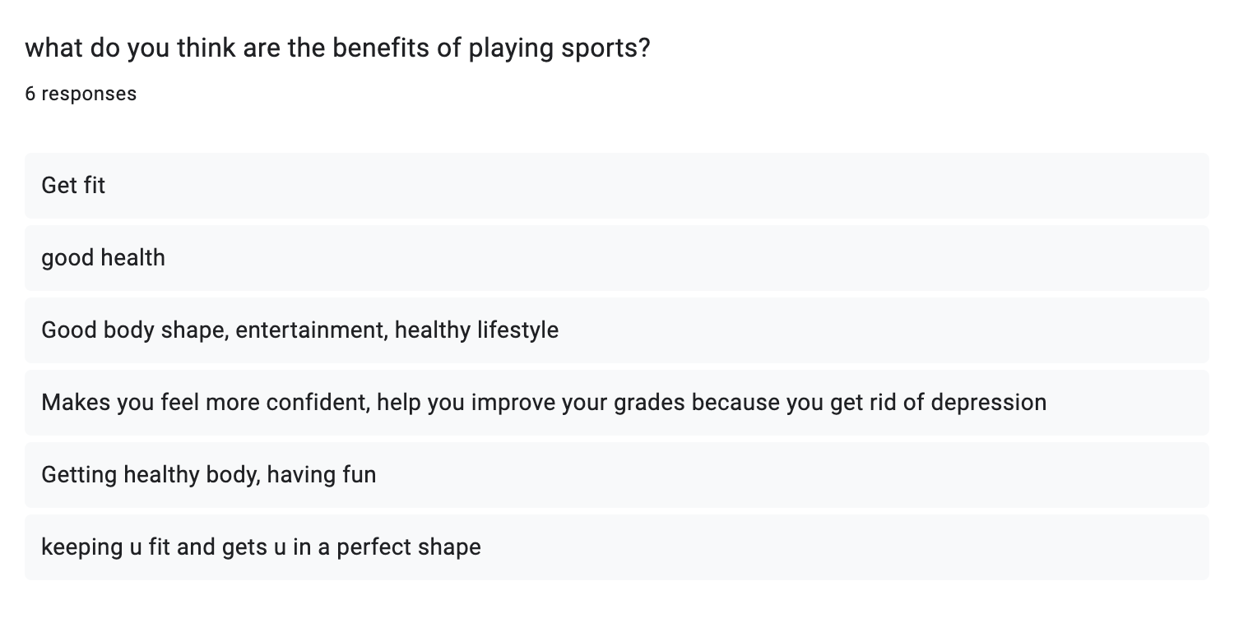
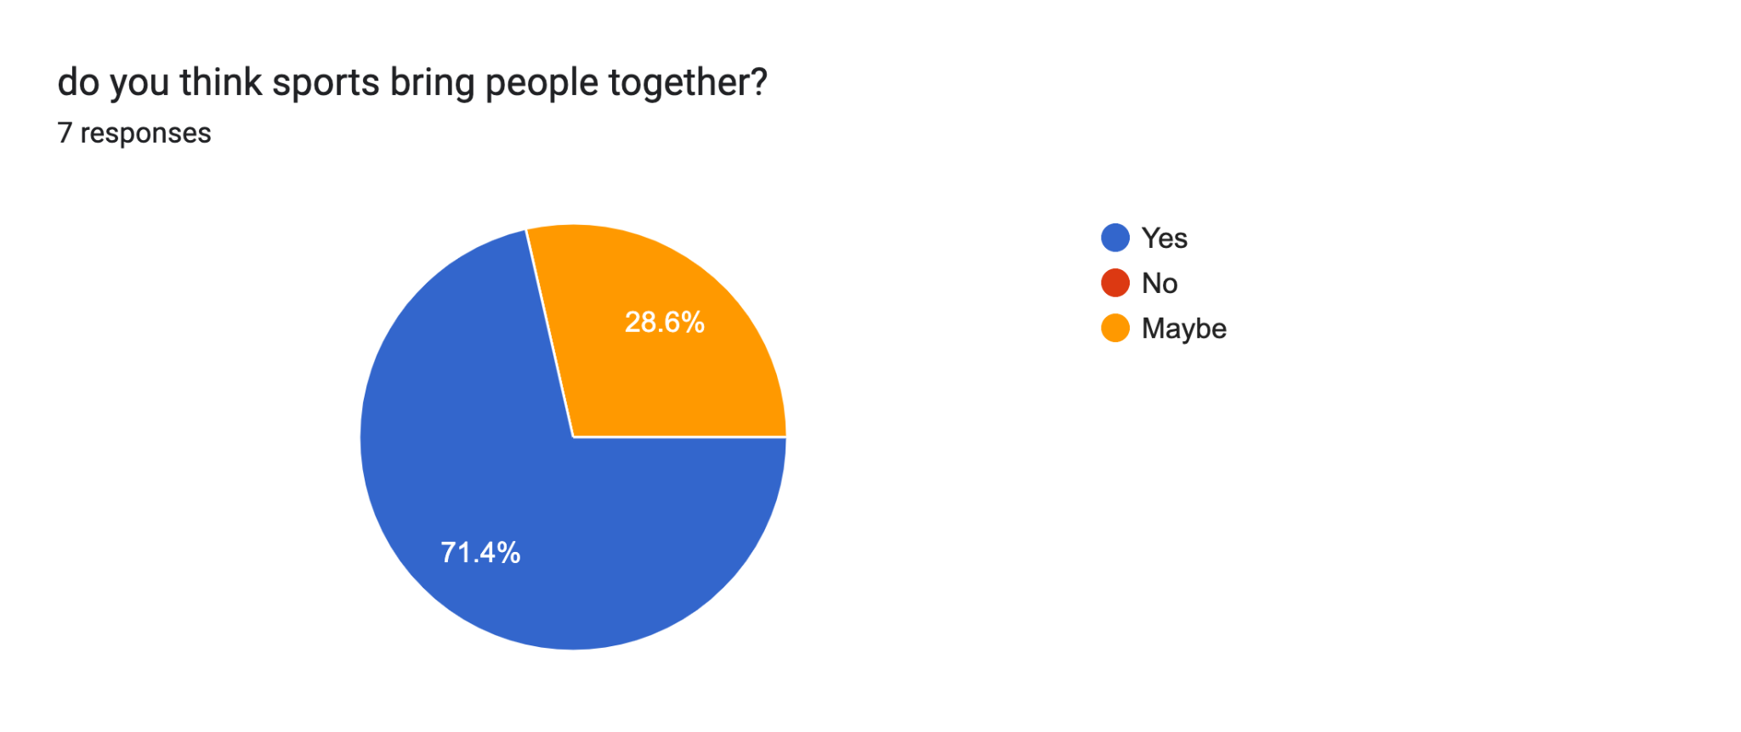
8-
9-

Slide 7
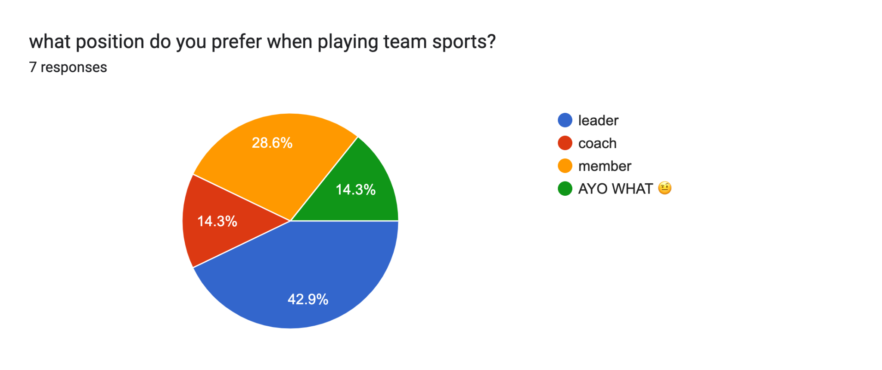
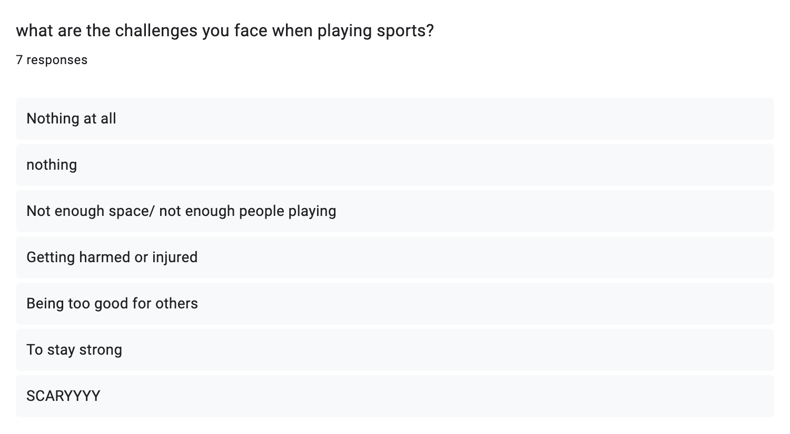
10-
11-

Slide 8
Here is a link to the full form :https://docs.google.com/forms/d/e/1FAIpQLSebxEVXY-lBSXTA80-5wXgjwnEq1Jlg63PgX-Zr_huZR3Jz-Q/viewform?usp=sf_link
We also conducted a real life interview during some of the breaks , here is the link to the video :
https://drive.google.com/file/d/1RTblu10OnrzZLUvrjN7jw0Y1xbWOF3Ec/view
These were the questions asked
Do you practice any sports and why?
Do you have any suggestions/improvements for the school sports department? If so what are they?

