Slide 1
Virtual reality
Leen ghosheh
8H

Slide 2
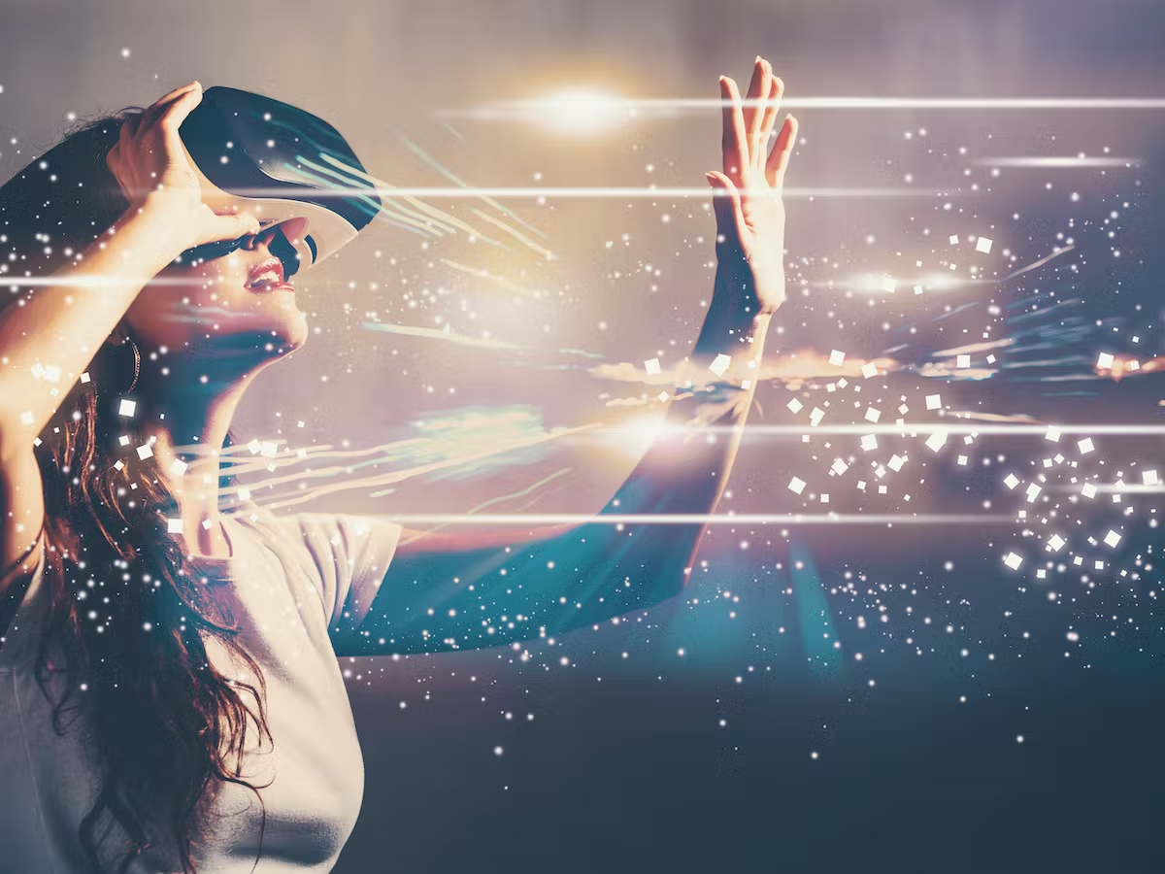
What is virtual reality?
is a computer-generated environment with scenes and objects that appear to be real, making the user feel they are immersed in their surroundings.

Slide 3
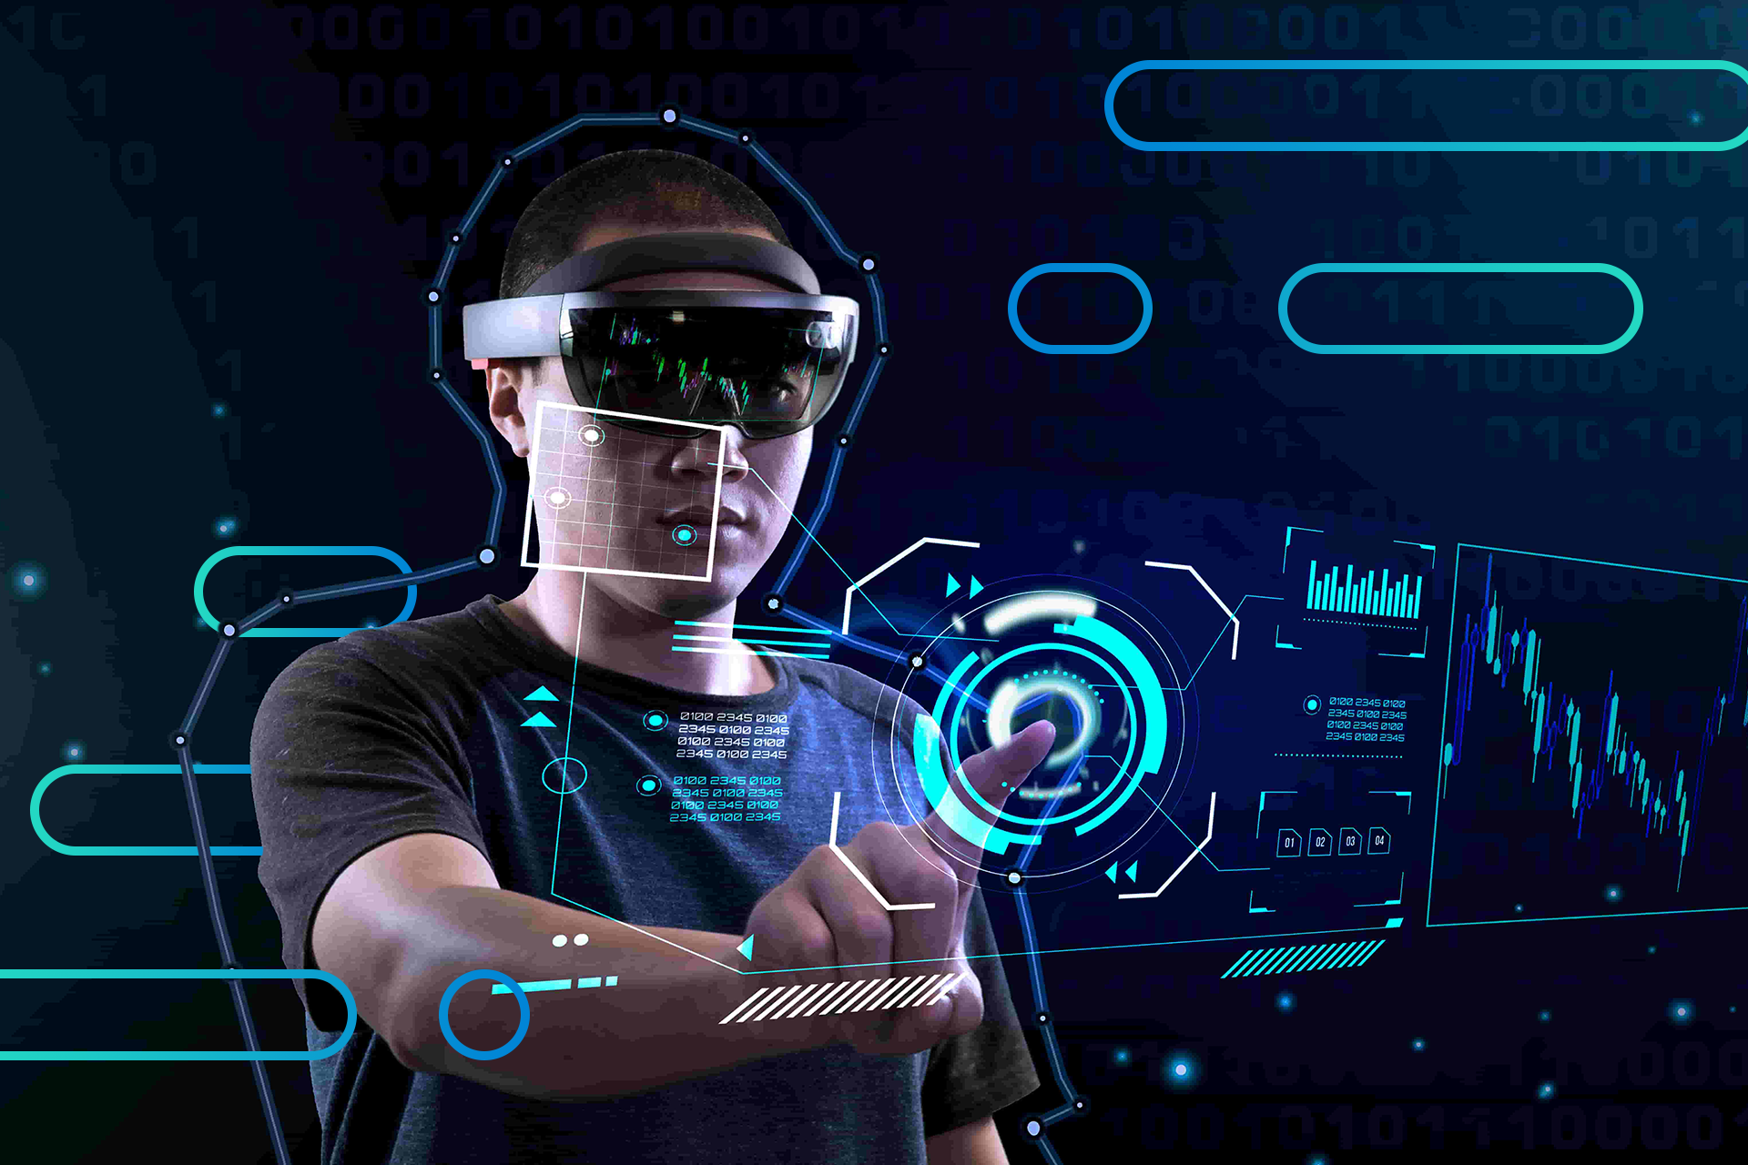
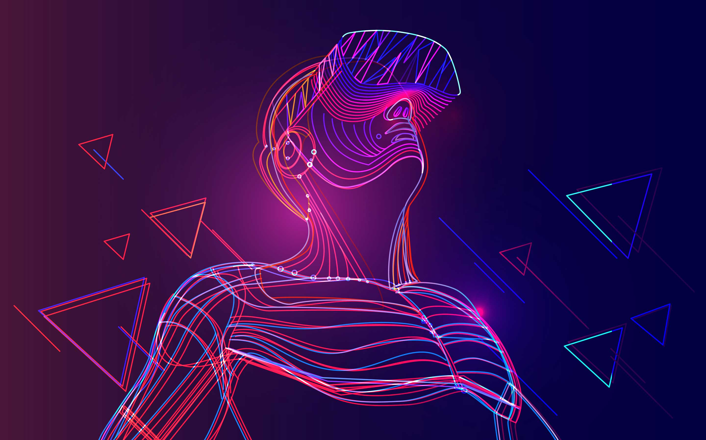
What is the use of graphics in virtual reality?
the visualization effect and computer graphics are critical to enhance the engagement of participants and thus increases the education and training effectiveness

Slide 4
How does virtual reality work?
you can overlay digital objects in your space and interact with them, virtual reality places a user in a virtual dimension through computer graphics, AI sensors, head, and body trackers. Combining VR hardware and software components creates an immersive experience for the end user.

Slide 5
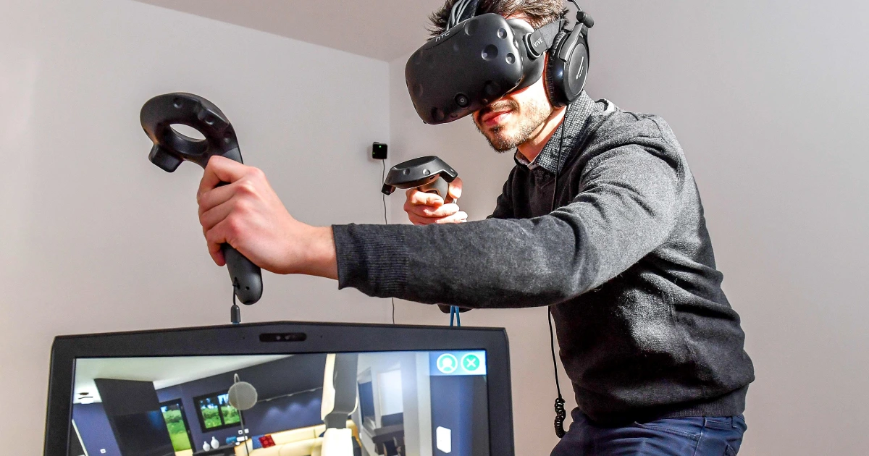
How is virtual reality made?
VR headsets have embedded stereoscopic lenses positioned between a built-in LED screen and eyes, distorting the image so it looks 3-D and real. The headset passes two images through these lenses, one for each eye, similar to our vision.

Slide 6
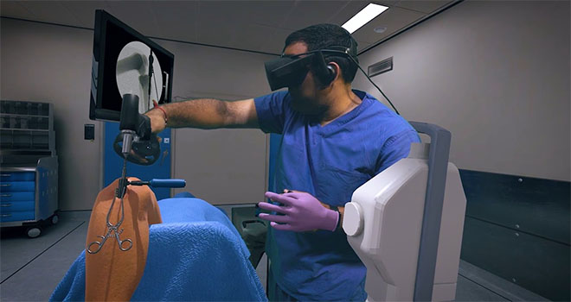
What do people use virtual reality to do?
VR makes it possible to see not just what a building or space will look like but how it will feel. For example, if someone was looking to add an extension to their property, they can experience the space and what it will look like before it's physically built and then make real-time changes.

Slide 7
Does virtual reality help people train for their jobs?
Virtual reality helps doctors train to be doctors so they wouldn’t train on actual people, they train using virtual reality. Which also helps pilots to learn how to fly planes and not to crash them, and much more.

Slide 8
Thank you

