Slide 1
Virtual reality
Sanad madanat

Slide 2
What is virtual reality
virtual Reality (VR) is a computer-generated environment with scenes and objects that appear to be real, making the user feel they are immersed in their surroundings.

Slide 3
Why is virtual reality important
Virtual Reality is essential for the growth and expansion of the metaverse industry. The technology supports the vision of metaverse clusters by aiding in creating the 3D virtual world. With VR, users can immerse themselves in interactive experiences that are hard to access in the physical environment.

Slide 4
How do people use vr
VR makes it possible to see not just what a building or space will look like but how it will feel. For example, if someone was looking to add an extension to their property, they can experience the space and what it will look like before it's physically built and then make real-time changes.

Slide 5
How do we use vr
Virtual reality is most commonly used in entertainment applications such as video games, 3D cinema, amusement park rides including dark rides and social virtual worlds

Slide 6
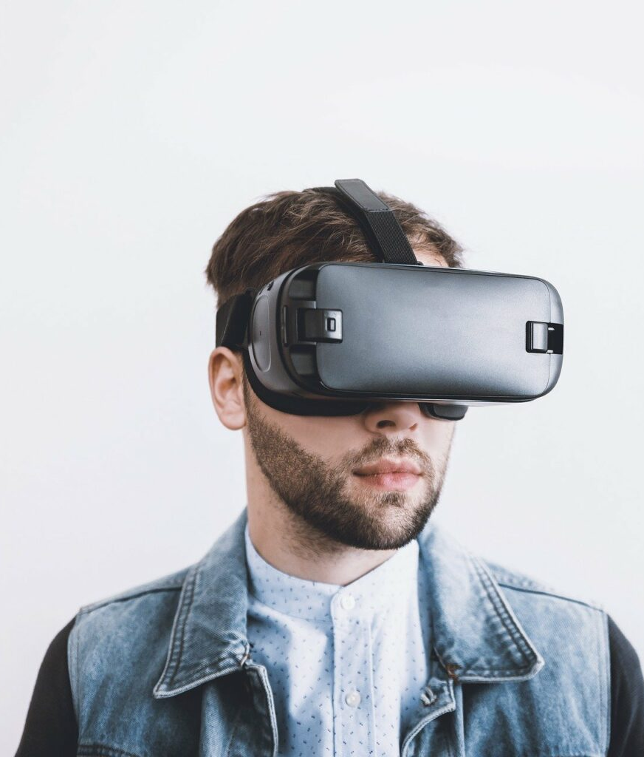
What are three common uses of virtual reality?
VR in Military. The military in the UK and the US have both adopted the use of virtual reality in their training as it allows them to undertake a huge range of simulations.... VR in Sport. ... VR in Mental Health. ... VR in Medical Training. ... VR in Education. ... VR in Fashion.
This Photo by Unknown Author is licensed under CC BY-SA-NC

Slide 7
Thank you

