Slide 1
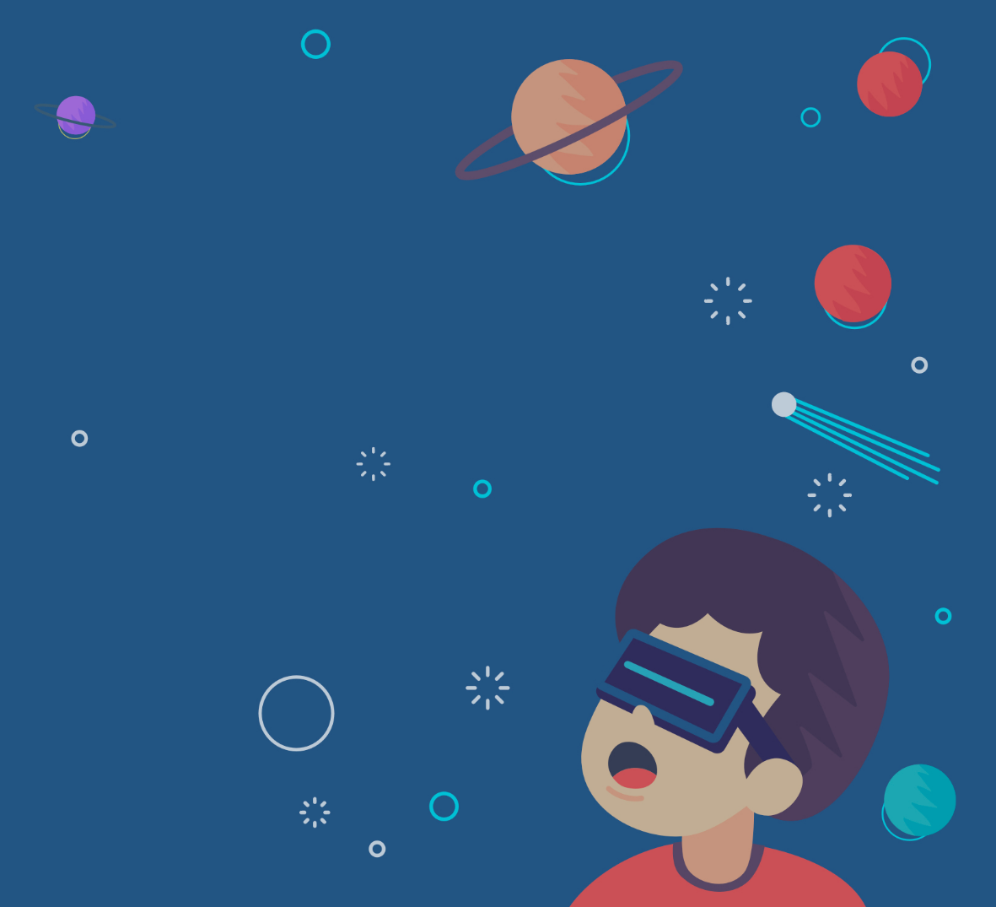
Virtual Reality
By: laya nowwara 8g

Slide 2
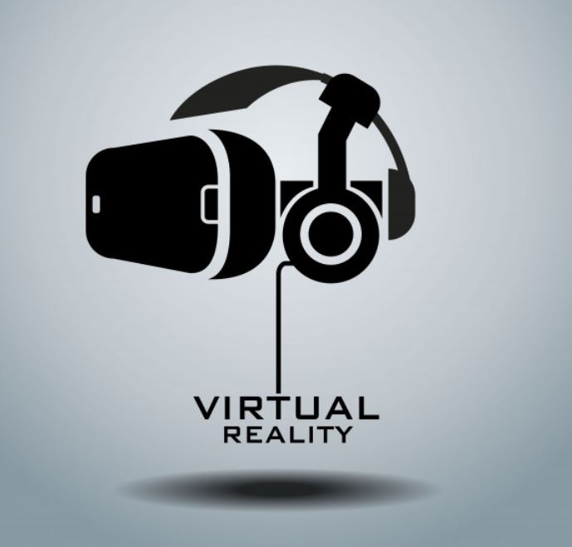
What is Virtual Reality?
Virtual Reality is a computer-generated environment with scenes and objects that appear to be real, making the user feel they are immersed in their surroundings.

Slide 3
Virtual Reality Uses
Virtual reality is most commonly used in:
Entertainment applications
Video games
3D cinema
Amusement park rides including dark rides
Social virtual worlds

Slide 4
Virtual Reality Types
There are 3 primary categories of virtual reality simulations used today:
Non-immersive
Semi-immersive
Fully-immersive simulations

Slide 5
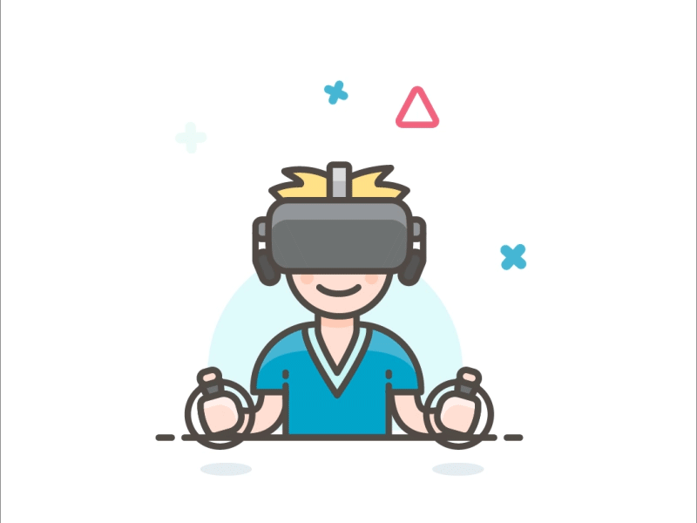
Non-Immersive Simulations
This technology provides a computer-generated environment, but allows the user to stay aware of and keep control of their physical environment.
Non-immersive virtual reality systems rely on a computer or video game console, display, and input devices like keyboards, mice, and controller.
A video game is a great example of a non-immersive VR experience.

Slide 6
Semi-Immersive Simulations
This type will still give users the perception of being in a different reality when they focus on the digital image, but also allows users to remain connected to their physical surroundings.
Semi-immersive technology provides realism through 3D graphics, a term known as vertical reality depth. More detailed graphics result in a more immersive feeling.
This category of VR is used often for educational or training purposes and relies on high-resolution displays, powerful computers, projectors or hard simulators that partially replicate design and functionality of functional real-world mechanisms.

Slide 7
Fully-Immersive Simulations
Fully-immersive simulations give users the most realistic simulation experience, complete with sight and sound.
To experience and interact with fully-immersive virtual reality, the user needs the proper VR glasses or a head mount display (HMD). VR headsets provide high-resolution content with a wide field of view.
The display typically splits between the user’s eyes, creating a stereoscopic 3D effect, and combines with input tracking to establish an immersive, believable experience.
This type of VR has been commonly adapted for gaming and other entertainment purposes, but usage in other sectors, namely education, is increasing now as well. The possibilities for VR usage are endless.

Slide 8
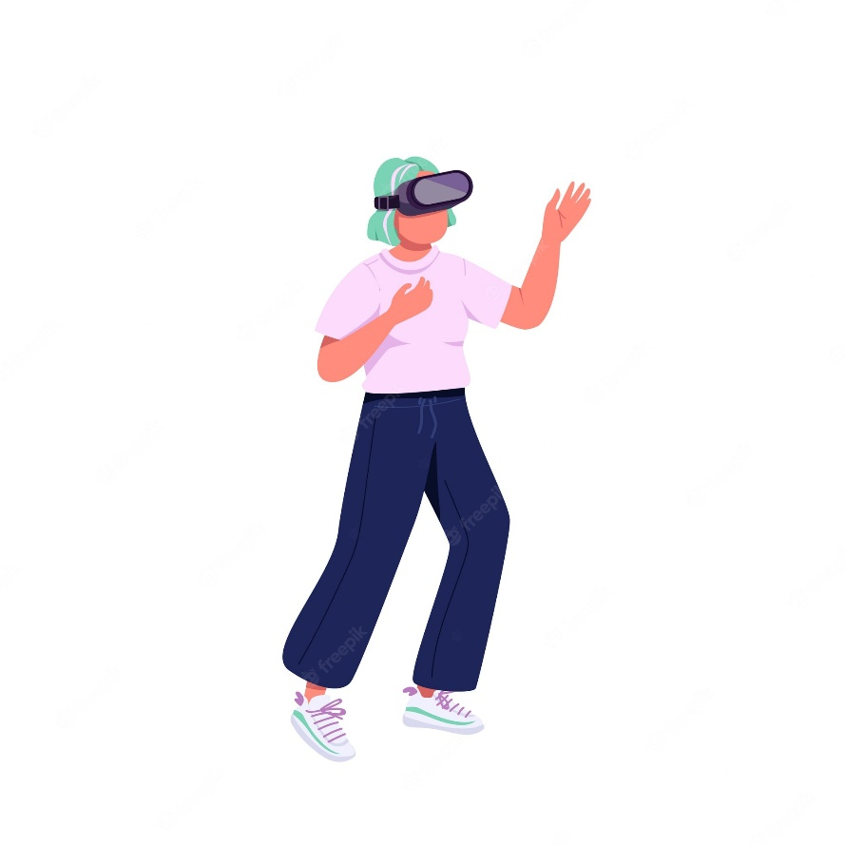
Virtual Reality Disadvantages
One of the main disadvantages is the health risks associated with using VR headsets.
These headsets can cause eye problems, such as eyestrain, headaches, and nausea.
They can also cause motion sickness because they can make users feel like they are moving when they are not.
It can be expensive.

Slide 9
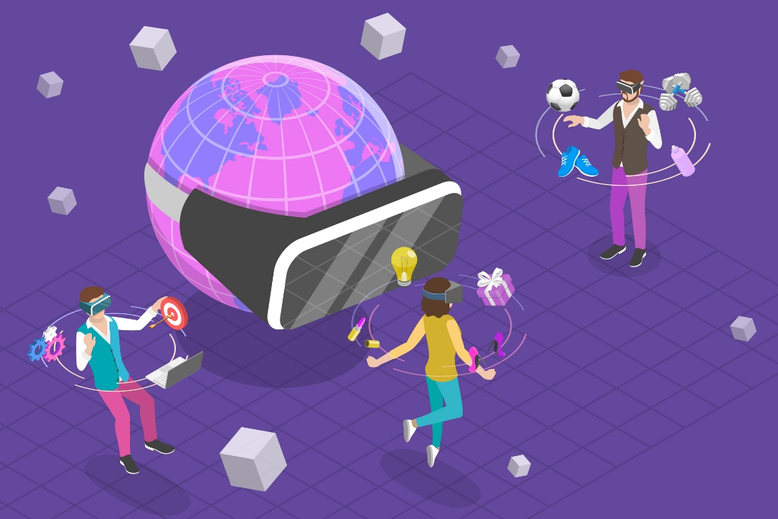
Virtual Reality Advantages
Helps exploring places without actually being there
Lowest risk to try new things
Increases productivity
Improves and modernizes education
Healthy Escapism from real life stress

Slide 10
Citations
https://metaversevrnow.com/vr/advantages-and-disadvantages-of-virtual-reality/
https://heizenrader.com/the-3-types-of-virtual-reality/
https://www.iberdrola.com/innovation/virtual-reality
https://en.wikipedia.org/wiki/Virtual_reality

