Slide 1
Simulation
By: Jason Wahhab 8csG

Slide 2
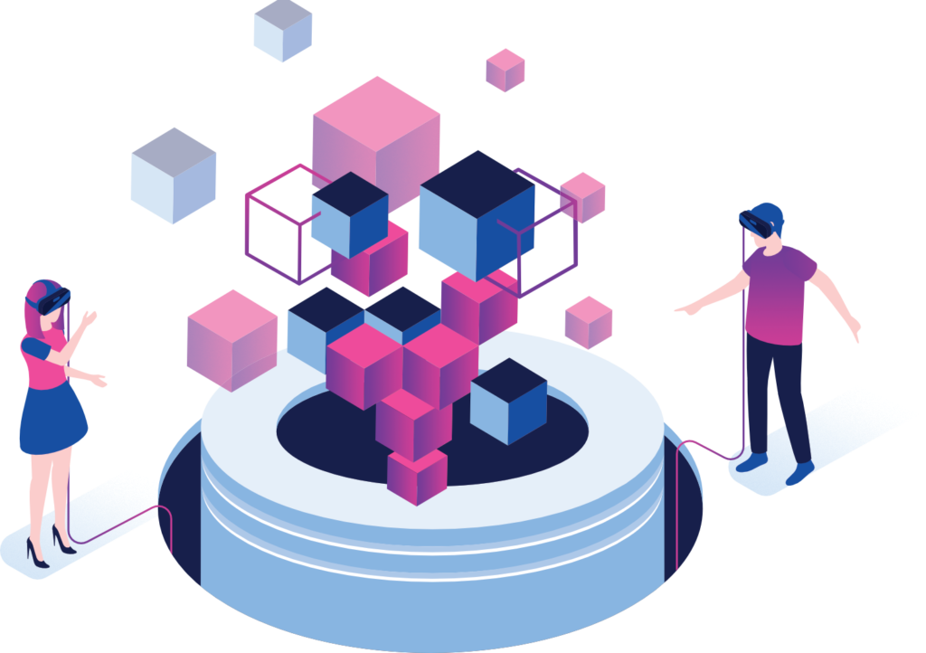
What is a simulation?
A simulation is a time-lapse simulation of the operation of a real-world process or system. Models are required for simulations; the model represents the key characteristics or behaviors of the selected system or process, whereas the simulation represents the model's evolution over time.

Slide 3
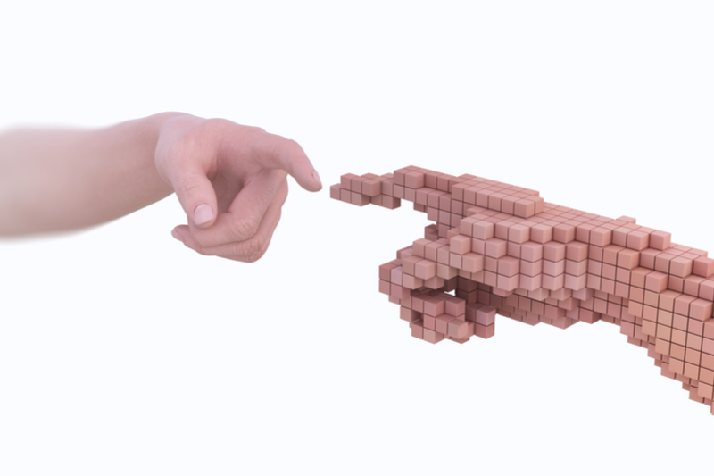
What are the benefits of simulations?
Simulation can help you gain a better understanding of a process. Identify process bottlenecks or problem areas. Consider the impact of changes to systems or processes such as demand, resources, supply, and constraints. Determine whether actions are required upstream or downstream of a given operation, organization, or activity to improve or mitigate processes or events. Prior to implementation, assess the impact of policy changes.

Slide 4
What are examples of simulations?
Simulations are used in multiple ways and multiple works of life. Some examples include:
Fire drills,
Weather forecasting,
CGI graphics in entertainment,
Simulation used in healthcare to teach skills or prepare for emergencies

Slide 5
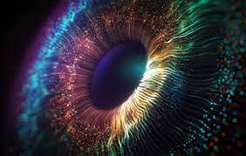
How do people use simulations in real life?
Simulations can be used to improve performance, optimize a process, increase safety, test theories, train employees, and even entertain in video games! A user can gain insight into the effects of various conditions and courses of action by scientifically modeling systems.

Slide 6
What are the advantages and disadvantages of simulations?
Advantages
Disadvantages
Study the behavior of a system without building it.
Results are accurate in general, compared to the analytical model.
Help to find an unexpected phenomenon, and behavior of the system.
Easy to perform ``What-If'' analysis.(What-If Analysis is the process of changing the values in cells to see how those changes will affect the outcome of formulas on the worksheet)
Expensive to build a simulation model.
Expensive to conduct simulation.
Sometimes it is difficult to interpret the simulation results.

Slide 7
Recources:
https://en.wikipedia.org/wiki/Simulation
https://ors.od.nih.gov/OD/OQM/cms/Pages/default.aspx
https://study.com/academy/lesson/simulations-definition-uses.html#:~:text=Simulations%20are%20used%20in%20multiple,skills%20or%20prepare%20for%20emergencies.
https://www.twi-global.com/technical-knowledge/faqs/faq-what-is-simulation#:~:text=Simulations%20can%20be%20used%20to,conditions%20and%20courses%20of%20action.
https://www.futurelearn.com/info/courses/simulation-for-logistics-an-introduction/0/steps/66020

