Slide 1
Simulation
By Ahmad Alkhateeb 8G

Slide 2
What is a simulation
A simulation is a model that copy's the work of an already existing system, giving proof for decisions by being able to test possible scenario.

Slide 3
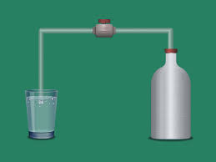
How simulations are used In chemistry
Simulations are used while learning of Chemistry to help students see microscopic reactions and to test dangerous chemical reactions without being in the way of harm.

Slide 4
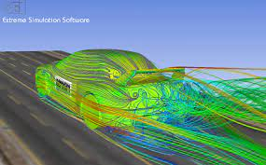
How simulations are used in physics
Physicists use simulations to see the forces and test how different combinations of forces act on objects to produce results.

Slide 5
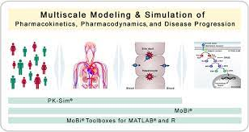
How simulations help us in biology
Simulations in biology help students learn about biology and These simulations allow students to visualize experiment that may take too long or an experiment that uses too many resources to do.

Slide 6
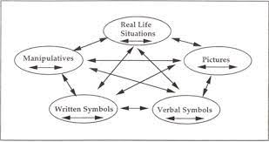
How simulations help us in math
Math Simulations are used to visualize math ideas. They let students write math and see what it looks like by showing it visually.

Slide 7
Citations
https://www.edutopia.org/article/what-math-looks/#:~:text=Math%20Simulations%20are%20tools%20I,see%20it%20as%20a%20length.
https://www.khanacademy.org/computing/ap-computer-science-principles/x2d2f703b37b450a3:simulations/x2d2f703b37b450a3:exploring-simulations/a/physics-simulations#:~:text=Physicists%20can%20use%20simulations%20to,objects%20to%20produce
https://www.biologysimulations.com/#:~:text=Biology%20Simulations%20helps%20students%20learn,a%20traditional%20science%20lab%20setting. %20different%20results.
https://www.rgs.edu.sg/rgsperl/research/research-projects/completed-projects/impact-of-learning-chemistry-using-simulation-tools#:~:text=ICT%2Denabling%20tools%20such%20as,affect%20the%20rate%20of%20reaction.

