Slide 1
By Marwan Kakish

Slide 2
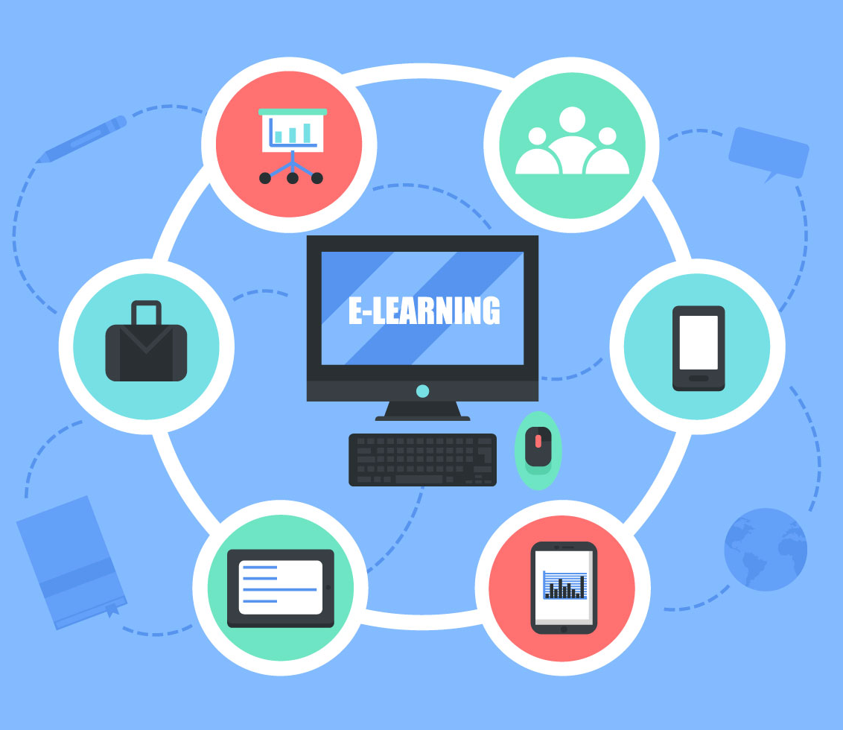
What is E-Learning?
E-learning is a structured course or learning experience delivered electronically; it can also include performance support content.
There are also many different elements that can make up an e-learning program, such as live or pre-recorded lecture content, video, quizzes, simulations, games, activities, and other interactive elements.

Slide 3
What are the types of E-Learning?
Computer-Managed Learning (CML)
Computer-Assisted Instruction (CAI)
Synchronous Online Learning
Asynchronous Online Learning
Fixed eLearning
Adaptive eLearning
Linear eLearning
Interactive eLearning
Individual eLearning
Collaborative eLearning

Slide 4
Synchronous versus Asynchronous E-Learning
Asynchronous E-Learning. This type of learning does not require the presence of courses on the ground and does not require the presence of the teacher and student.
Synchronous E-Learning. This type requires that the courses be viewed by the instructor and registered students and that interaction be online simultaneously.

Slide 5
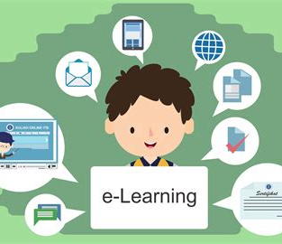
Benefits of E-learning
cost reductions, as e-learning lowers travel and meal expenses associated with employee training.
modularity, since employees can study only course sections that are relevant to their needs.
flexibility and accessibility, as e-learning allows learners to choose the time and place to study courses, making training outside of work hours possible.
Online learning methods also have several positive effects on the environment.
Flexibility. The first advantage of e-learning is flexibility in terms of time and place
Availability. The organization of teaching content at universities is almost unimaginable without platforms such as Moodle and Blackboard, but online courses also save vast amounts of time in the private
High Efficiency
Low Cost

Slide 6
Advantages of E-learning
1. Learning Irrespective Of Time And Place
2. Interaction-Based Learning
3. Flexibility
4. Efficiency And Effectiveness
5. Cost-Effectiveness
6. Performance Tracking
7. Interactive Media-Based Learning

Slide 7
What are the disadvantages of E-learning?
Relies on digital access and know how
Often lacks meaningful feedback
Relies on the self discipline of the learner to be successful
Can be socially isolating
Is difficult to do well
Is overabundant – too many competing providers
Makes it hard to monitor for plagiarism or cheating
Is less suited for teaching practical or soft skills
Lacks accreditation and quality assurance

Slide 8
What does E-learning help us with in the future?
E-learning has transformed education in both schools and businesses, making it easier for students and employees to learn at their own pace in an environment that suits them.
When it comes to the future of E-learning, it’s clear that E-learning will play a huge role in the delivery of learning materials.

Slide 9
Resources
Https://www.td.org/talent-development-glossary-terms/what-is-e-learning
https://infed.org/mobi/learning-theory-models-product-and-process/
https://e-student.org/what-is-e-learning/
https://learn.org/articles/What_is_eLearning.html

