Slide 1
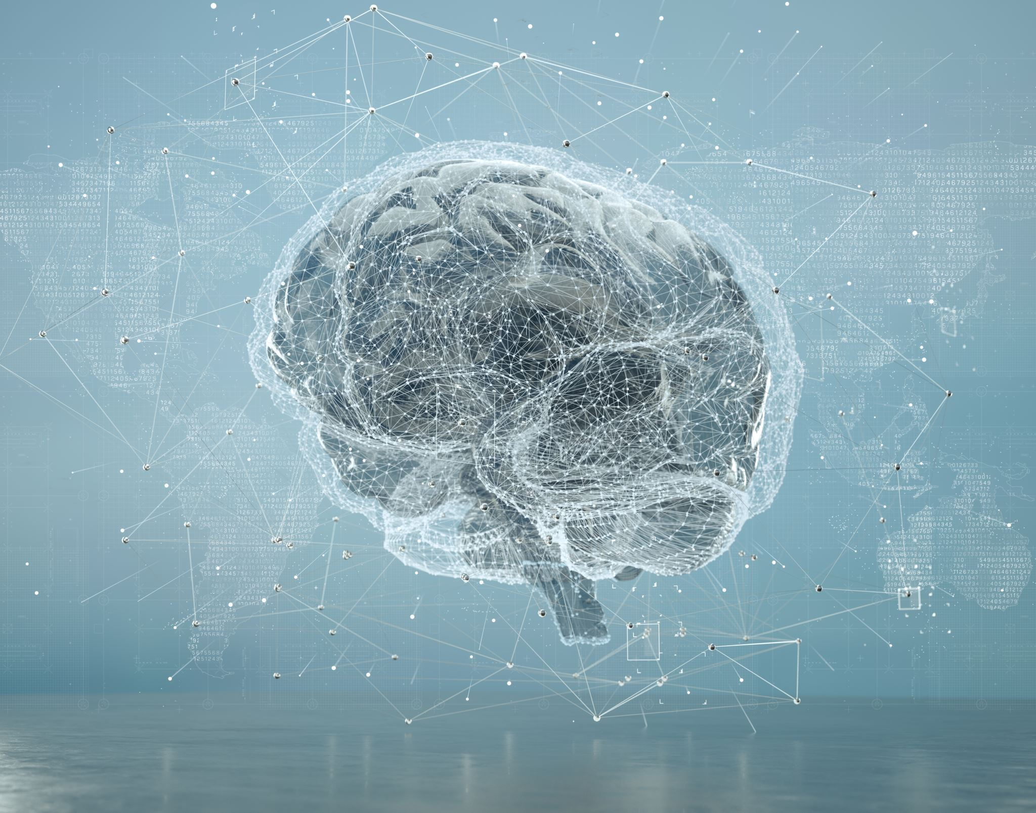
artificial intelligence
By:aoun hammad

Slide 2
Main topics
My main topics in this powerpoint are:
What is Artificial Intelligence?
Types of AI
Applications of AI

Slide 3
What is Artificial Intelligence?
Artificial Intelligence (AI) is a branch of computer science that seeks to create intelligent machines that can think and act like humans. AI is based on the idea that machines can learn from experience and act accordingly.
AI can be used to solve complex problems, such as recognizing objects, understanding language, and making decisions. AI can also be used to automate processes, such as scheduling tasks, driving cars, and playing games.

Slide 4
Types of AI
There are three main types of AI: weak AI, strong AI, and super AI. Weak AI is limited to specific tasks, such as playing chess or solving mathematical problems. Strong AI is capable of learning and adapting to new situations. Super AI is a hypothetical form of AI that is far more intelligent than humans.
AI can also be classified as either narrow or general. Narrow AI is limited to a specific task, while general AI is capable of learning and adapting to new situations.

Slide 5
Applications of AI
AI is being used in a variety of fields, from healthcare to finance. AI can be used to diagnose diseases, predict stock market trends, and automate mundane tasks. AI can also be used to improve customer service, manage logistics, and control robots.
AI is also being used to create virtual assistants, such as Siri and Alexa. These virtual assistants can help users with tasks such as scheduling appointments, playing music, and ordering items online.

