Slide 1
E-learning
Hind Habash

Slide 2
What is E-Learning?
Typically, e-learning is conducted on the Internet, where students can access their learning materials online at any place and time. E-Learning most often takes place in the form of online courses, online degrees, or online programs and meeting.

Slide 3
Here are some topics and information about E-learning:-
Types
History
Advantages
Disadvantages
Fun facts

Slide 4
1-Types
-Computer Managed Learning (CML)
(computers are used to manage and assess learning)
-Synchronous Online Learning
(is when group of students join and participate together from anywhere they are(meets))
-Interactive Online Learning
(allows senders to become receivers and vice versa, effectively enabling a two-way communication channel)(between teachers and student company managers and employees ect.)

Slide 5
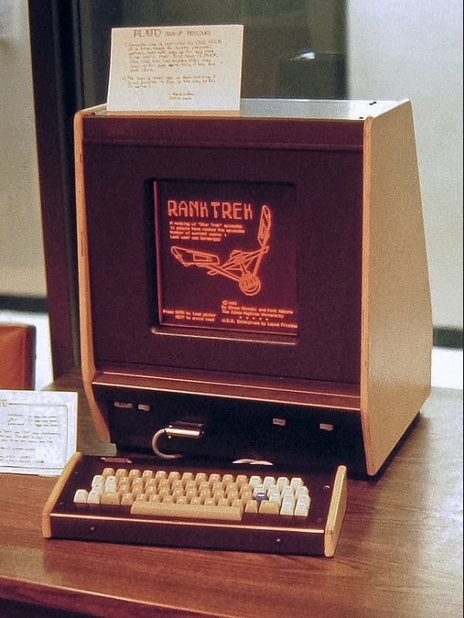
2-History
Online learning started in 1960 when Donald Bitzer, a laboratory assistant at the University of Illinois, created the very first e-learning system called the PLATO.
PLATO was the first generalized computer-assisted instruction system.
This Photo by Unknown author is licensed under CC BY-NC.

Slide 6
3-Advantages
You are able to link the various resources in several varying formats.
E-Learning is cost-effective
E-learning allows for customized learning environments
E-learning is time-efficient
E-learning reduces the need for textbooks
E-learning could solve teacher scarcity

Slide 7
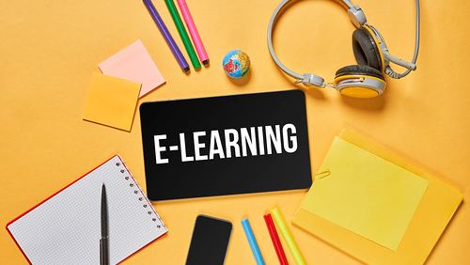
4- Disadvantages
E-Learning can cause social Isolation
Lack of communicational skill development
Cheating prevention during online assessments
Online instructors tend to focus on theory rather than practice
E-Learning lacks face-to-face communication
This Photo by Unknown author is licensed under CC BY.

Slide 8
5-Fun Facts about E-Learning
E-learning takes 40% to 60% less employee time than traditional learning.
42% of companies saw increased revenue after implementing e-learning.
The E-Learning market is over 13 years old
This Photo by Unknown author is licensed under CC BY-SA-NC.

Slide 9
Thanks for watching !
This Photo by Unknown author is licensed under CC BY-NC-ND.

Slide 10
Refrences
What is the Definition of E-Learning? - E-Student
https://e-student.org/types-of-e-learning
e-student.org/history-of-e-learning/
10 Major Advantages of E-Learning - E-Student
10 Biggest Disadvantages of E-Learning - E-Student

