Slide 1
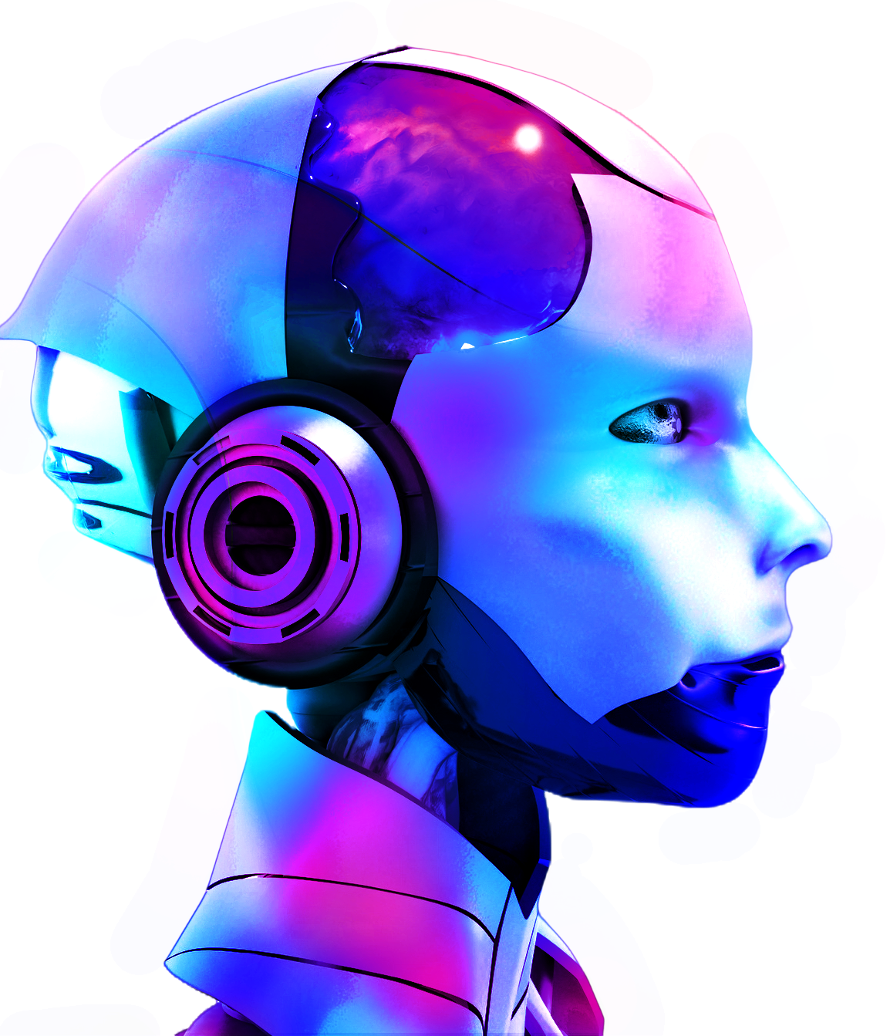
Simulations
- and when it is used
Made by : Tala Tadros

Slide 2
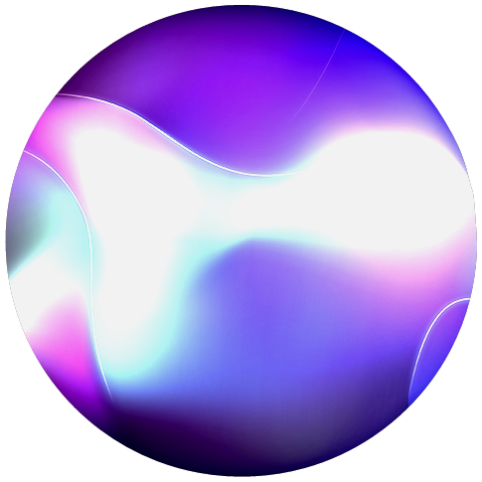
What are Simulations?
A simulation is a model that mimics the operation of an existing or proposed system, providing evidence for decision-making by being able to test different scenarios or process changes.

Slide 3
Main Usages of Simulations in Education
01
02
03
04
Biology- Medicine
Mathematics
Operations and vertebrates/plant models.
Angles, algebra, shapes.
Physics
Chemistry
Forces, light, circuits, waves, energy
Atoms, chemical reactions.

Slide 4
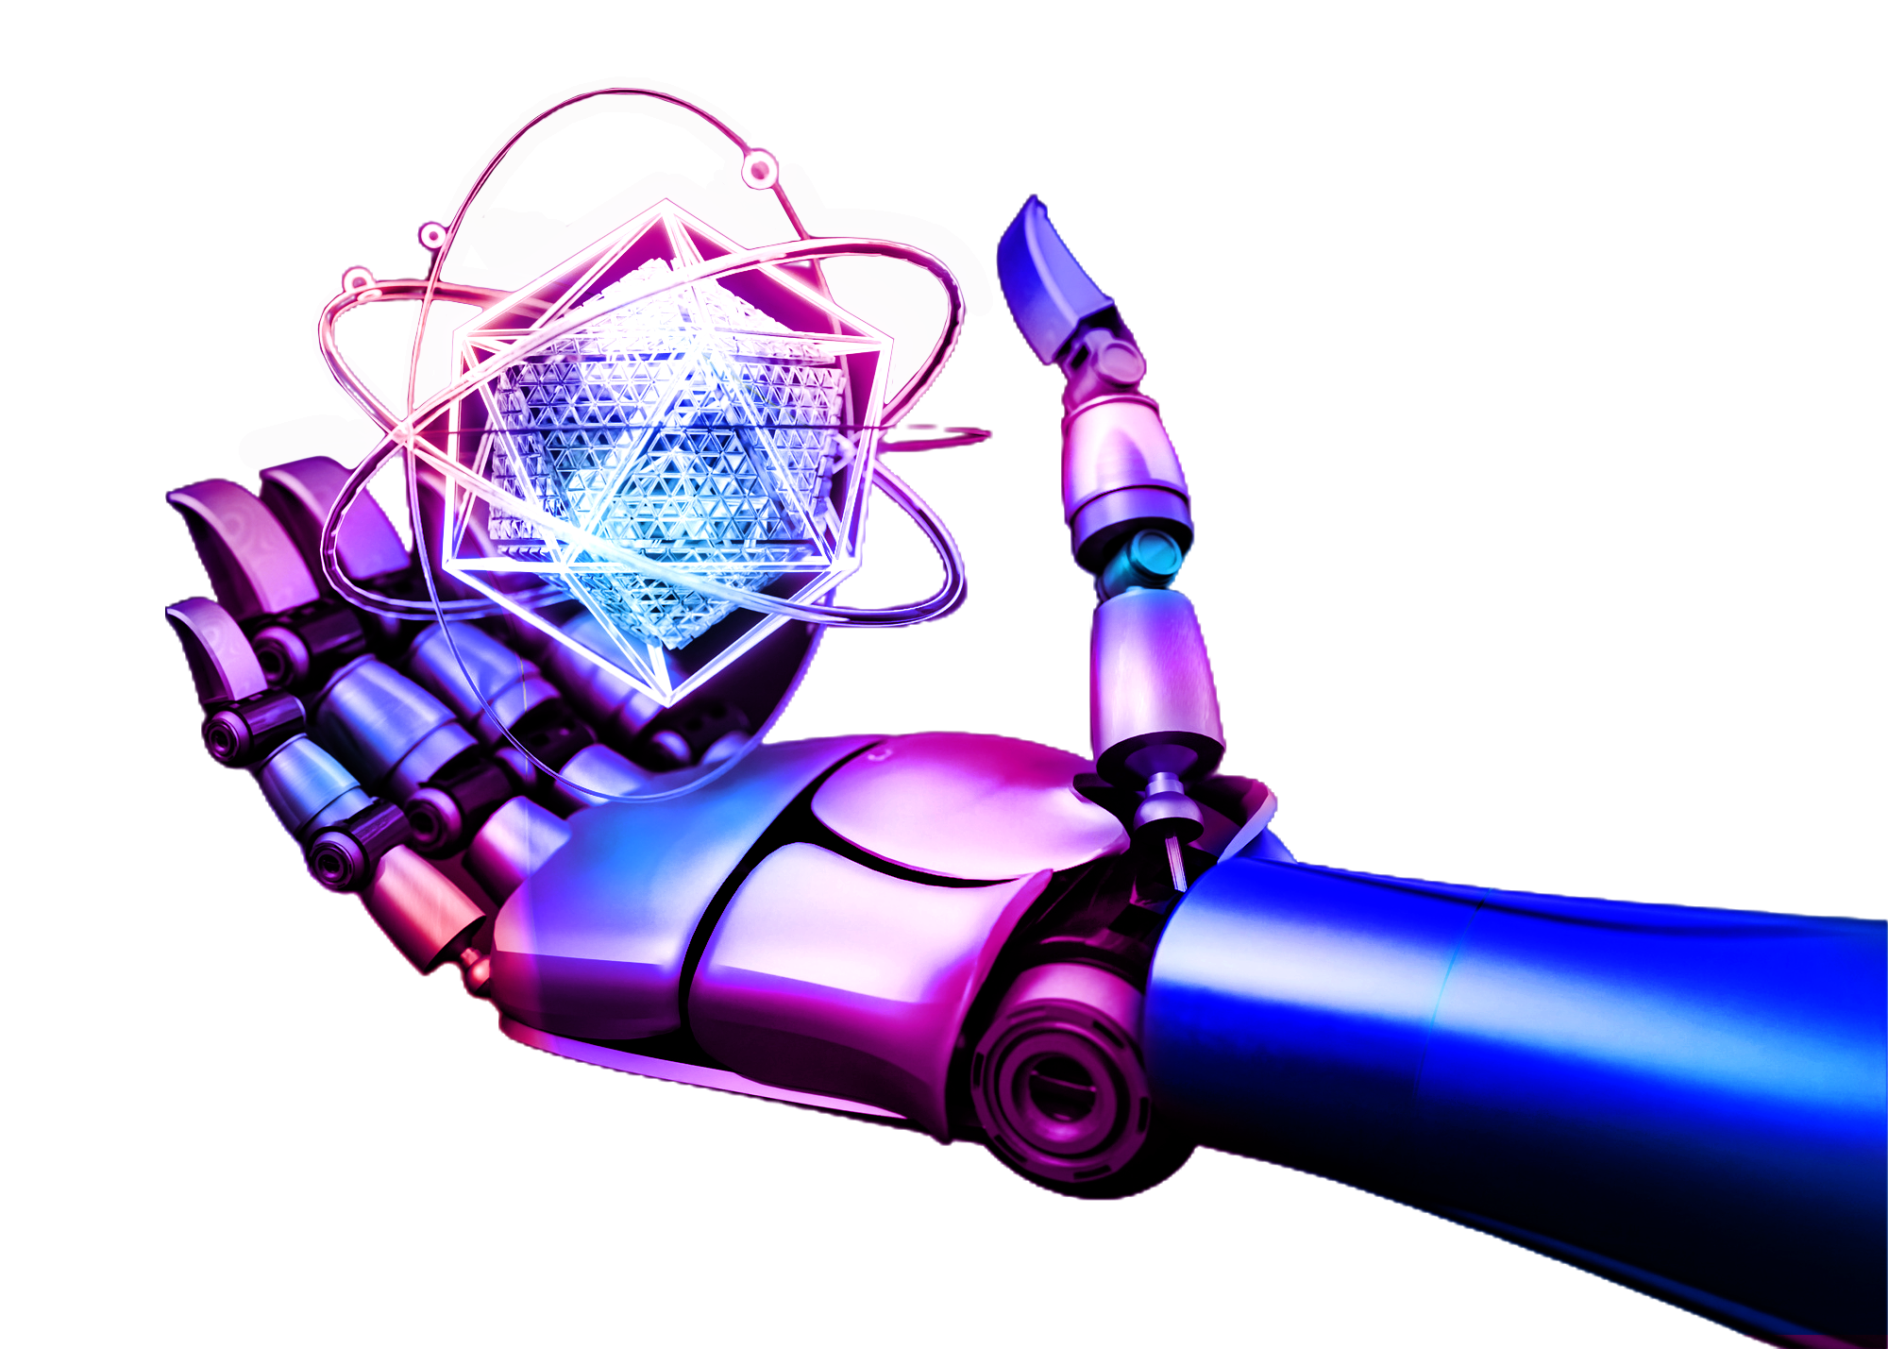
01
Biology-Medicine
Operations and vertebrates/plant models.

Slide 5
Operations and vertebrates/plant models.
Simulations can be used to imitate surgeries to make sure they go correctly before being done. Simulations can also imitate systems in the body and how they function. Adding to that it can show cells and and how they work and function.

Slide 6
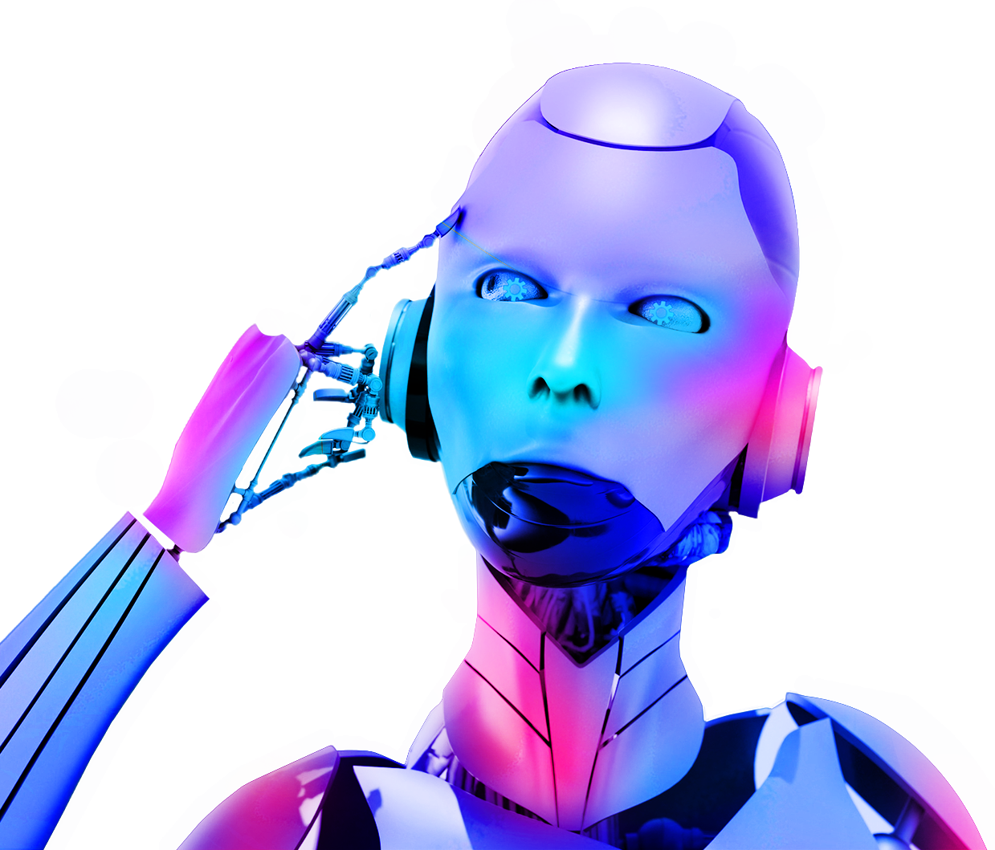
02
Mathematics
Angles, algebra, shapes.

Slide 7
Angles, algebra, shapes.
Simulations can help further explain and help the user understand math. First, it can help with calculating angles. Furthermore, it makes understanding algebra easy by giving you visuals of how it works. for starters, it can explain fractions and basic operations work by giving visuals. Lastly, it can help you learn about shapes and their properties, as well as calculating areas and perimeter.

Slide 8
03
Physics
Forces, light, circuits, waves, energy

Slide 9
Forces, light, circuits, waves, energy
Simulations can show how light rays work and its properties since you can see it in real life. You can also build and make circuits without using the actual supplies if you don’t have them. It could also show you different forms of energy and forces in ways you cant see in real life, as well as demonstrate waves. Simulations in physics help show you things you cant see with your bare eyes

Slide 10
04
Chemistry
Atoms, chemical reactions.

Slide 11
Atoms, chemical reactions.
The change of states of matter can be shown in the way of atoms and particles. The structure of atoms and they way they act can also be seen through simulations. Chemical reactions that are too dangerous to be made at home can be done, and the way atoms move and transfer according to the reaction. These simulations help you understand what cannot be seen, and give you an experience that you may not be able to do in real life.

