Slide 1
Computer Project 2023
By ziad Qutaishat 8f

Slide 2
Simulations.
What is a simulation?
A simulation is a scenario or a plan we can experience in virtual or mixed reality
Our topic today is virtual reality

Slide 3
What is virtual reality?
Virtual reality, means being in a reality which isn’t physically real.
Virtual reality is a simulation that puts you in the center as if you are experiencing it first hand

Slide 4
Advantages of virtual reality:
Virtual reality is a safe and immersive way to experience events with no consequences.
In experiments you can use virtual reality to speed up the process and have no issues
You can do whatever you want whenever you want in virtual reality
Modern day virtual reality is very affordable and really accessible to consumers
It can help in building 3D models (i.e. buildings, cars, etc)

Slide 5
Disadvantages of virtual reality
Too much time in the virtual world can:
Cause eyestrain
Makes the individual lose their senses of the physical world
You cannot fathom or benefit physically from virtual reality

Slide 6
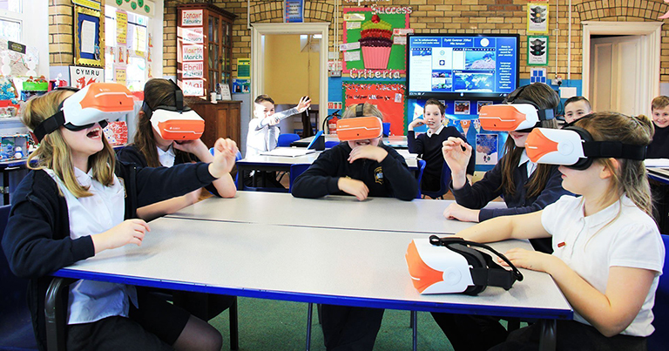
How is virtual reality used nowadays?
Many schools worldwide are starting to use virtual reality for a more immersive learning experience.
Meetings can be attended virtually if you aren’t able to physically attend.

Slide 7
VR headsets include front cameras.
When you use cameras and vr at the same time, this is known as mixed/augmented reality

Slide 8
Thank you for watching ☺

