Slide 1
Computers
Suhail Khalaf 8B

Slide 2
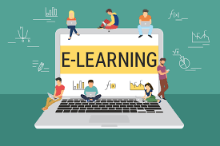
In what subjects can you use computers?
1. e-learning:
E-Learning is the process of sharing knowledge through various channels such as e-books, CDs, webinars, and more. E-Learning is defined as Courses that are specifically delivered through the internet everywhere other than the traditional classroom where the teacher is teaching.

Slide 3
In what subjects can you use computers?
2. Virtual reality:
One of the most common and effective ways of utilising VR in education is via virtual reality classrooms, or immersive classrooms. An immersive classroom is a teaching room in which images are projected onto the internal walls of the room. This creates a virtual environment within the classroom.

Slide 4
Sources
www.digitalclassworld.com
Immersionvr.co.uk

