Slide 1
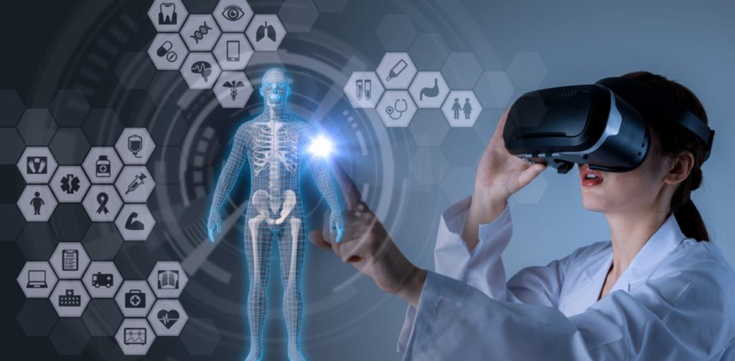
VIRTUAL REALITY
BY GEORGE FAKES
8F

Slide 2
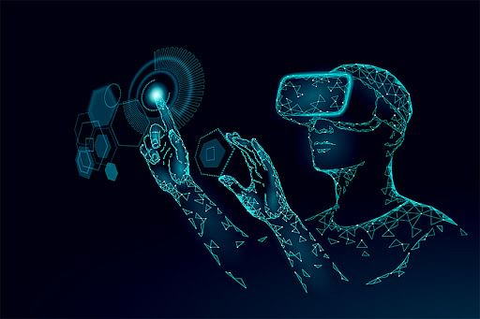
What is VIRTUAL REALITY
Virtual reality is a simulated experience that employs pose tracking and 3D near-eye displays to give the user an immersive feel of a virtual world. Applications of virtual reality include entertainment, education and business.

Slide 3
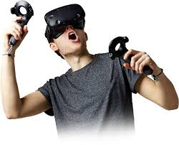
For what virtual reality is used
Virtual reality is most commonly used in entertainment applications such as video games, 3D cinema, amusement park rides including dark rides and social virtual worlds.
Virtual reality is most commonly used in entertainment applications such as video games, 3D cinema, amusement park rides including dark rides and social virtual worlds.

Slide 4
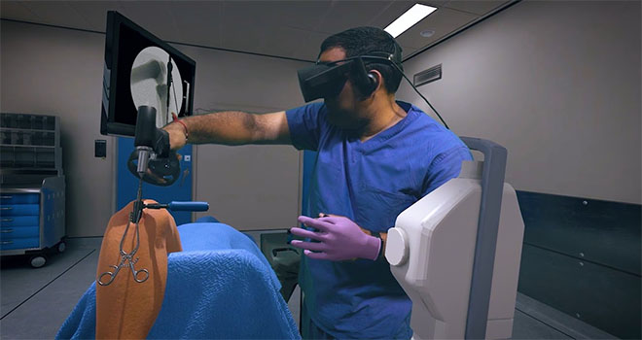
advantages of virtual reality
The Virtual Reality creates the real world around us. It can transform the way of education which is provided nowadays.
It can be also used in industries, medical, security, military,
anti-terrorism, traffic accidents awareness and Weather forecasting

Slide 5
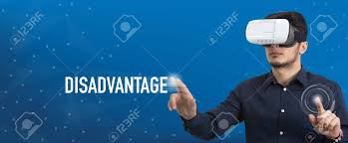
disadvantages of virtual reality
The virtual reality headsets can cause eye problems, such as eyestrain, headaches, and can cause sickness .

Slide 6
Resources
https://www.marxentlabs.com/what-is-virtual-reality/
https://www.techtarget.com/whatis/definition/virtual-realit
https://www.simplilearn.com/tutorials/artificial-intelligence-tutorial/what-is-virtual-reality
https://www.google.com/search?q=What+is+VIRTUAL+REALITY&oq=What+is+VIRTUAL+REALITY+&aqs=chrome..69i57j0i512l9.3895j0j15&sourceid=chrome&ie=UTF-8

Slide 7
The end

