Slide 1
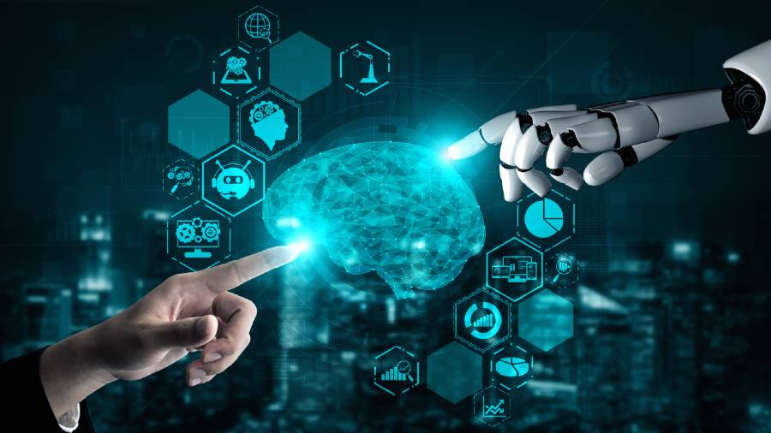
Artificial Intelligence
By: Jana Jweihan

Slide 2
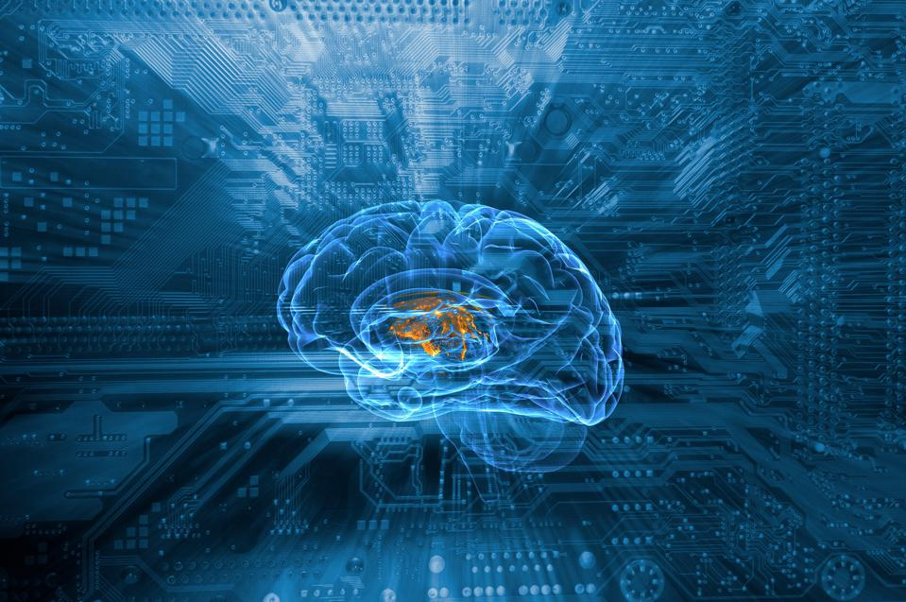
What is AI?
Artificial intelligence (AI) is the intelligence of humans installed into and processed by machines using technology and science. The machines can distinguish differences, synthesize things, and theorize.

Slide 3
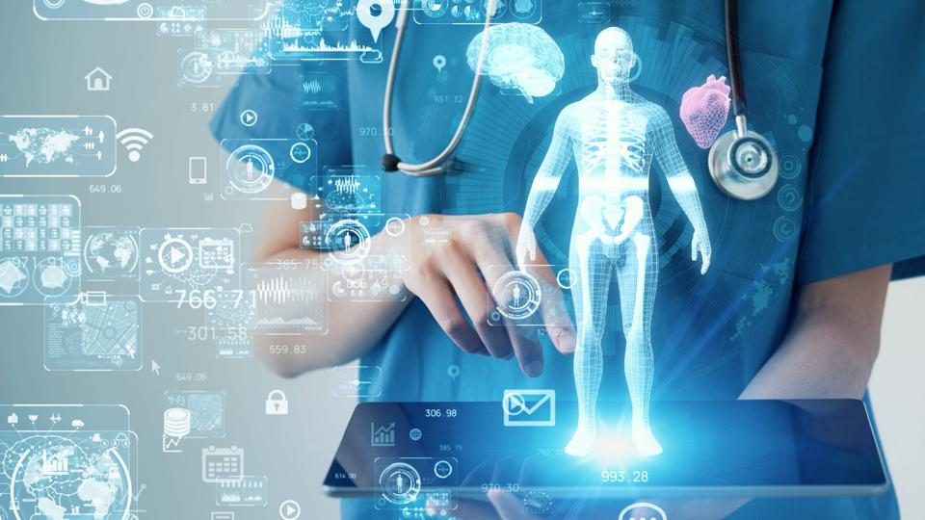
Examples of AI
AI robotics: machines that are programed with certain assignments and have a limited thinking capacity.
Smart assistants: virtual assistants located in technology such as phones, computers , and smart cars. Example: Siri in iPhones.
AI in healthcare: virtual assistants help to
improve the efficiency of medical expenses
and surgeries.
AI in transportation: virtual assistants and
programed apps help many people in
transportation. Example: google maps.

Slide 4
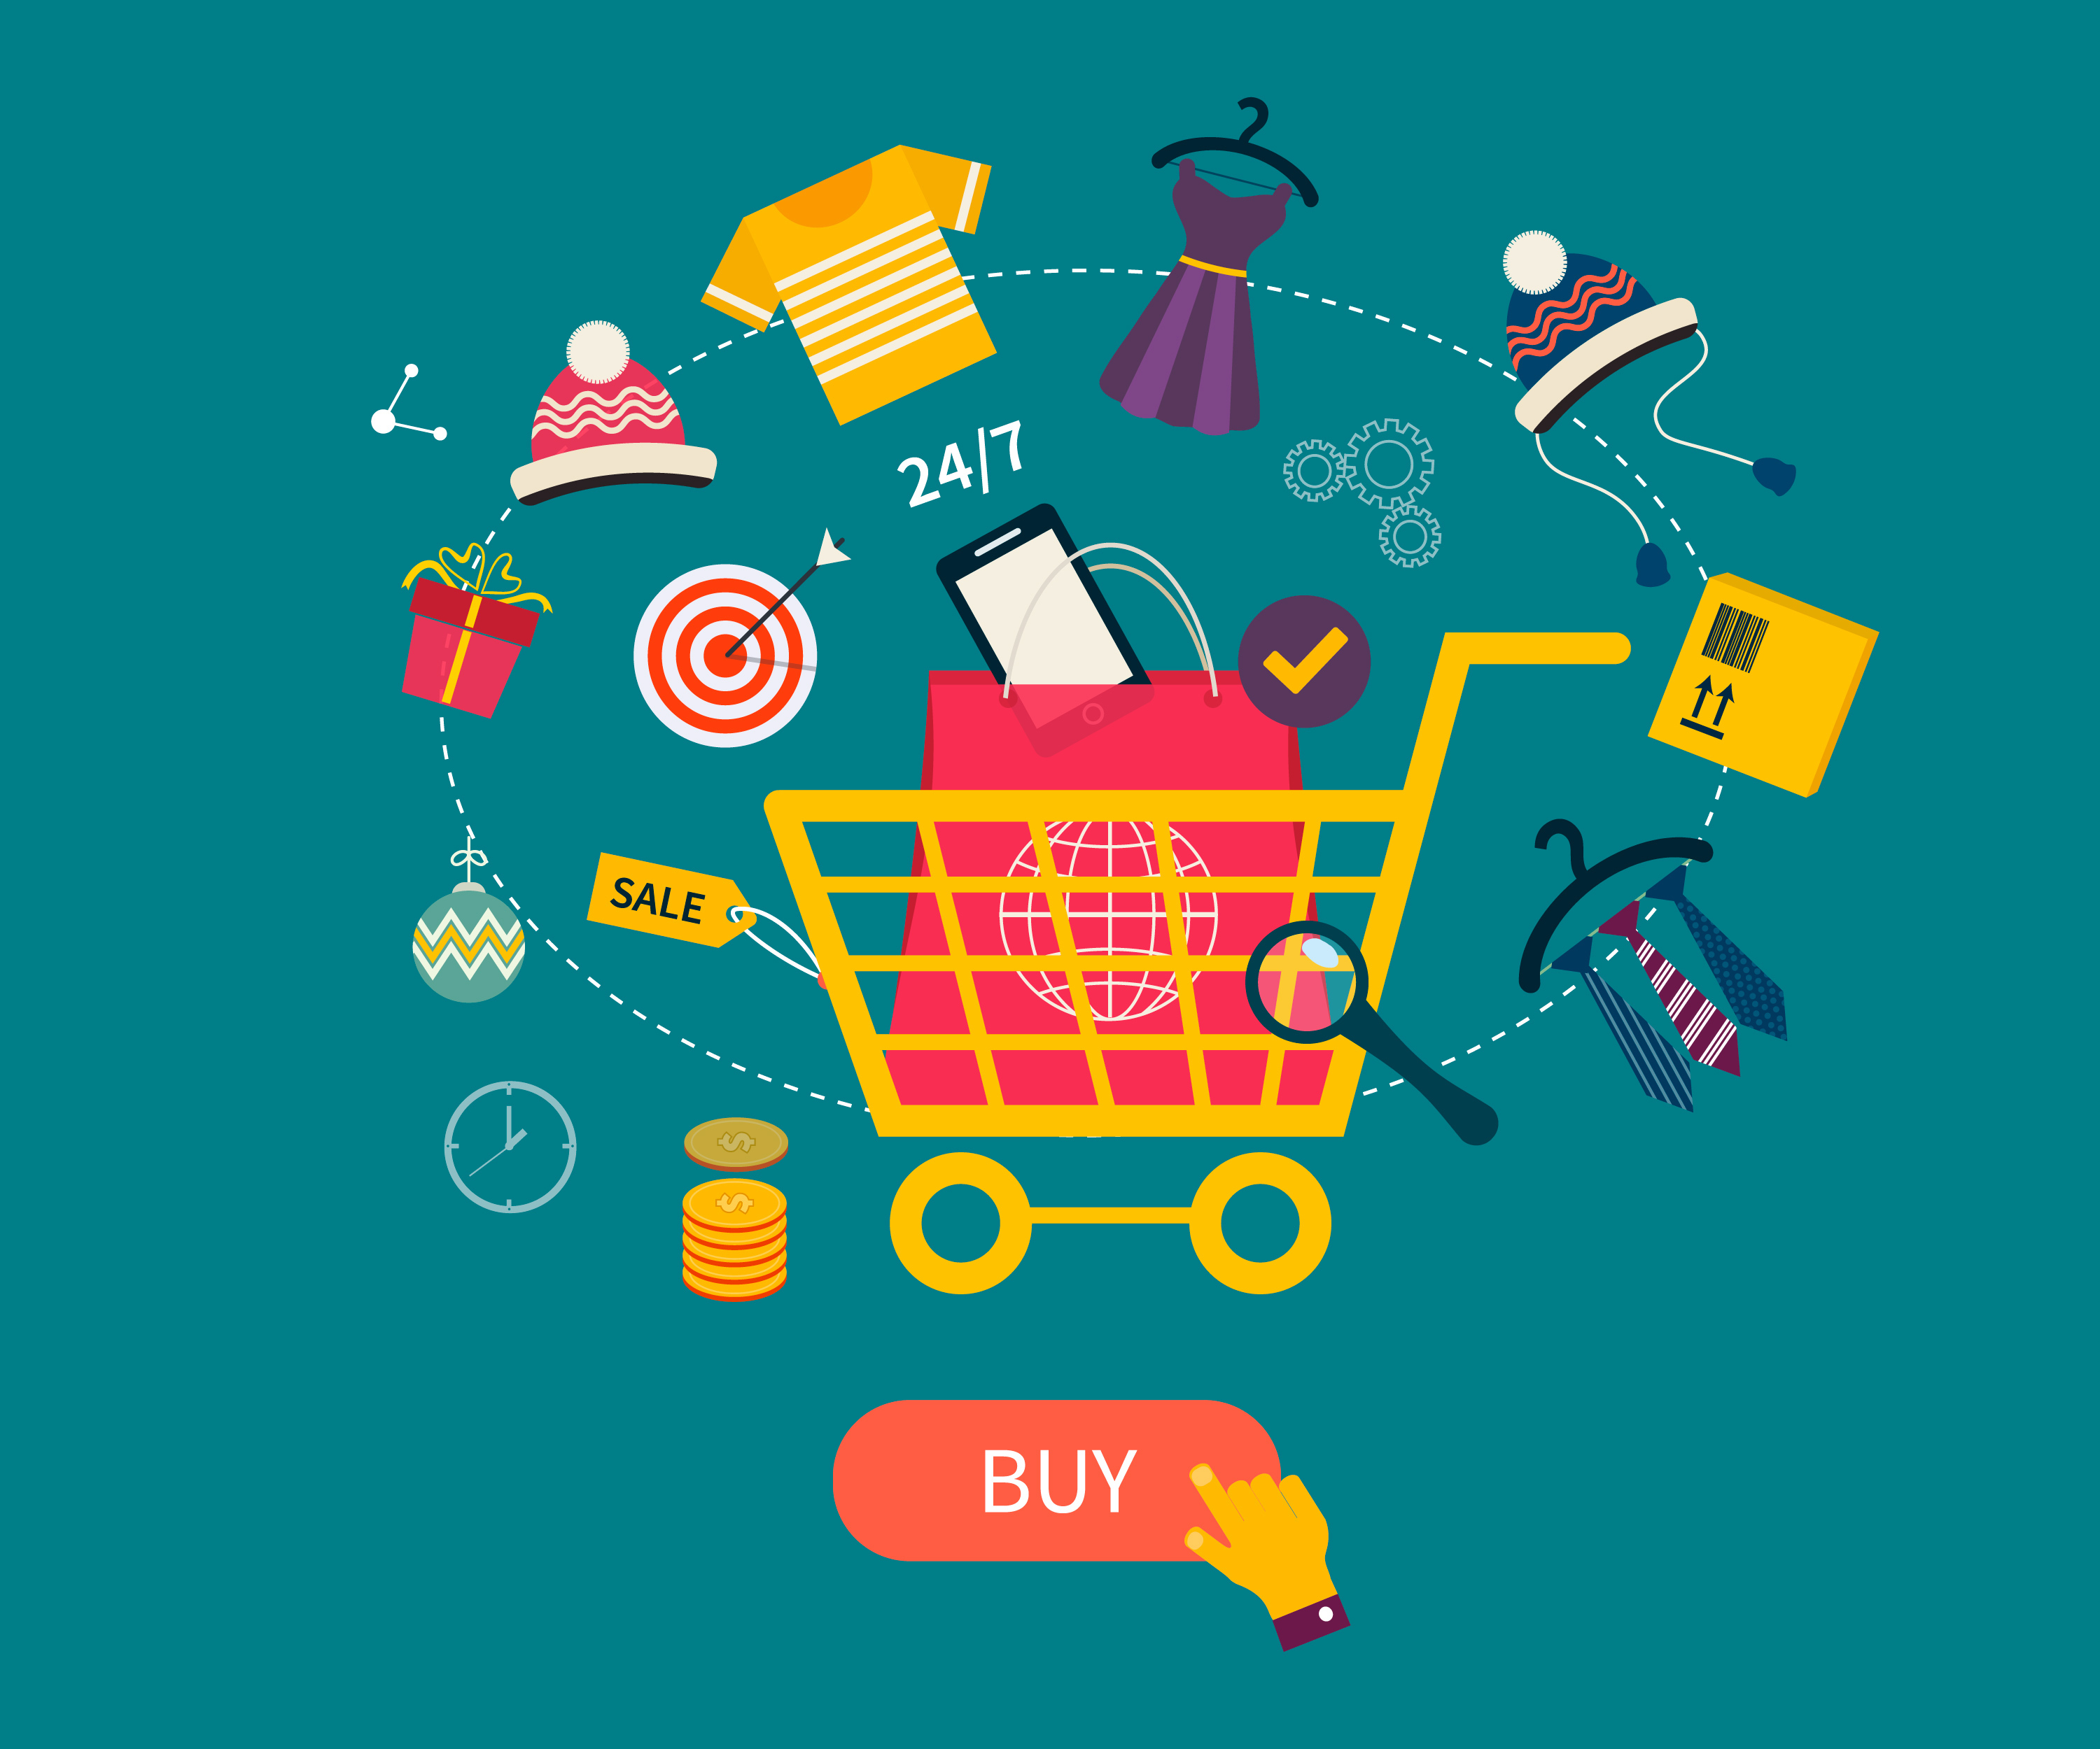
How does AI affect us now?
AI has already affected us in our everyday lives, as it is already installed in most of what we use. Many people use AI without even realizing it. For example, many people like to shop online rather than physically going to the shop, which is an example of AI. Even schools
and universities use AI such as emails and google
because it helps make things much more easier.

Slide 5
How will AI affect the future?
AI will continue to grow in the future and will impact
our lives. AI will improve in transportation, just like
how we see the self-driving cars, we will see that the
technology will spread to other transportations.
Furthermore, we will see robotic assistants or virtual
assistants in school classrooms to help the human teachers which would improve the efficiency.
In addition, there will be programed machines in our own homes, which would help with cleaning and tasks that the humans are to busy to do. AI could also watch over kids, though something could go wrong so it wouldn’t be more efficient than a humans job.

Slide 6
Sources
What is artificial intelligence (AI)?:
https://www.techtarget.com/searchenterpriseai/definition/AI-Artificial-Intelligence#:~:text=Artificial%20intelligence%20is%20the%20simulation,speech%20recognition%20and%20machine%20vision.
Artificial intelligence and its impact on everyday life:
https://online.york.ac.uk/artificial-intelligence-and-its-impact-on-everyday-life/#:~:text=AI%20touches%20every%20aspect%20of,potential%20growth%20trajectory%20is%20limitless.
7 Ways AI Will Affect Humans In Our Future:
https://www.forbes.com/sites/naveenjoshi/2022/08/02/7-ways-ai-will-affect-humans-in-our-future/?sh=2f0fd11d5db0
Future of AI:
https://builtin.com/artificial-intelligence/examples-ai-in-industry

