Slide 1
Virtual reality
By Adam 8G

Slide 2
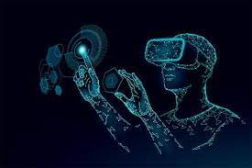
What is virtual reality?
the computer-generated simulation of a three-dimensional image or environment that may be interacted with by a person wearing specialized electronic equipment, such as a helmet(virtual reality headset) with an internal screen or gloves with sensors, to make it seem real or physical.

Slide 3
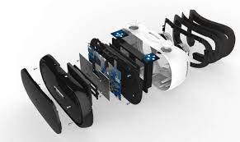
Main components of a typical VR headset
They feature stereo sound, a stereoscopic head-mounted display that displays distinct images for each eye, and sensors that measure head motion. These sensors may be gyroscopes, accelerometers, magnetometers, or structured light systems. Some VR headsets are equipped with game controllers and eye-tracking sensors.

Slide 4
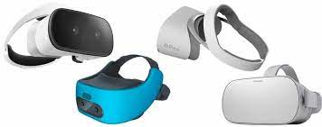
Types of VR headsets
Virtual reality simulations fall into three main categories: non-immersive, semi-immersive, and fully-immersive.

Slide 5
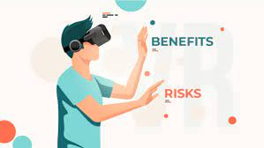
Benefits and Risks of Virtual reality
benefits
Help in providing training
Lowest risks
Helps in simulating actions before done
Risks
Addiction
Impact on health
Not engaged in real world

Slide 6
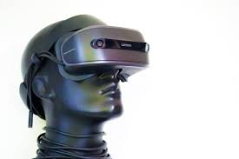
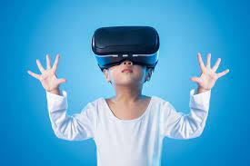
Virtual Reality uses
In-Depth Home Tours
Fostering Empathy For Nonprofits' Missions
Immersive Gaming Experiences
Virtual Fashion Shows
Demonstrating Products At Conferences
Providing Safe Manufacturing Training

