Slide 1
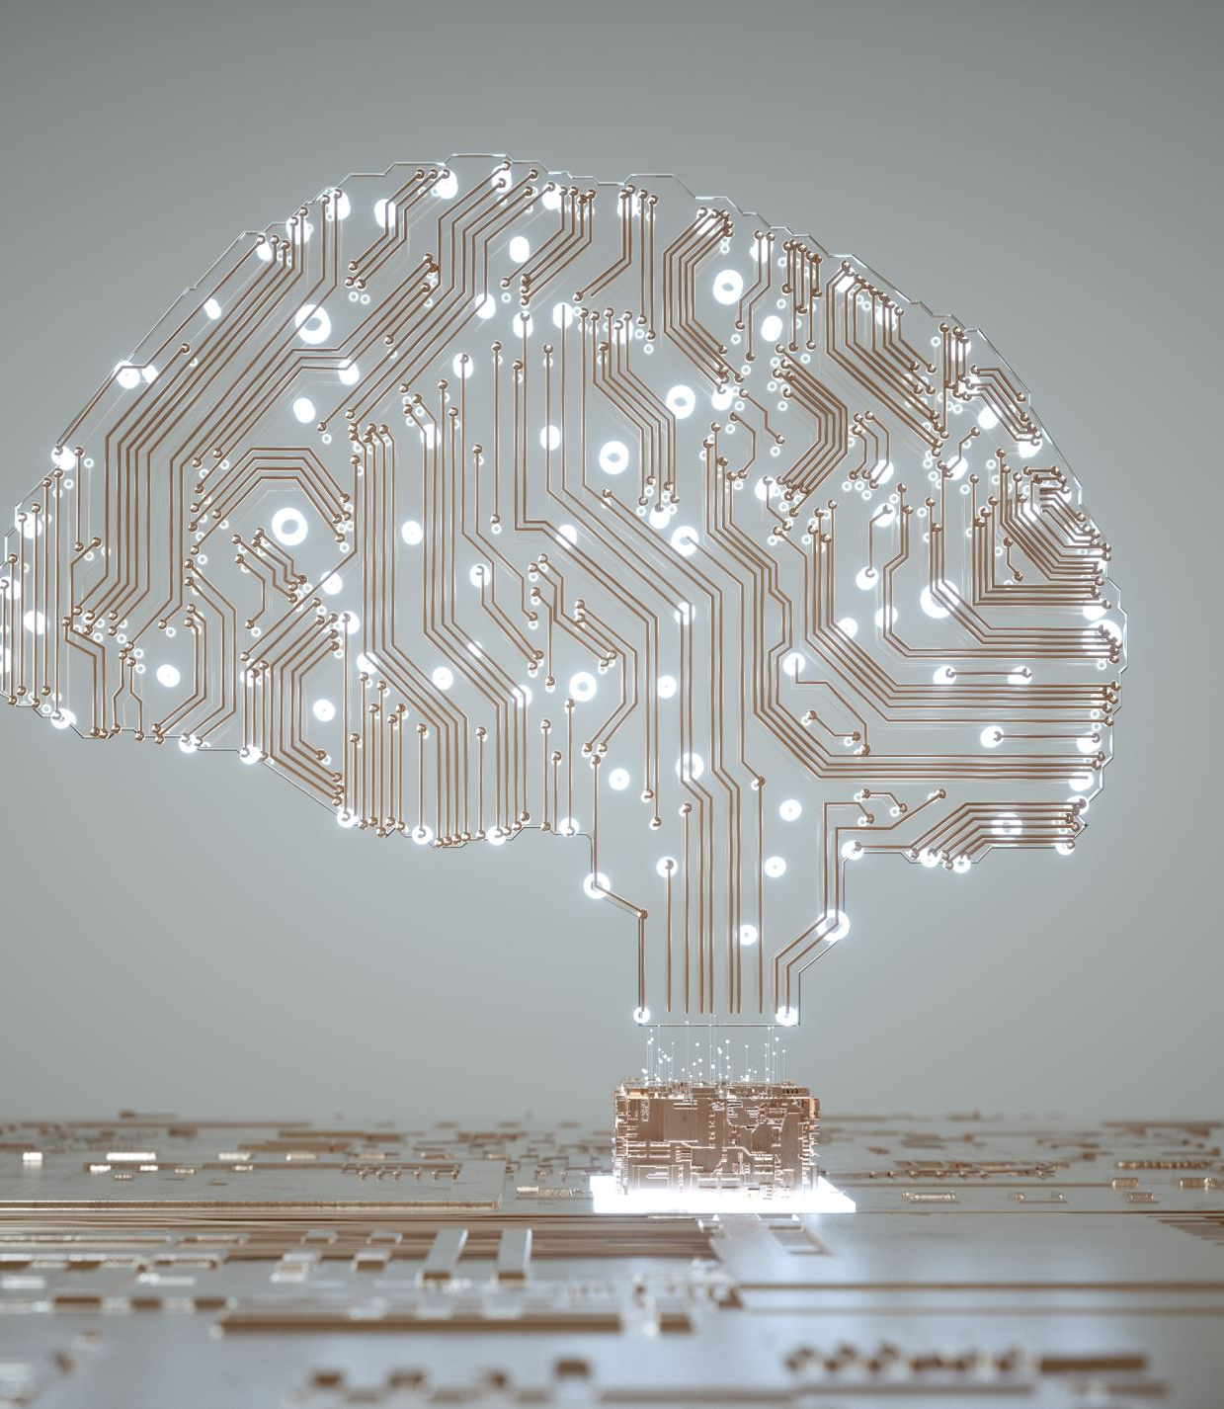
Artificial Intelligence
Made by: Jana Momani
Date: 9/2/2023

Slide 2
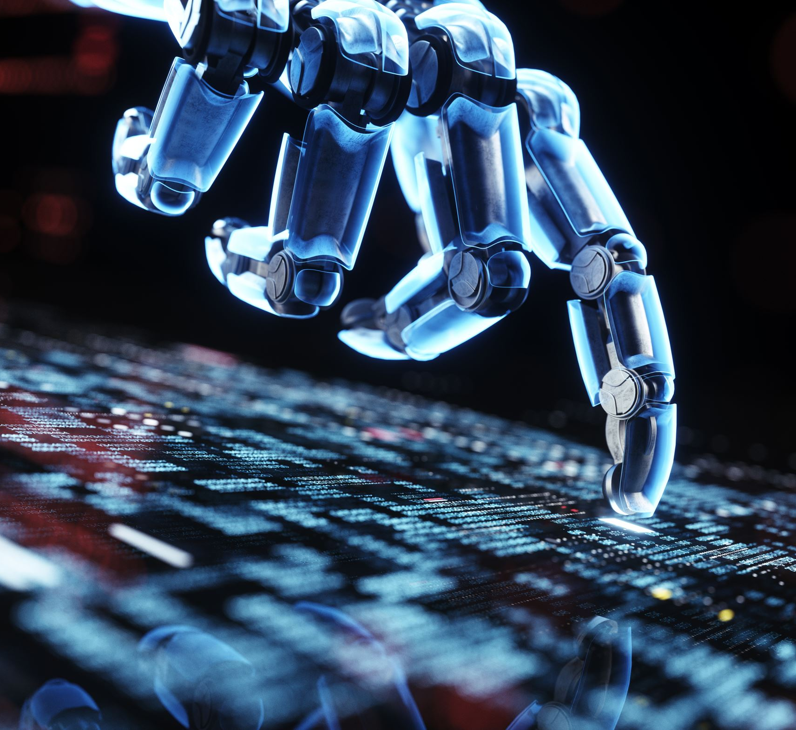
What is Artificial Intelligence?
The capacity of a digital computer or computer-driven robot to carry out functions often performed by human beings.

Slide 3
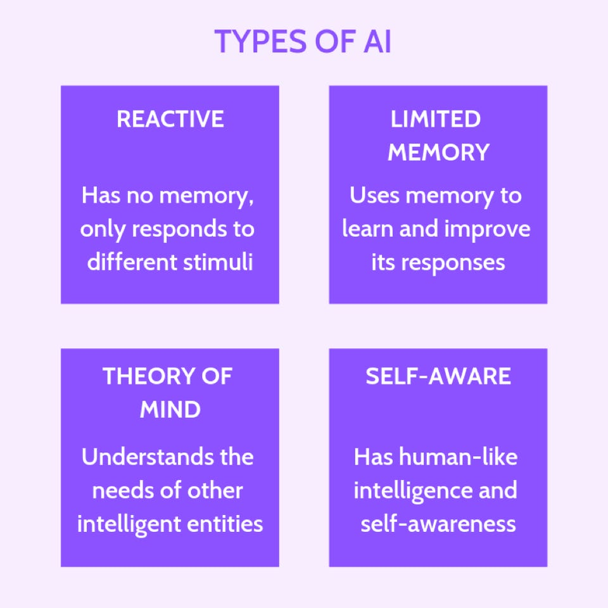
Types of Artificial Intelligence
1-Reactive Machines
2-Limited Memory
3- Theory of Mind
4-Self Aware

Slide 4
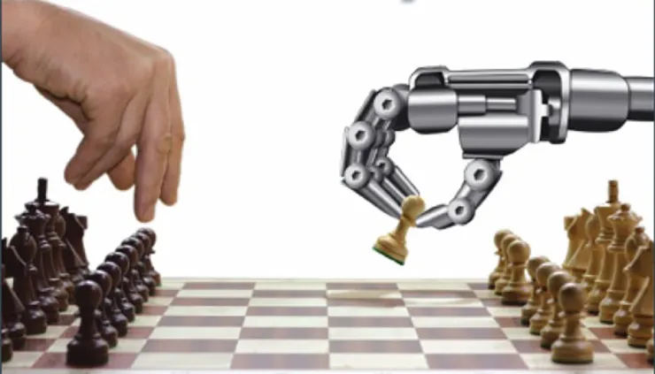
Reactive Machines
These are the earliest varieties of AI systems, and they have very little capabilities. They mimic the capacity of the human mind to react to various stimuli.

Slide 5
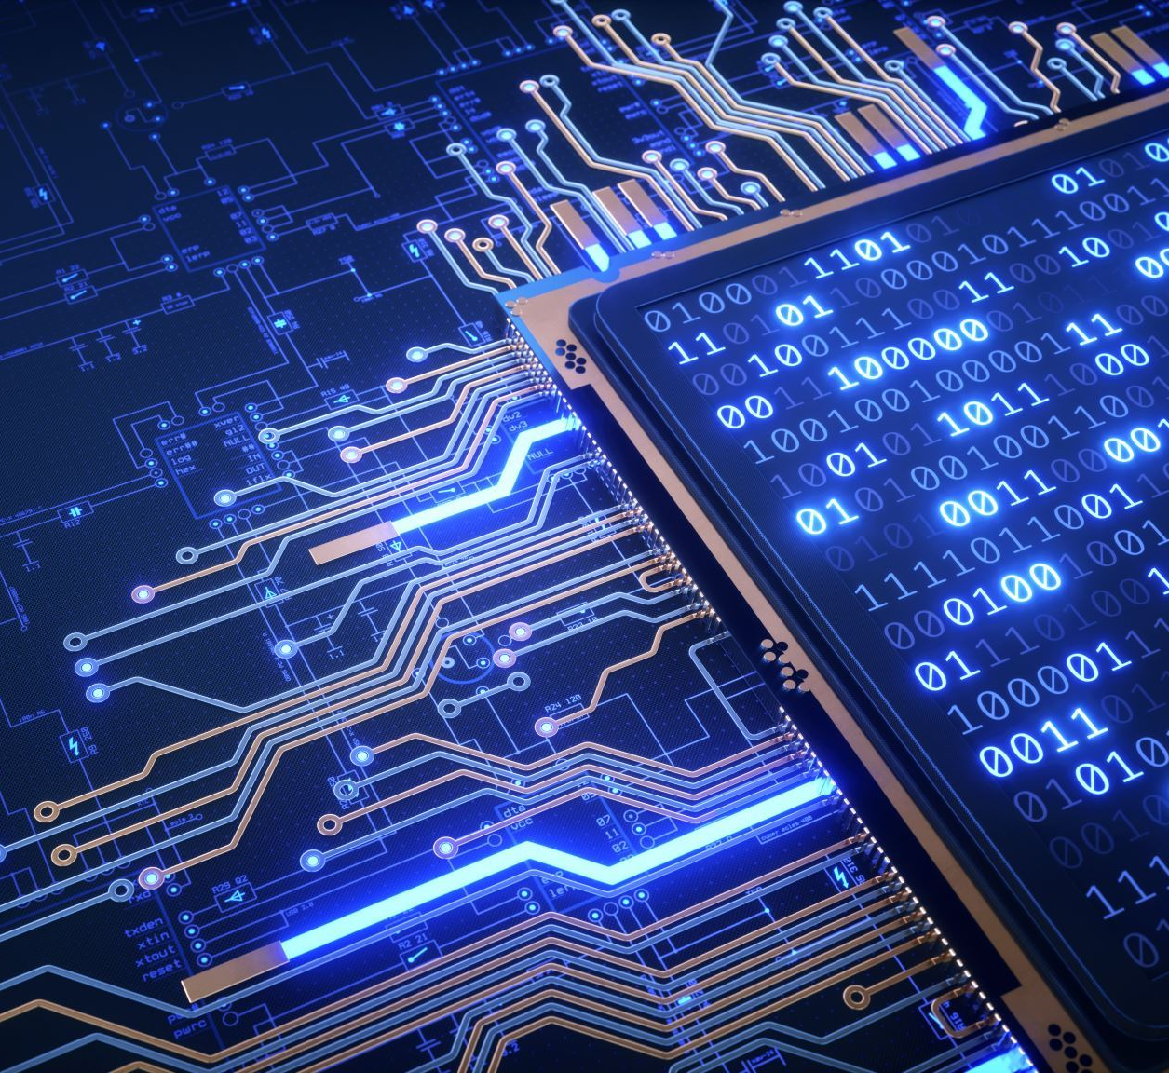
Limited Memory
Limited memory machines have both the characteristics of fully reactive machines and the ability to learn from past data to make judgments.

Slide 6
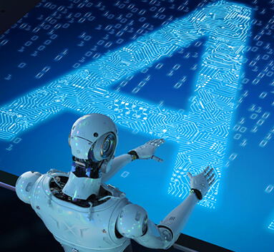
Theory of Mind
The capacity of the human mind to attribute mental states to others.

Slide 7
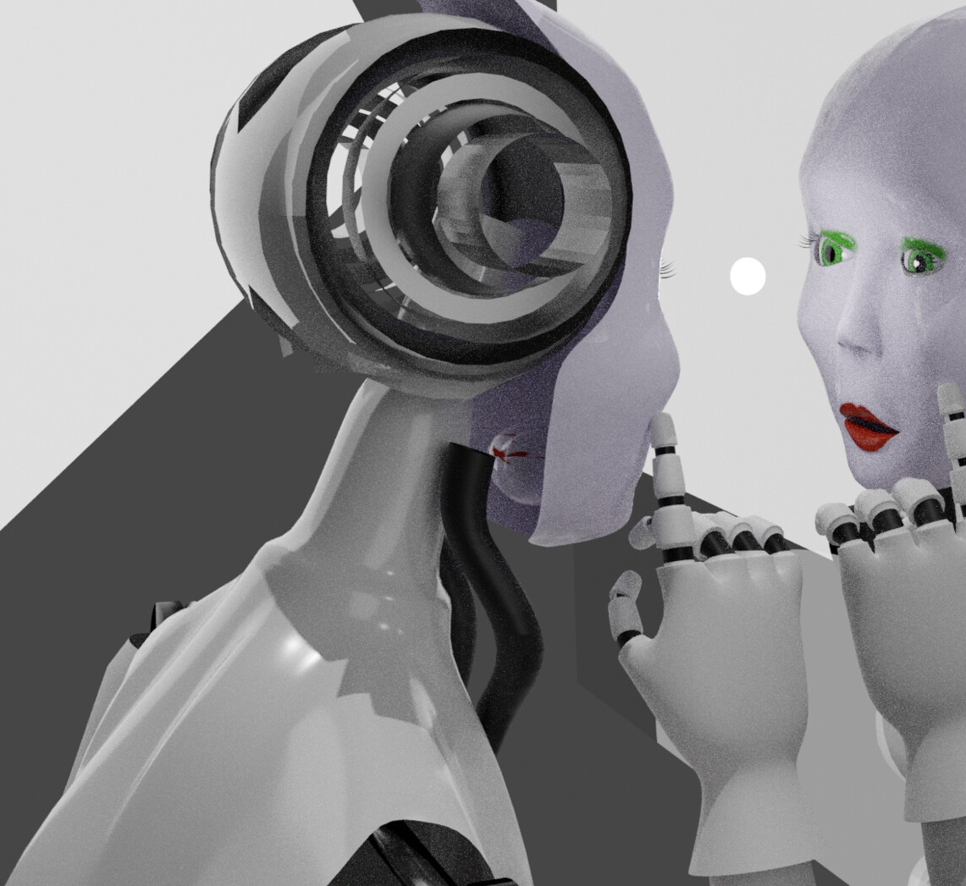
Self-aware
Machines can sense their own internal states, as well as the emotions, actions, and intelligence of others.

Slide 8
What are the Benefits of Artificial Intelligence?
Detecting illnesses precisely
Protecting natural resources
Predicting natural catastrophes
Improving education

Slide 9
What are the Disadvantages of Artificial Intelligence?
Artificial Intelligence needs a lot of investments
Experience Doesn't Help AI Applications Get Better
Over Dependency on Machines
Risk of Data Loss

Slide 10
Sources
Artificial intelligence | Definition, Examples, Types, Applications, Companies, & Facts | Britannica
The Four Types of Artificial Intelligence (lifewire.com)
Artificial Intelligence (AI): What it is and why it matters | SAS
7 Types Of Artificial Intelligence (forbes.com)
https://bernardmarr.com/what-are-the-four-types-of-ai/
The Benefits of AI: 6 Societal Advantages of Automation | Rasmussen University
Knowing me, knowing you: theory of mind in AI - PubMed (nih.gov)
What if AI becomes self-aware? - Express Computer

Slide 11
Thank you

