Slide 1
supercomputers
By sanad halasa 8c

Slide 2
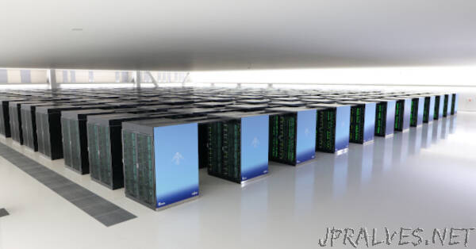
What are supercomputers?
A supercomputer is a type of computer that performs at a higher level than a general-purpose computer.
Instead of million instructions per second(MIPS) , a supercomputer's performance is typically measured in floating-point operations per second (FLOPS).

Slide 3
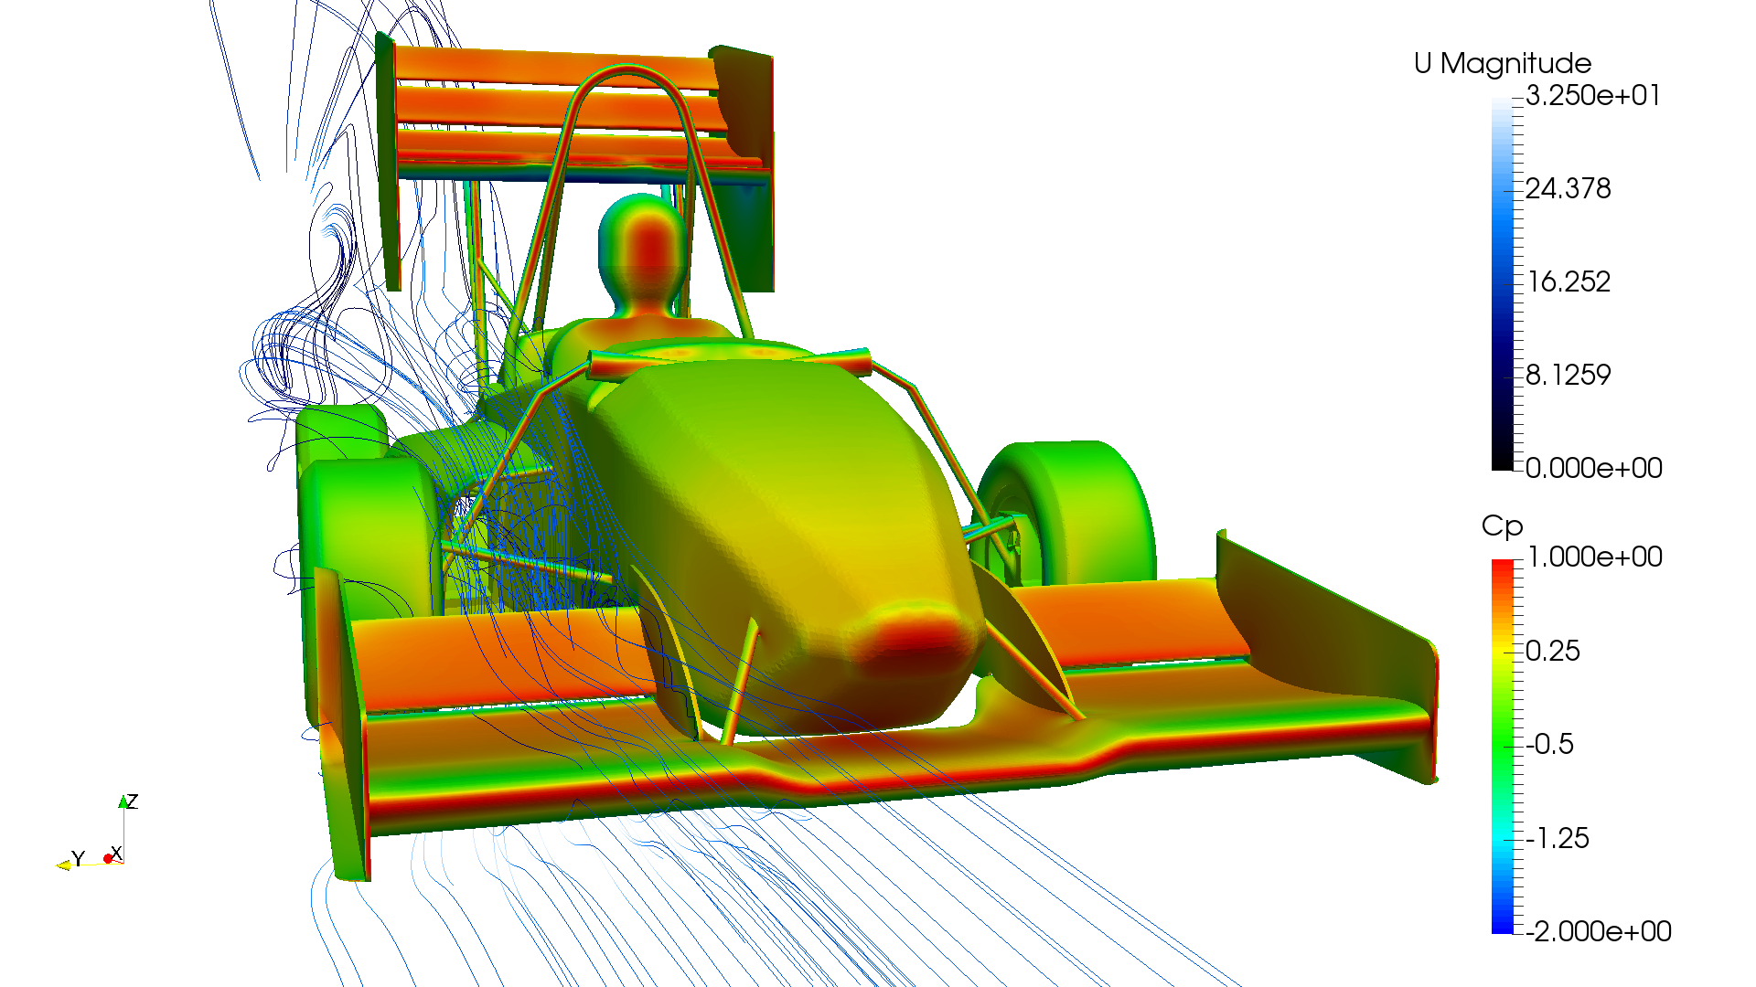
What are they generally used for?
In fields including quantum physics, weather forecasting, oil and gas exploration, molecular modeling, physical simulations, aerodynamics, nuclear fusion research, and cryptoanalysis, supercomputers are utilized for data-intensive and computation-intensive tasks.

Slide 4
Features of a supercomputer
Supercomputers are distinguished by a few characteristics. They typically feature more than one CPU (central processing unit), which is unusual for ordinary computers and contains circuits for deciphering program instructions and carrying out arithmetic and logic operations in the right order.

Slide 5
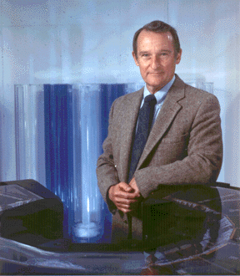
invention
The first supercomputer was built in 1964 by SEYMOUR CRAY. The CDC 6600 is the first supercomputer, and it ran up to one megaflop. Seymour Cray is also known as the Father of a supercomputer.

Slide 6
SOURCES
https://homework.study.com/explanation/who-invented-the-first-supercomputer.html#:~:text=The%20first%20supercomputer%20was%20built,the%20Father%20of%20a%20supercomputer.
https://en.wikipedia.org/wiki/Supercomputer
https://www.suse.com/suse-defines/definition/supercomputer/#:~:text=Supercomputers%20are%20used%20for%20data,nuclear%20fusion%20research%20and%20cryptoanalysis.
https://www.britannica.com/technology/supercomputer

