Slide 1
Virtual Reality (VR)
Noor Dweiri
Grade 8

Slide 2
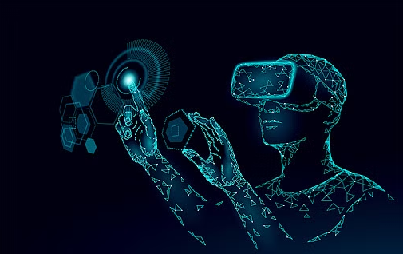
Virtual Reality
What is Virtual Reality?
What are the types of Virtual Reality?
What is the difference between Virtual Reality and Augmented Reality?
What is the hardware used in Virtual Reality? Input and Output devices.
Examples of input and output devices/
What are the applications of Virtual Reality?

Slide 3
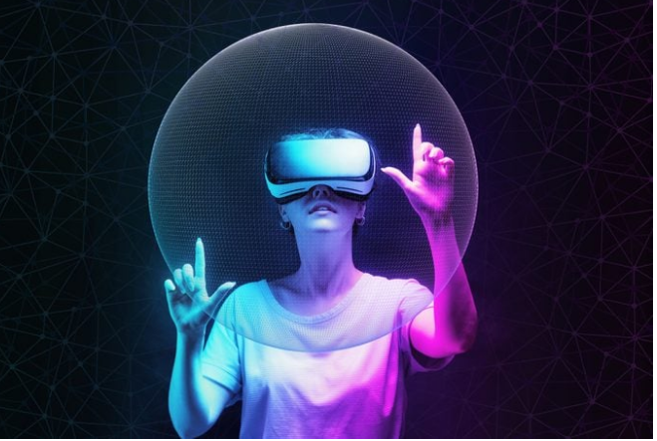
What is Virtual Reality?
Virtual reality is a simulated 3D environment that lets users explore and interact with a virtual surrounding in a way that comes close reality, as it is seen through the users' senses.
It uses the computer technology to create an interactive 3D world effect in which the objects have a sense of spatial presence.

Slide 4
What are the Types of virtual reality?
Non-immersive VR.
Large display without surrounding the user.
Fully-immersive VR
Feels like physically present in a non- physical world
Semi-immersive VR.
Feels a partial virtual environment

Slide 5
Types of virtual reality
Non-immersive VR: uses a computer-generated virtual environment . The user is fully aware and controlled by their physical surroundings at the same time. Examples: Games
Semi-immersive VR: gives a part of the virtual experience using graphics computing and huge projector systems. Example: Training and Educational purposes
Fully-immersive VR: creates the most realistic simulation experience allowing the user to experience the real sensations. Example: Car racing games

Slide 6
What is the Difference between Virtual Reality & Augmented Reality?
Virtual Reality | Augmented Reality
VR and AR are both reality technologies that work toward enriching real-life surroundings.
User can add digital elements to a real-world situation by using a smartphone or a tablet screen. |  | Replaces the real world with a simulated virtual one.
combines the real and simulated worlds and can improve both. |  | It makes you feel the imaginary world rather than the real one.

Slide 7
What is the hardware used in virtual reality?
Input Devices:
It helps navigate and interact with the VR environment to make it as natural as possible
Output Devices:
It is used to display VR Content, with a 360-surround effect supporting a 3D experience.

Slide 8
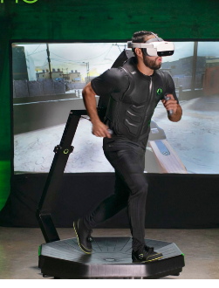
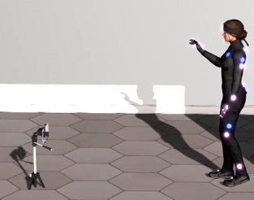
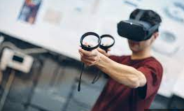
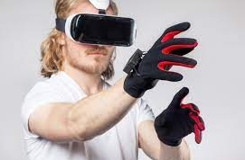
VR input devices
Motion Tracker
Joystick
Treadmill
Sensing gloves

Slide 9
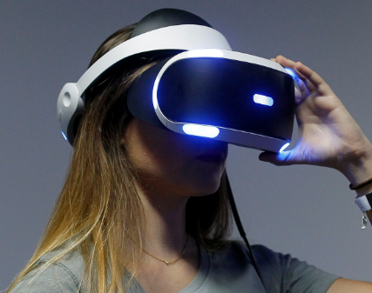
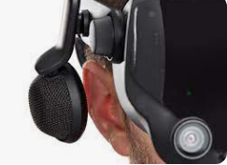
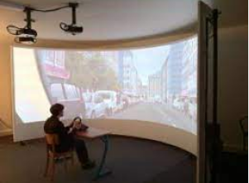
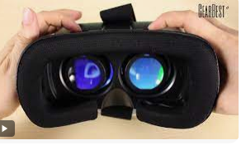
VR Output devices
Head mounted displays
Headphones & Speakers
Large projection screens
3D glasses

Slide 10
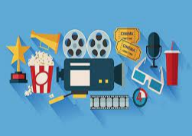
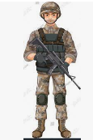
What are the Applications of VR?
Healthcare
Socialists who need to perform very precise operations can practice without being in the midst of an emergency.
Entertainment
VR is used in cinemas and theme parks to stimulate movie-like adventures
Education
provides professional training to employees. students, who can use VR as educational games, and field trips.
Space & Military
enables trainees to overcome risky conditions and helps soldiers suffering from battlefield trauma overcome these challenges.
Tourism
goes on guided virtual tours of hotels, landmarks, restaurants.

Slide 11
References
https://www.techtarget.com/whatis/definition/virtual-reality
https://www.nas.nasa.gov/Software/VWT/vr.html
https://thecorporatereview.com/entering-into-a-new-world-virtual-reality/
https://www.halorenders.com/blogs/news/
https://www.atriauniversity.edu.in/types-of-virtual-reality/#Types-of-Virtual-Reality
https://www.sjf.tuke.sk/transferinovacii/pages/archiv/transfer/29-2014/pdf/319-321.pdf
https://www.halorenders.com/
https://www.trio.dev/blog/virtual-reality-applications#:~:text=VR%20helps%20car%20manufacturers%20in,the%20market%20in%20the%20future.

Slide 12
Thank You

