Slide 1
A.I(Artificial intelligence)
Made by Sameh Jabari 8(c)

Slide 2
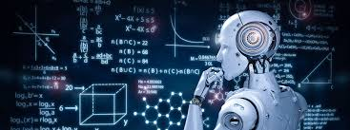
What is A.I ?
A.I is the simulation of human intelligence processes by machines, especially computer systems. Specific applications of AI include expert systems, natural language processing, speech recognition and machine vision.

Slide 3
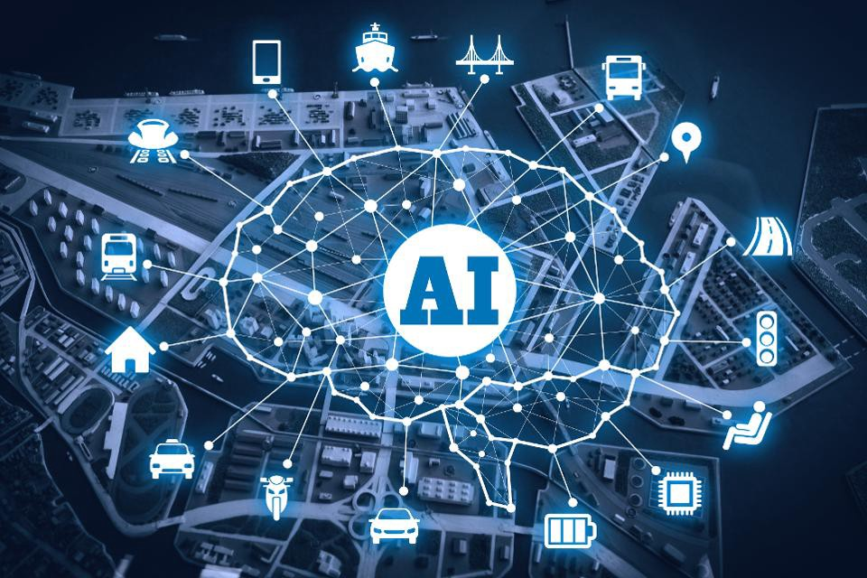
How is A.I used in our daily life?
Voice assistants, image recognition for face unlock in cellphones, and ML-based financial fraud detection are examples of AI software currently being used in everyday life. Typically, just downloading AI software from an online store and having no other devices is required.

Slide 4
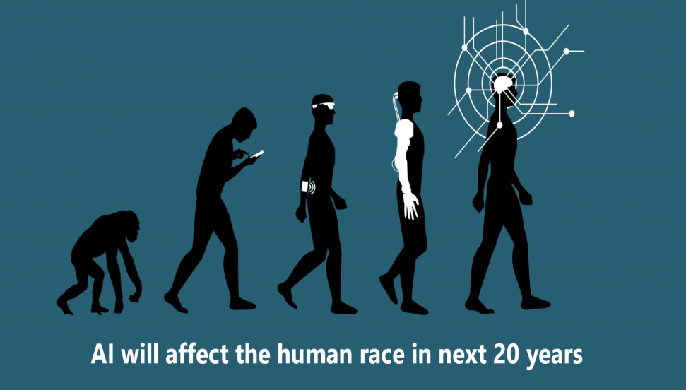
What will happen to A.I in the next 20 years
In the next 20 years, in the social good space, we’ll see AI as a critical tool to bring to life and deeply connect what we call the Ecosystem of Good-people, organizations and communities working toward social impact in a collaborative way that enhances the effect of their efforts, so we can do more good, faster, better and more effectively.

Slide 5
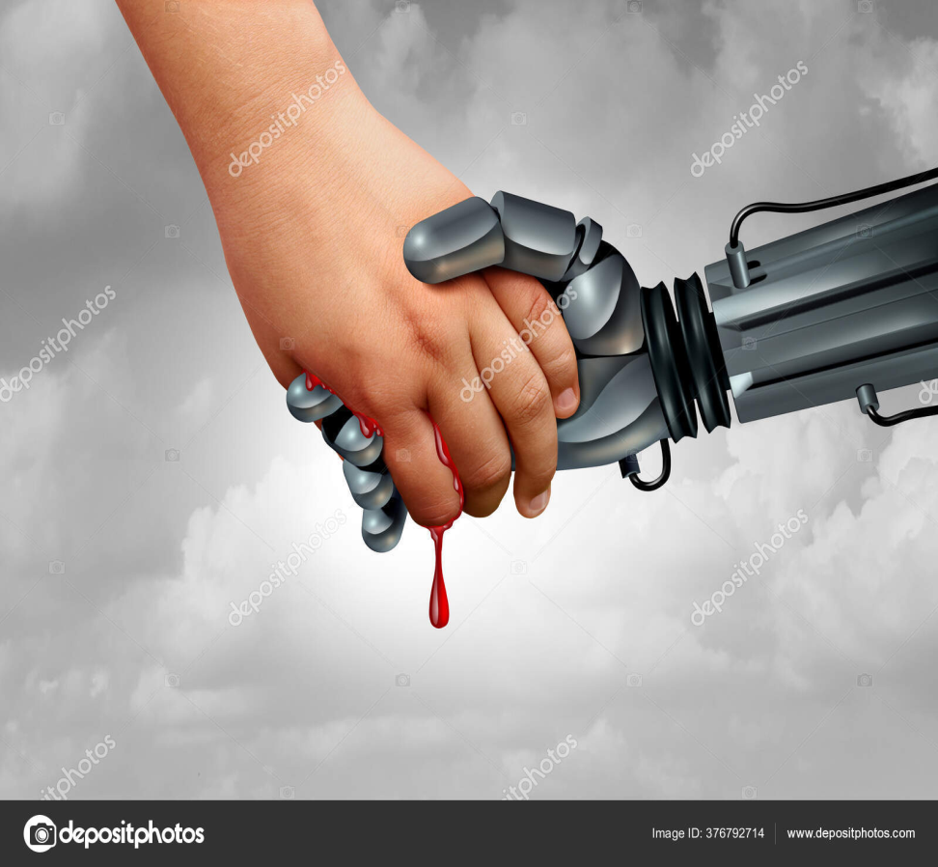
What are the dangers of A.I ?
In the future with A.I taking an even bigger part in our daily lives, problems/risks would come with it , an example of these problems would be: Privacy violations, deep fakes, market volatility and Weapons automatization.

Slide 6
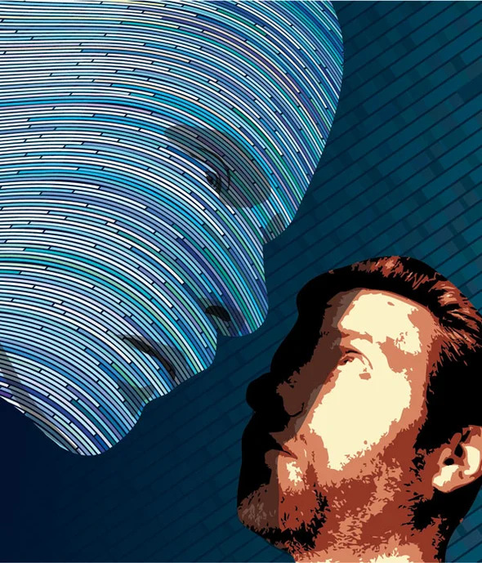
Will A.I ever be more intelligent than humans?
Yes, it can. Compared to the human brain, machine learning (ML) can process more data and do so at a faster rate. This allows it to discover patterns in data that would go unnoticed by a person

Slide 7
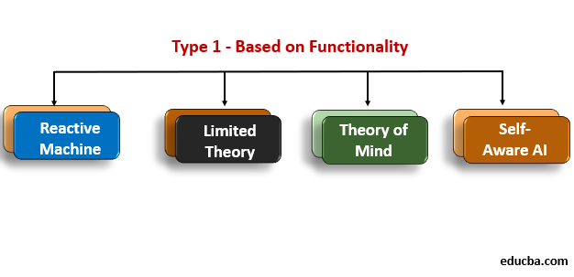
What are the 4 types of A.I that are based on functionality ?
the 4 types of A.I that are based on functionality are reactive, limited memory, theory of mind and self-aware.

Slide 8
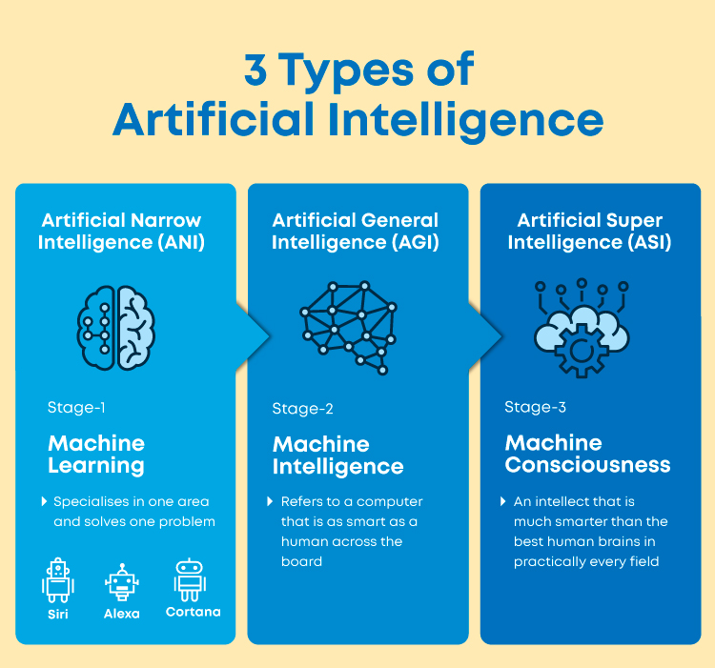
What are 3 types of A.I that are based on capability ?
The 3 types of A.I that are based on capability Artificial narrow intelligence (ANI), which has a narrow range of abilities; Artificial general intelligence (AGI), which is on par with human capabilities and Artificial super intelligence (ASI), which is more capable than a human.

Slide 9
Resources
1. https://codebots.com/artificial-intelligence/the-3-types-of-ai-is-the-third-even-possible
2. https://www.techtarget.com/searchenterpriseai/definition/AI-Artificial-Intelligence#:~:text=Artificial%20intelligence%20is%20the%20simulation,speech%20recognition%20and%20machine%20vision
3. https://dataconomy.com/2022/05/artificial-intelligence-in-everyday-life/#:~:text=Voice%20assistants%2C%20image%20recognition%20for,no%20other%20devices%20is%20required
4. https://dataconomy.com/2022/04/is-artificial-intelligence-better-than-human-intelligence/#:~:text=making%20better%20judgments%3F-,Is%20Artificial%20Intelligence%20better%20than%20Human%20Intelligence%3F,go%20unnoticed%20by%20a%20person

Slide 10
Resources
5. https://bernardmarr.com/understanding-the-4-types-of-artificial-intelligence/#:~:text=According%20to%20the%20current%20system,mind%2C%20and%20self%2Daware.
6. https://codebots.com/artificial-intelligence/the-3-types-of-ai-is-the-third-even-possible

