Slide 1
Assistive Technology
By Tia Beiruty

Slide 2
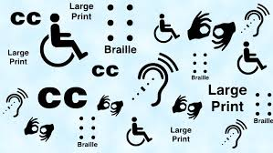
What is Assistive Technology?
Technology designed to make it easier for people with impairments to learn, work, and go about their daily lives.

Slide 3
What are the Advantages of Assistive Technology?
By enabling care to be provided only when necessary, assistive technology increases people's independence, privacy, and dignity, protecting the people we support.
Additionally, it aids individuals in making their own decisions and choices regarding their lives.
Using assistive technology can occasionally result in financial savings.

Slide 4
What are the Barriers for Assistive Technology?
Lack of awareness: the availability of assistive goods and services is not widely known among many people with disabilities and their families.
Lack of national programs, laws, and policies.

Slide 5
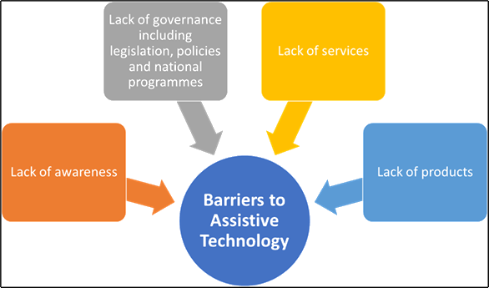
What are the Barriers for Assistive Technology? (Continuation)
Lack of services: services for assistive technology are frequently scarce and dispersed far from where children with impairments reside.
Lack of products: assistive product production is either nonexistent or very limited in many nations. It is small in terms of both the amount and the variety of product types, models, and sizes.

Slide 6
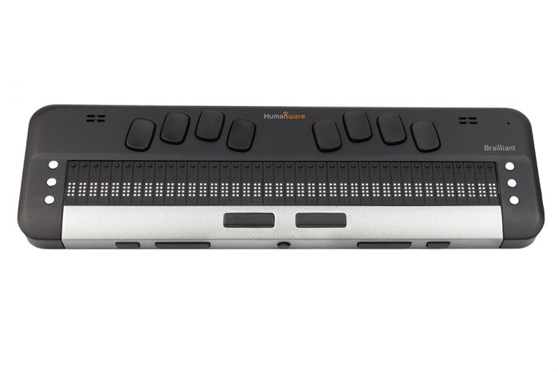
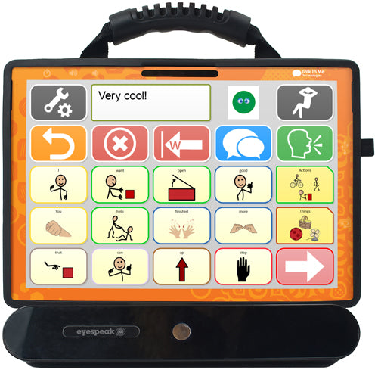
Examples of Assistive Technology!
Braille Displays
Speech Generating Devices
Vibrating Alarm Clock

Slide 7
Citations
Types of at. Guide to Assistive Technology. (2022, August 17). Retrieved February 1, 2023, from https://mn.gov/admin/at/getting-started/understanding-at/types/
Www.unicef.org. (n.d.). Retrieved February 1, 2023, from https://www.unicef.org/media/126246/file/Assistive-Tech-Web.pdf
Benefits of Assistive Technology. Dimensions. (2022, April 20). Retrieved February 1, 2023, from https://dimensions-uk.org/initiative/assistive-technology/
What is at? Assistive Technology Industry Association. (n.d.). Retrieved February 1, 2023, from https://www.atia.org/home/at-resources/what-is-at/

