Slide 1
Exploring the Virtual Frontier
Zain Attiyat
(8F)

Slide 2
`Introduction to Virtual Reality
The Benefits of Virtual Reality
The Limitations of Virtual Reality
The Future of Virtual Reality
The Impact of Virtual Reality
Conclusion

Slide 3
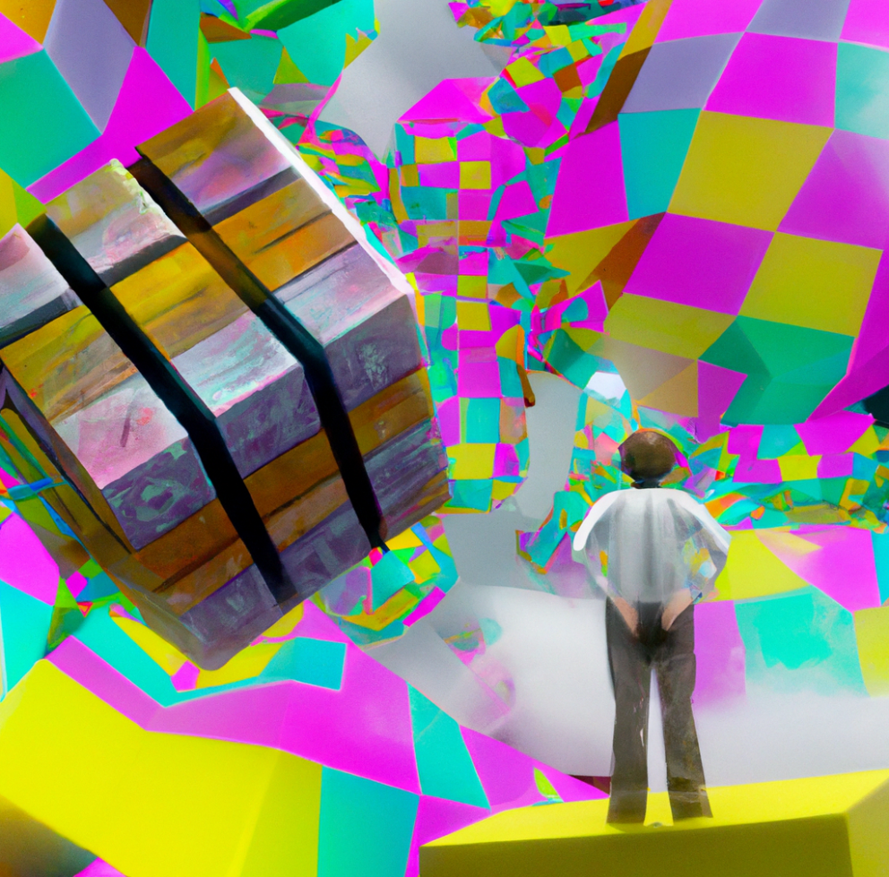
Introduction to Virtual Reality
`Virtual Reality (VR) is a computer-generated experience that immerses the user in a simulated environment. It is a three-dimensional, interactive environment that allows the user to explore, interact, and experience the world in a completely new way.
VR technology has been around for decades, but it has only recently become more widely accessible due to advancements in hardware, software, and user experience. With the help of virtual reality, users can now explore new places, participate in activities, and even create their own virtual worlds.

Slide 4
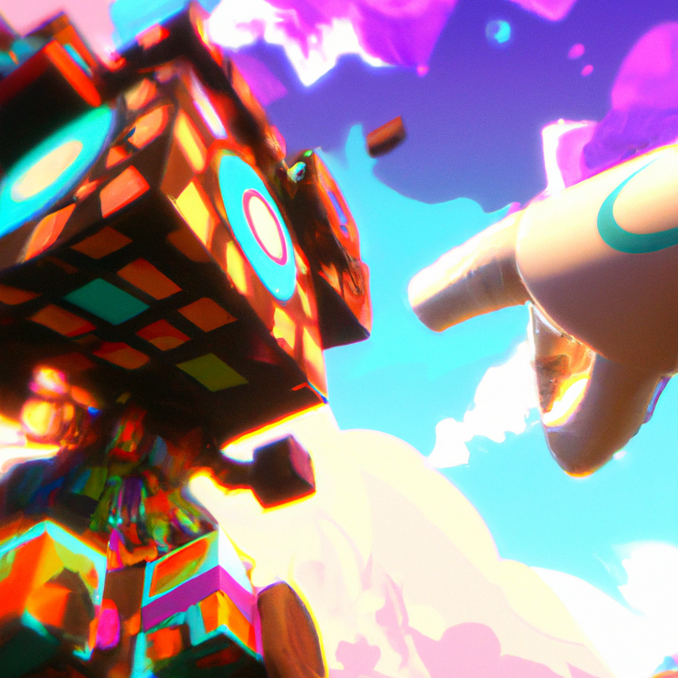
Types of Virtual Reality
There are many different types of virtual reality, from simple video game simulations to fully immersive, interactive environments. Some of the most popular types of VR include augmented reality (AR), mixed reality (MR), and 360-degree video.
Augmented reality is a type of VR that overlays digital elements onto the real world. Mixed reality combines the real and virtual worlds, allowing users to interact with both at the same time. 360-degree video is a type of VR that allows users to view a scene from all angles, as if they were really there.

Slide 5
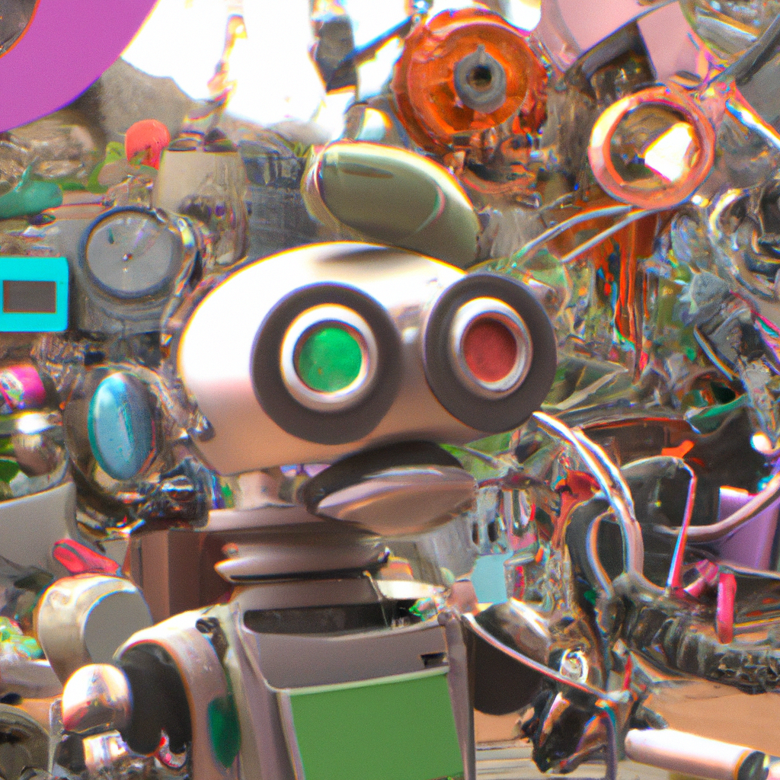
Applications of Virtual Reality
Virtual reality has a wide range of applications, from entertainment and gaming to education and training. It can be used to create immersive experiences that allow users to explore and interact with virtual environments.
VR can also be used for medical and therapeutic purposes, such as helping patients with physical or mental disabilities to practice activities that would otherwise be difficult or impossible. It can also be used for training purposes, such as simulating dangerous scenarios to prepare people for real-life situations.

Slide 6
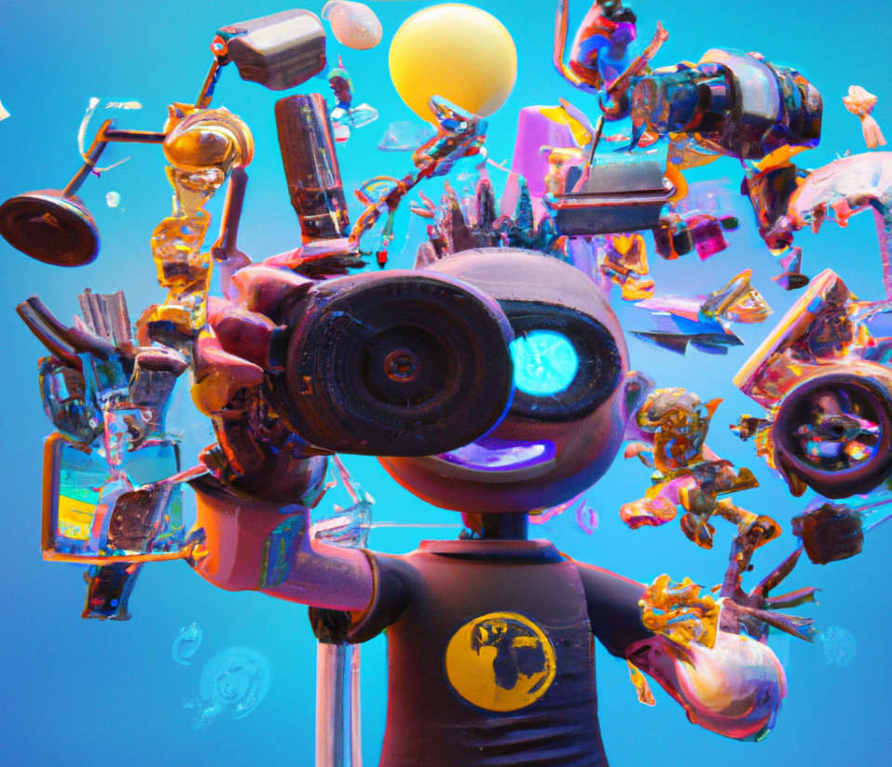
Advantages of Virtual Reality
Virtual reality offers many advantages over traditional methods of entertainment and learning. It is a cost-effective way to create immersive, interactive experiences that can be accessed from anywhere. It also allows users to explore and interact with virtual environments in ways that would not be possible in the real world.
VR also offers the potential for more efficient training, as it allows users to practice activities in a safe, simulated environment. Additionally, VR can be used to create unique experiences that would not be possible in the real world, such as exploring virtual worlds or interacting with virtual characters.

Slide 7
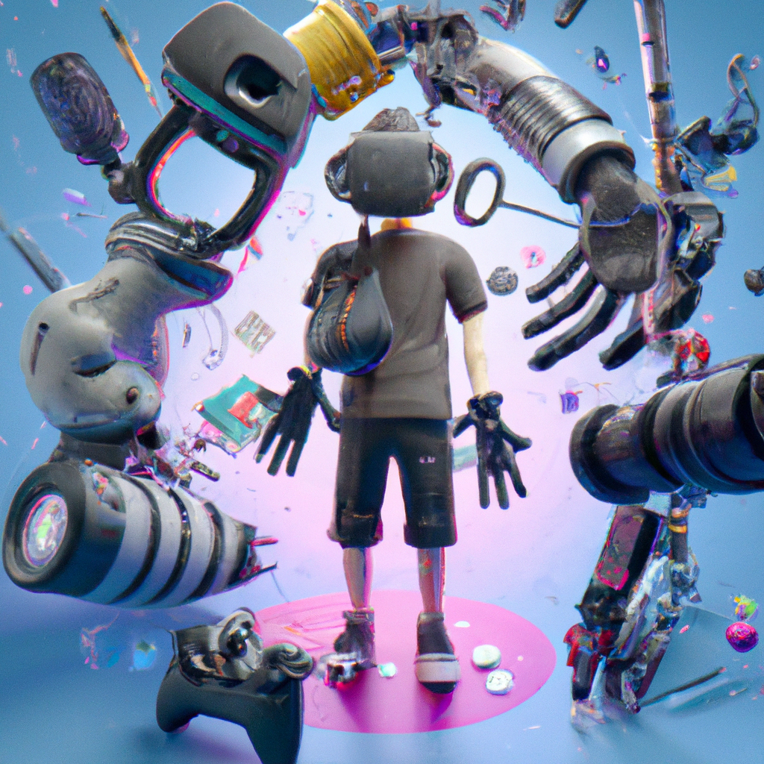
Disadvantages of Virtual Reality
Although virtual reality offers many advantages, there are also some potential drawbacks. One of the main concerns is the potential for users to become overly immersed in the virtual world, leading to a disconnect from the real world. Additionally, VR can be expensive, as it requires specialized hardware and software.
VR also has the potential to cause motion sickness in some users, as the disconnect between the user’s physical movements and what they see in the virtual world can cause disorientation. Finally, there is the potential for users to be exposed to inappropriate content, as some VR experiences contain graphic or violent content.

Slide 8
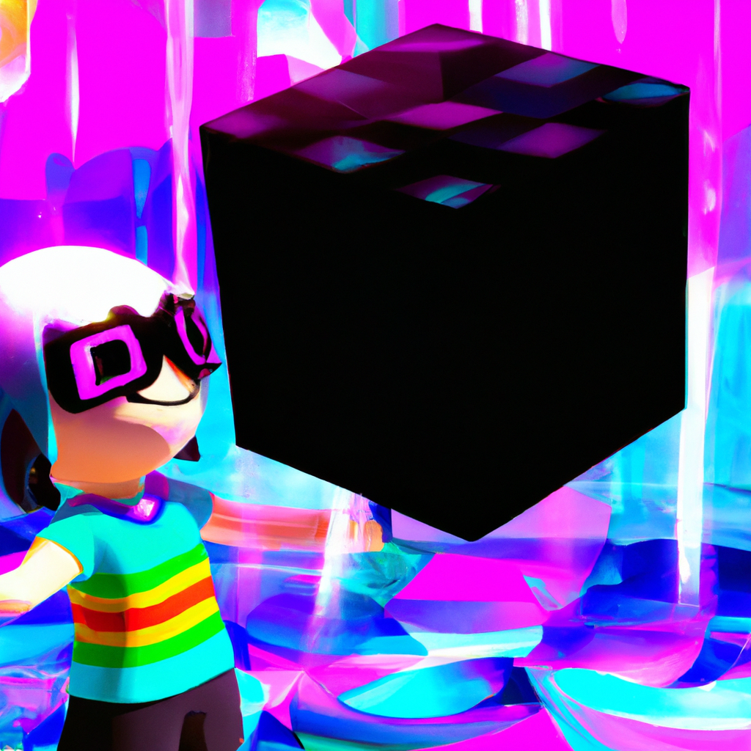
Conclusion
Virtual reality is a powerful technology that has the potential to revolutionize the way we experience the world. It offers a wide range of applications, from entertainment to education and training, and can be used to create immersive experiences that are not possible in the real world.
However, there are also some potential drawbacks to virtual reality, such as the potential for users to become overly immersed in the virtual world and the potential for users to be exposed to inappropriate content. Despite these potential drawbacks, virtual reality is an exciting technology that is sure to continue to evolve and expand in the coming years.

