Slide 1
Virtual Reality
7/2/2023

Slide 2
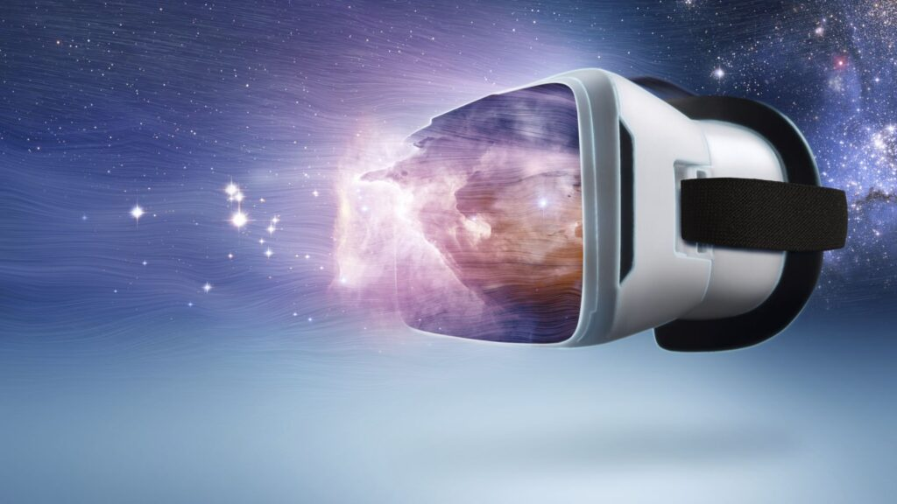
What is Virtual Reality?
a computer generated environment with scenes and objects that appear to be real, making the user feel they are immersed in their surroundings. Virtual reality VR is a simulated experience that employs pose tracking and 3D near-eye displays to give the user an immersive feel of a virtual world. Applications of virtual reality include entertainment particularly video games, education such as medical, military or pilot training and business such as virtual meetings.

Slide 3
What is Virtual Reality used for? and Examples
Virtual reality is most commonly used in entertainment applications such as video games, 3D cinema, amusement park rides including dark rides and social virtual worlds. Car racing games are an example of immersive virtual reality that gives the user the sensation of speed and driving skills. Developed for gaming and other entertainment purposes.
Training: One of the most obvious is the use of VR in employee training:
Like Flight Simulator: A simulator reproduces the equations that control how a real airplane maneuvers, how a plane reacts when you manipulate the flight controls, and how a plane responds to weather and other external forces. A pilot trainee sits in the simulator cockpit and learns to fly a plane with an instructor present.
Medical Simulator:Medical simulation allows the acquisition of clinical skills through deliberate practice rather than an apprentice style of learning. Simulation tools serve as an alternative to real patients. A trainee can make mistakes and learn from them without the fear of harming the patient.

Slide 4
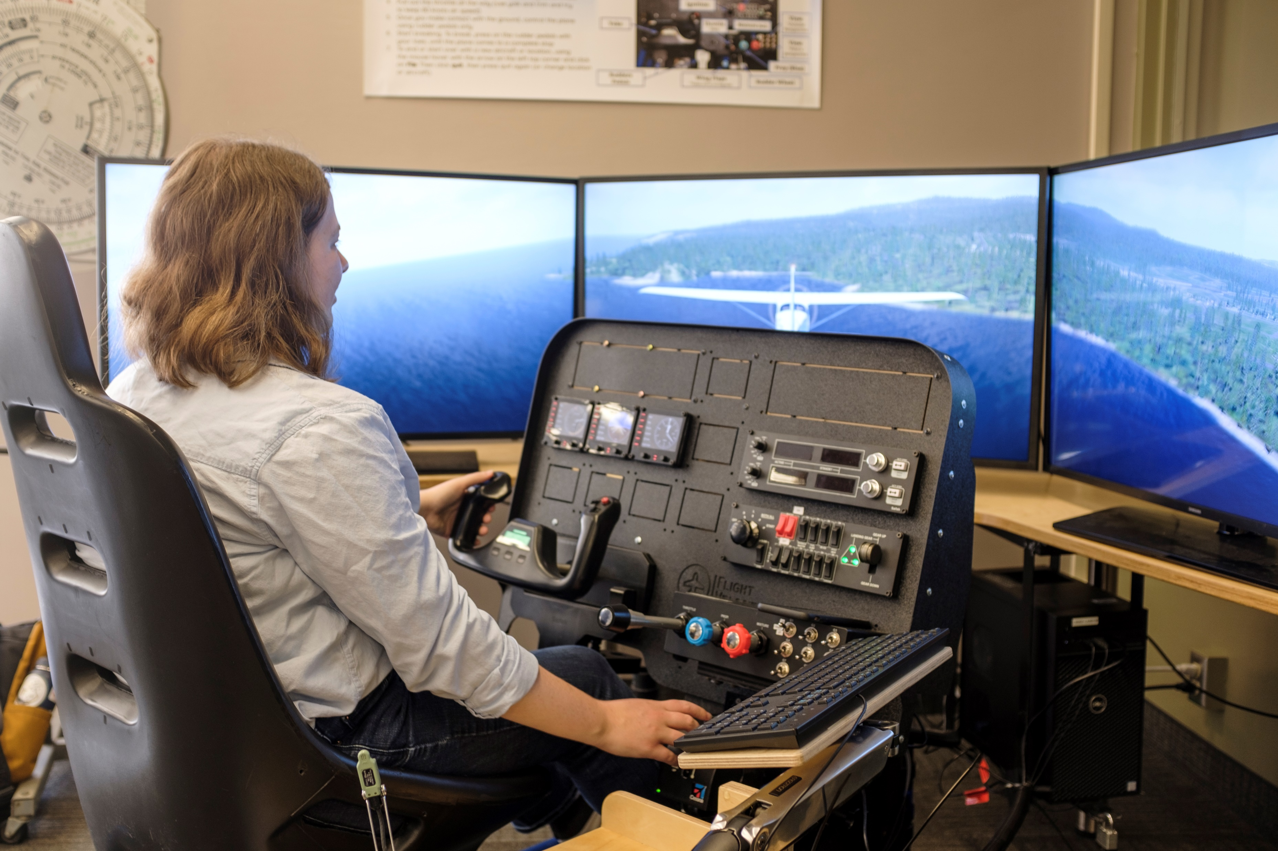
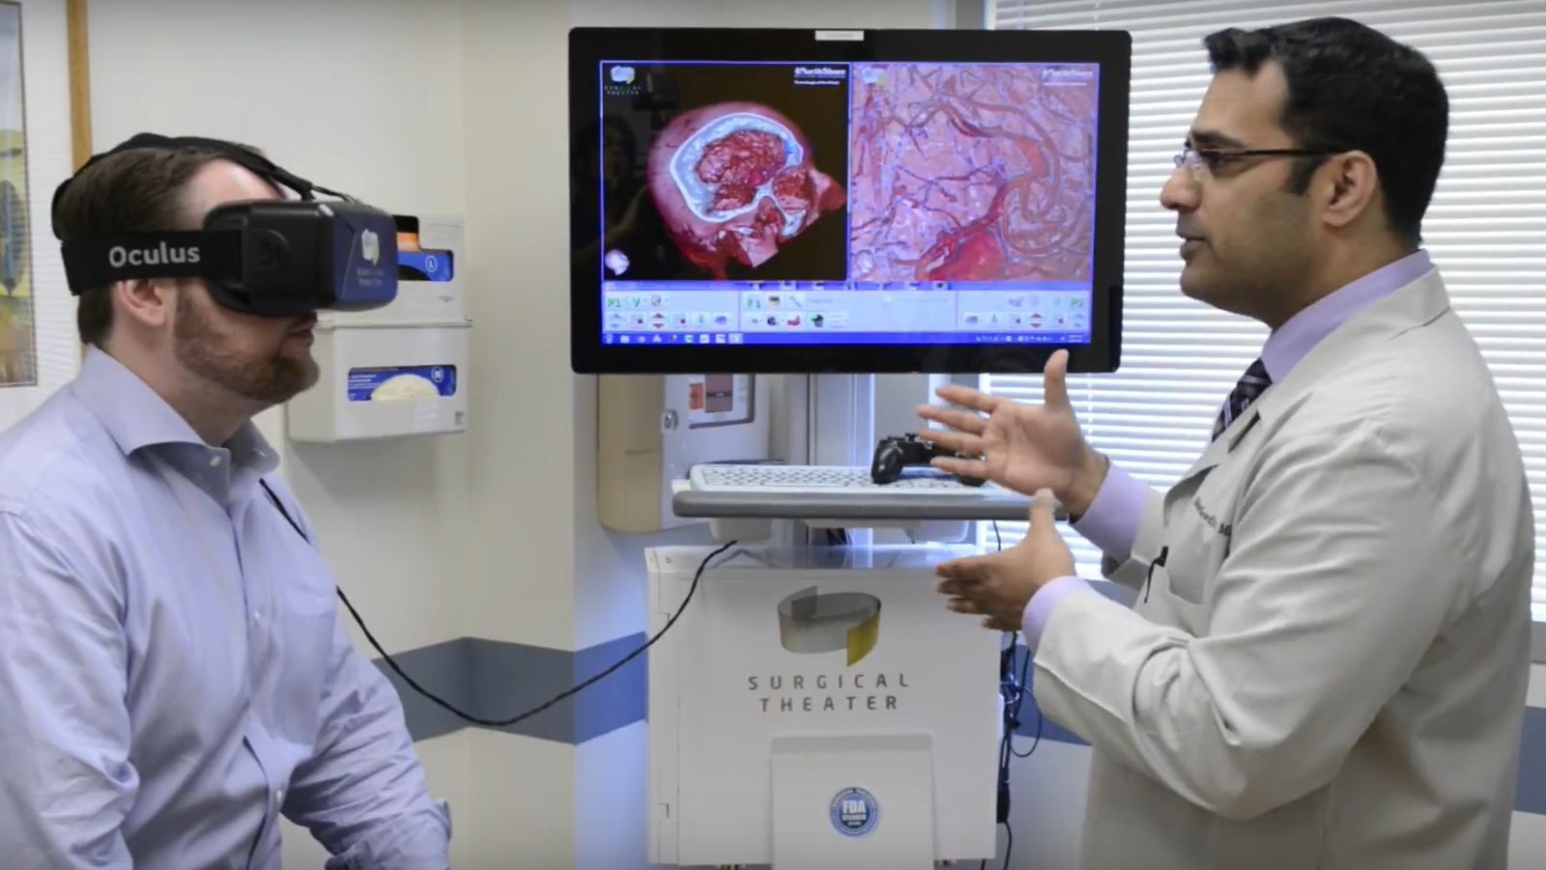
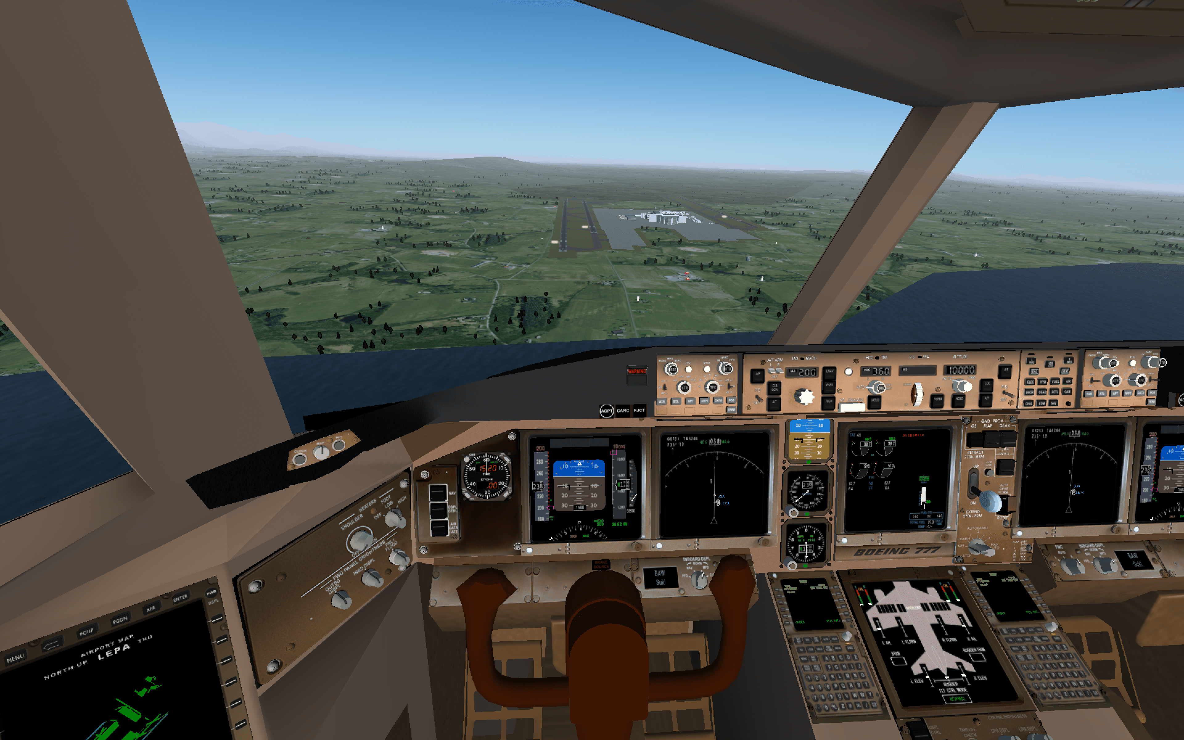
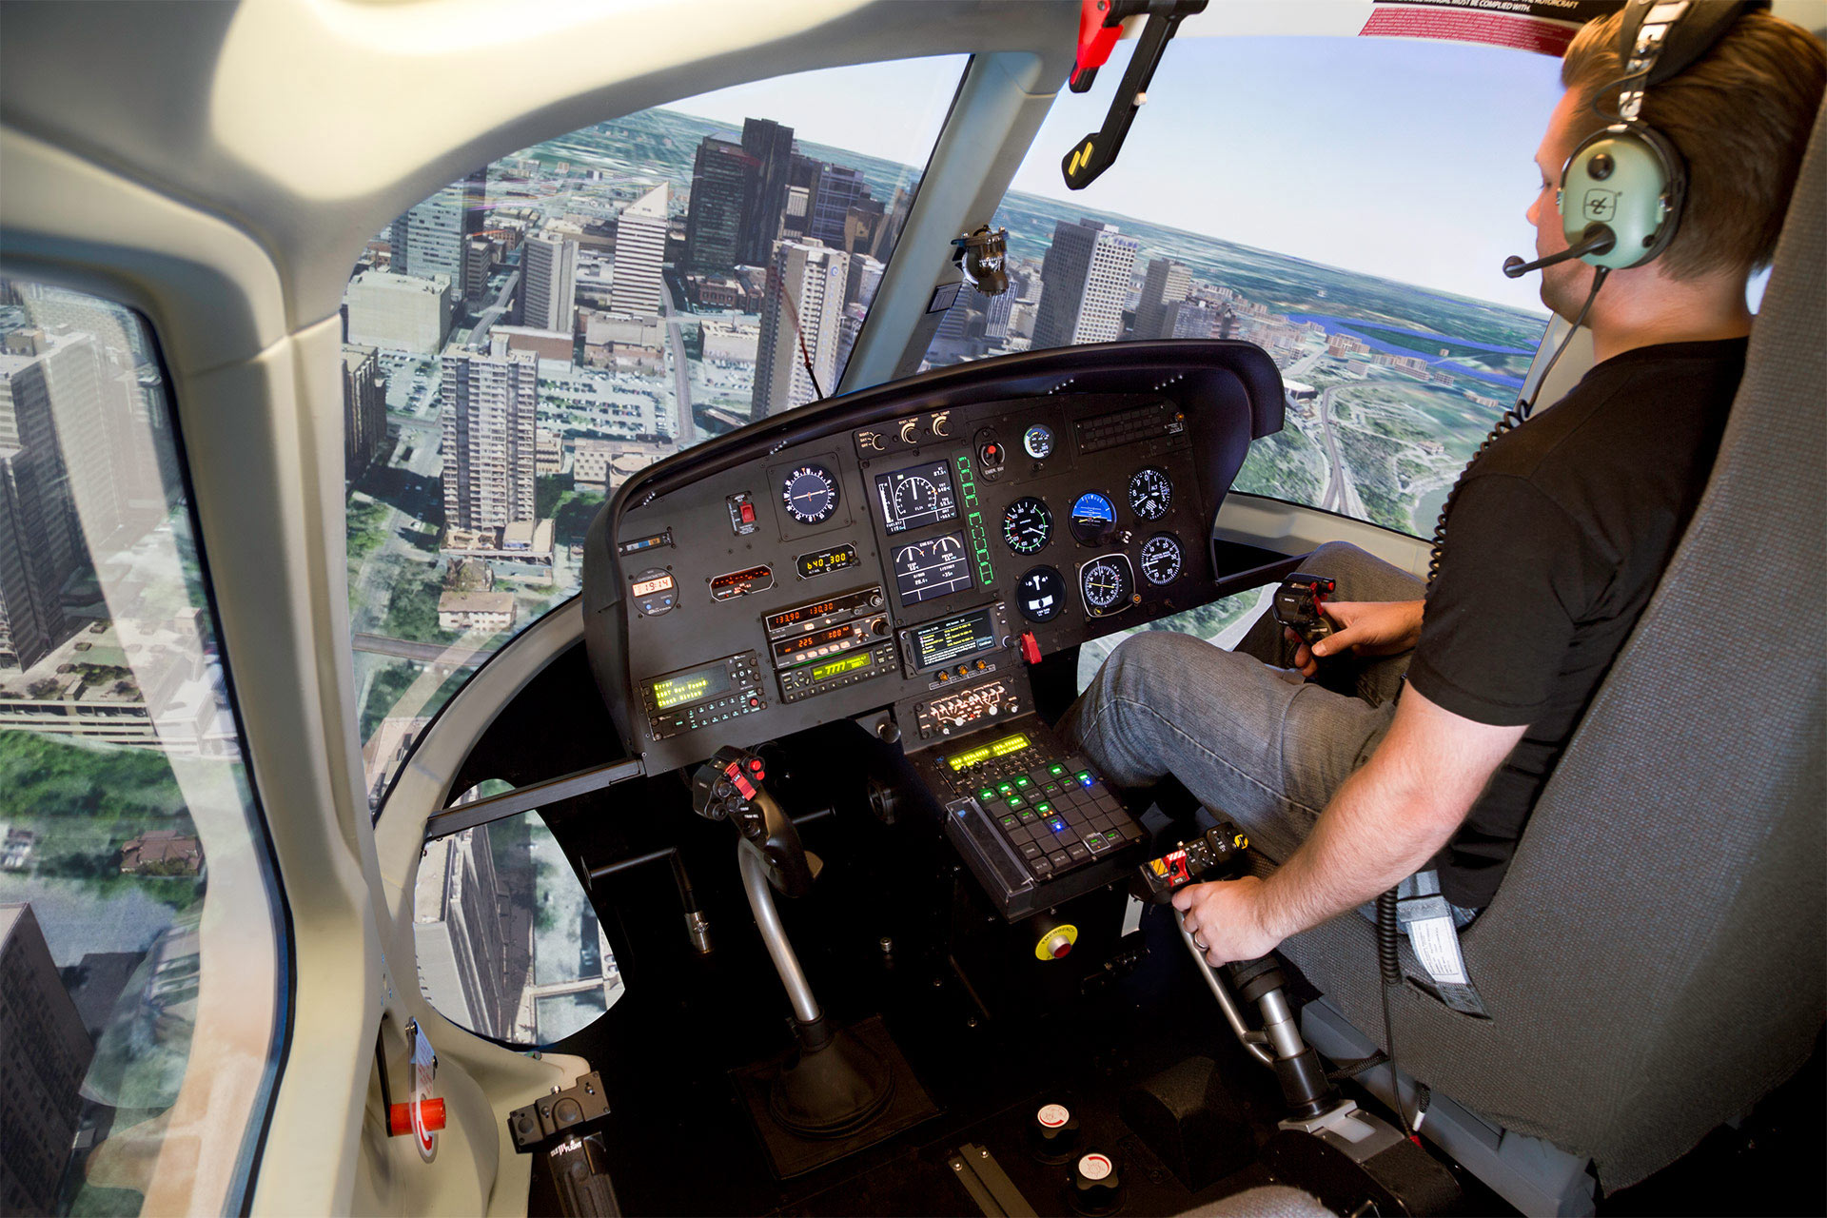
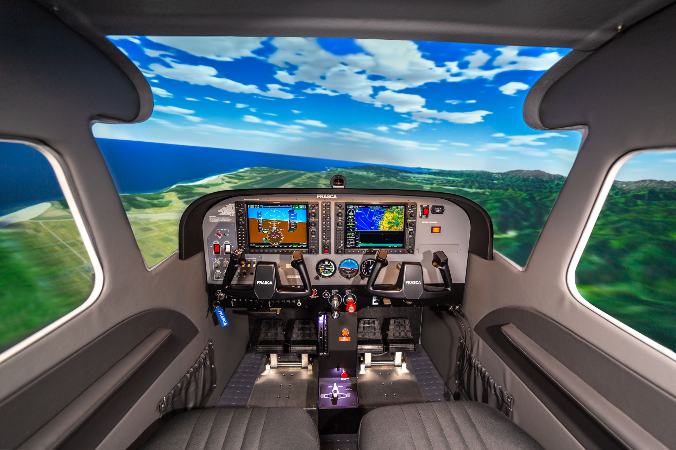
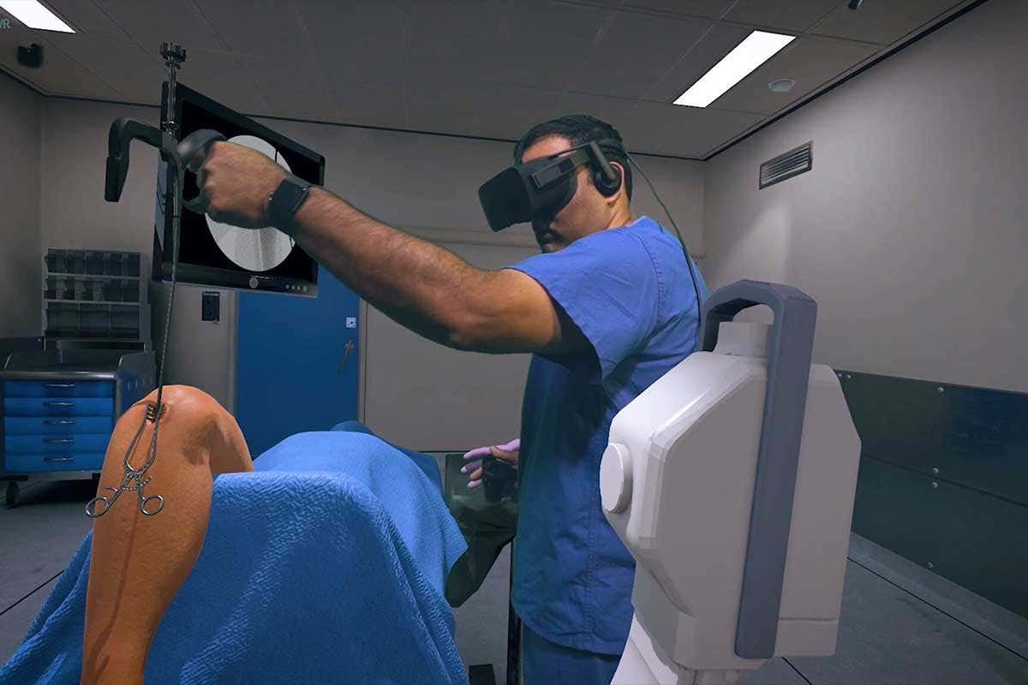
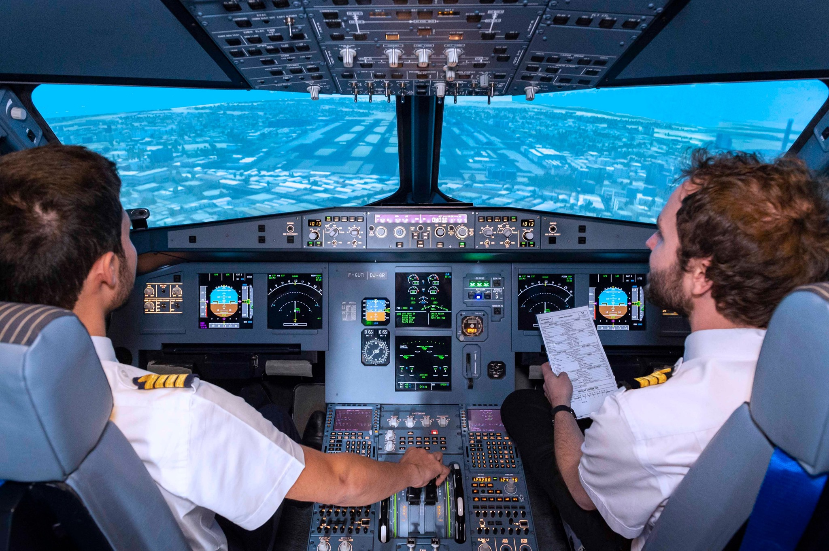

Slide 5
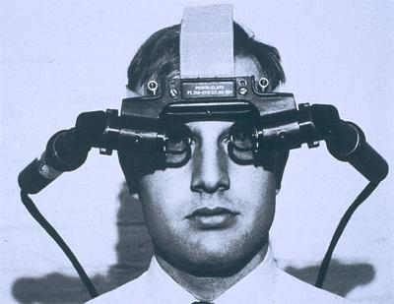
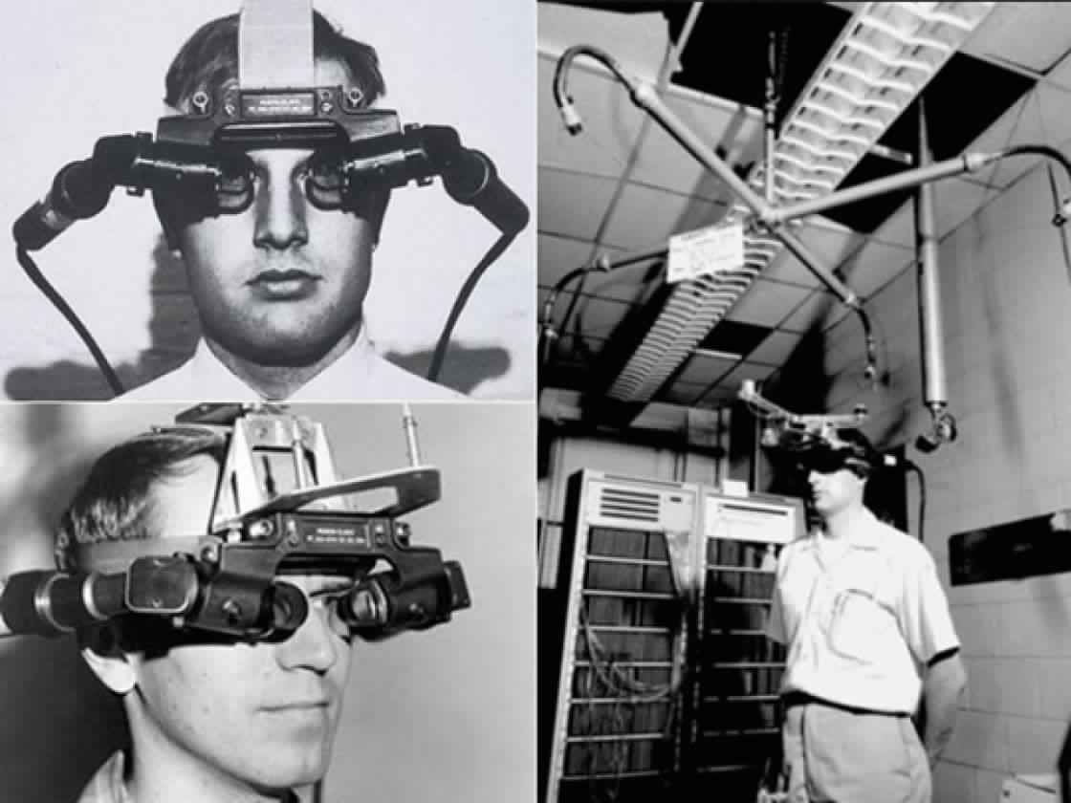
Who Invented Virtual Reality? The first invention..
In 1968 Ivan Sutherland and his student Bob Sproull created the first VR / AR head mounted display (Sword of Damocles) that was connected to a computer and not a camera. However, was first used in the mid-1980s when Jaron Lanier, founder of VPL Research, began to develop the gear, including goggles and gloves, needed to experience what he called “virtual reality.”

Slide 6
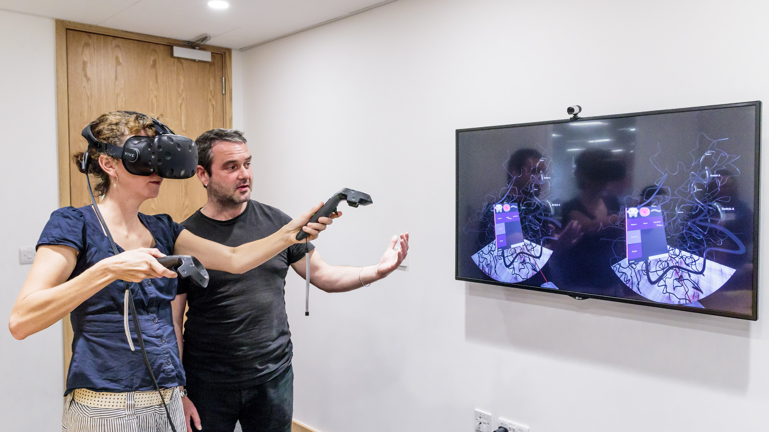
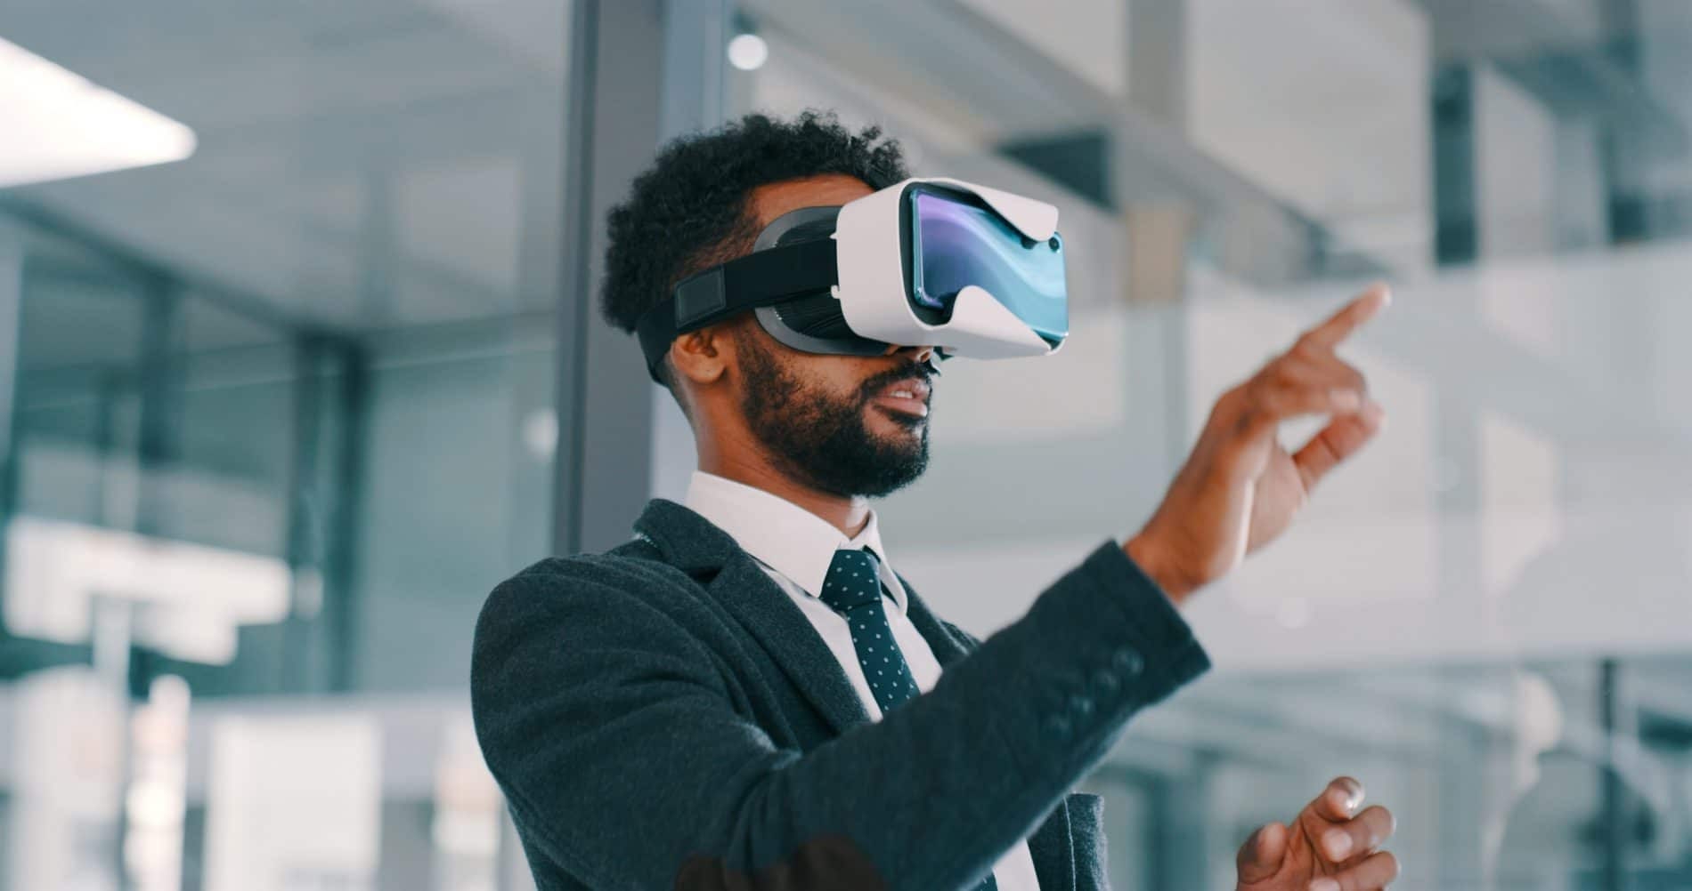
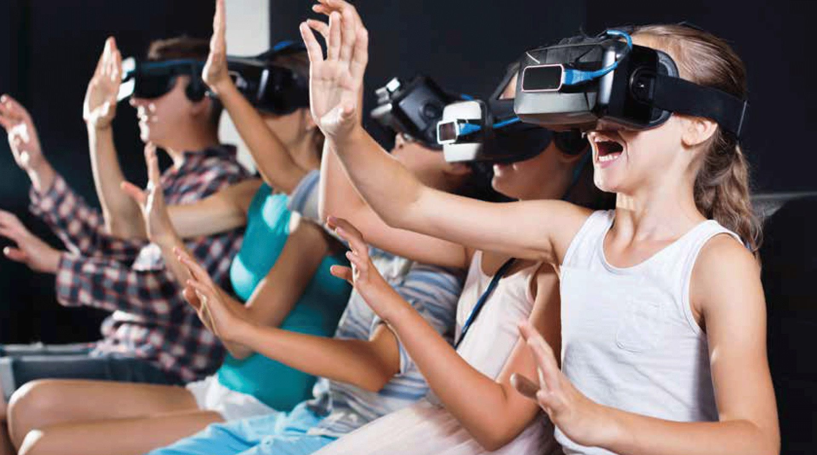
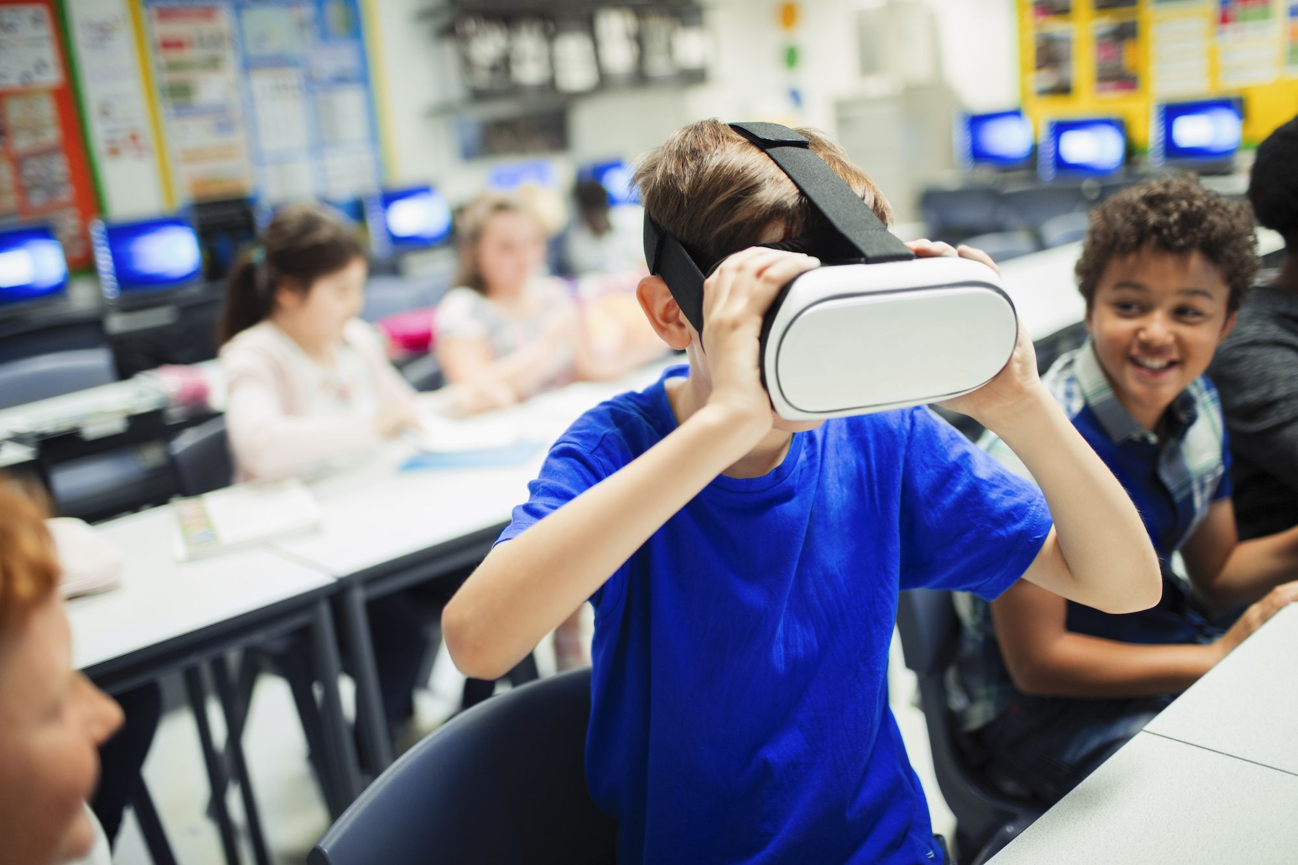
who is the primary target audience for virtual reality?
Indeed, most customers are not used to video games and do not know the virtual reality. According to a study carried out by us last November, the age groups that come the most in VR gaming rooms are 12 - 15 years old and 30 - 40 years old.

Slide 7
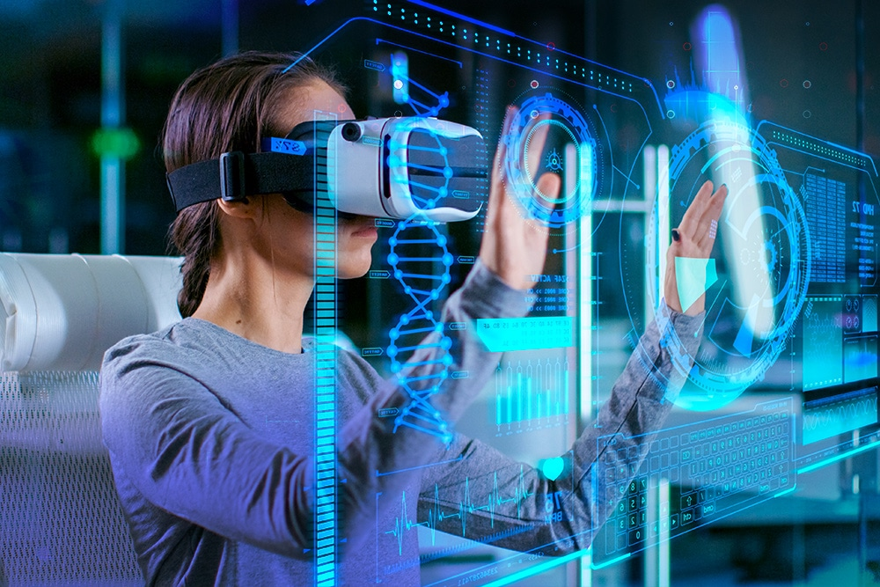
Is virtual reality necessary?
Virtual Reality is essential for the growth and expansion of the metaverse industry. The technology supports the vision of metaverse clusters by aiding in creating the 3D virtual world. With VR, users can immerse themselves in interactive experiences that are hard to access in the physical environment.

Slide 8
https://www.futurevisual.com/blog/vr-training/#:~:text=VR%20training%20is%20an%20immersive,they%20can%20learn%20by%20doing.
Links
https://www.vrs.org.uk/virtual-reality/history.html#:~:text=In%201968%20Ivan%20Sutherland%20and,ceiling%20(hence%20its%20name).
https://www.octopodvr.com/blog/what-is-market-for-vr-venue-17#:~:text=Indeed%2C%20most%20customers%20are%20not,women%20and%2050%25%20for%20men.
https://www.blockchain-council.org/metaverse/why-is-vr-important-in-the-metaverse/#:~:text=Virtual%20Reality%20is%20essential%20for,access%20in%20the%20physical%20environment.

Slide 9
THANK YOU For reading!
By: Angela Naber (8F)

