Slide 1
E-learning
CHRistina Al-Sharqawi
Grade 8h

Slide 2
The definition of E-learning
A learning system based on formalised teaching but with the help of electronic resources is known as E-learning
Teaching can be based in or out of the classrooms, the use of computers and the Internet forms the major component of E-learning.
E-learning refers to a learning system that we can obtain through the internet using an electronic device. We also call it online learning or online education. The 'E' in E-learning stands for 'Electronic. ' Hence, the original term 'electronic learning.

Slide 3
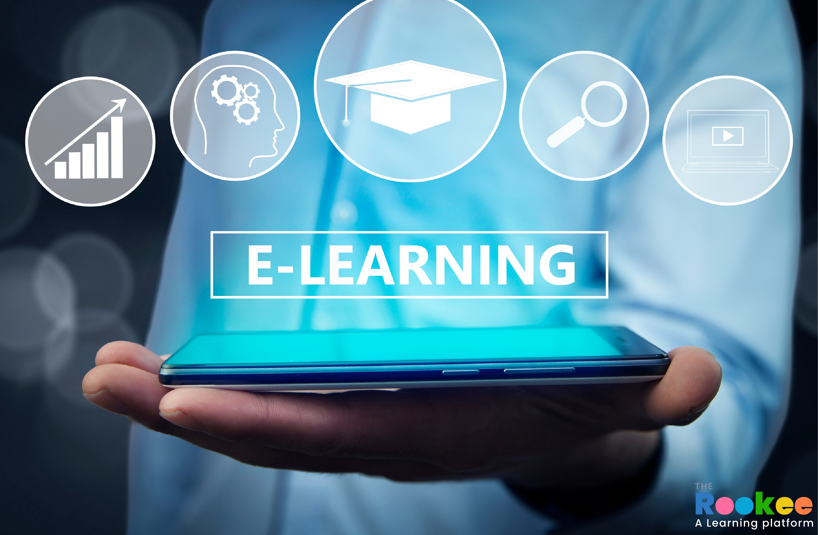
The benefits of E-learning
Fully Adjusts to Your Needs
Reduced Cost
Remote Approach To Various Classes
Transfer Credits & Commuting
Quick Delivery
Offers Personalization
Scalability
Consistency & Teacher Scarcity

Slide 4
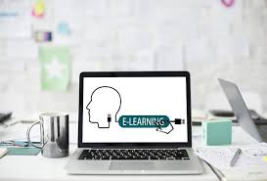
The disadvantages of E-learning
Online Learning May Create a Sense of Isolation
Online Learning Requires Self-Discipline
Online Learning Requires Additional Training for Instructors
Online Classes Are Prone to Technical Issues
Online Learning means more screen-time

Slide 5
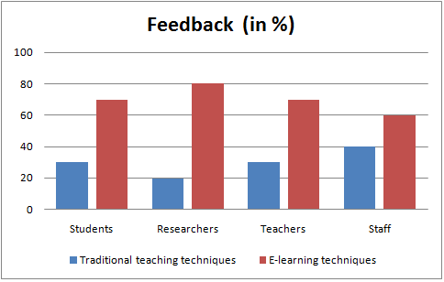
A graph for E-learning techniques
As you can see here in this graph the E-learning techniques is better than the traditional teaching techniques
A lot of people nowadays are using the E-learning techniques because it’s much easier

Slide 6
Resources
https://ailit.org/top-10-elearning-benefits/
https://economictimes.indiatimes.com/definition/e-learning
https://corp.kaltura.com/blog/advantages-disadvantages-online-classes/

