Slide 1
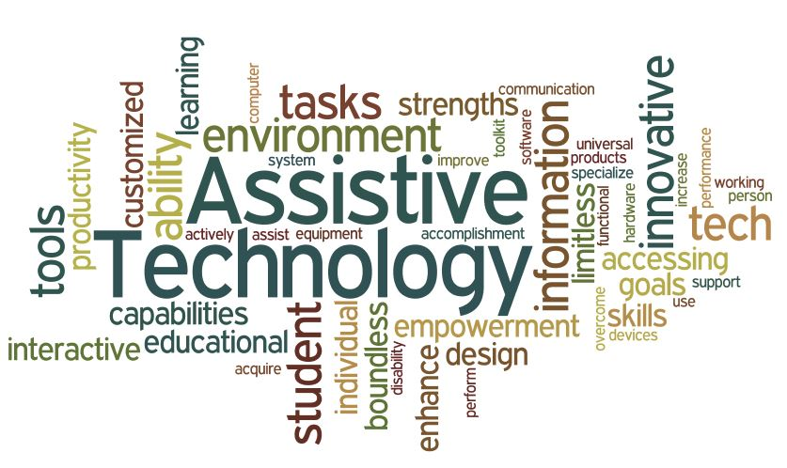
Assistive Technology
By: Tia Samara

Slide 2
What is Assistive Technology?
Assistive technology is known as any tool, piece of machinery, piece of software, or product system used to enhance, maintain, or improve the functional capacities of a person with disability.
People who struggle with speaking, typing, writing, seeing, hearing, and many other tasks can benefit from assistive technology.
Different assistive technologies are needed for various disabilities.

Slide 3
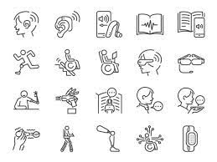
Examples of Assistive Technology
Magnifiers,
Talking devices such as a talking thermostat,
Braille displays,
Screen reading software,
Text-to-speech systems,
Large print materials,

Slide 4
Who pays for Assistive technology?
Materials used in general special education are funded by school systems.
Certain assistive technology is covered by government programs (such as Social Security, veteran's benefits, or state Medicaid agencies) if prescribed by a doctor as an essential medical device.
Rehabilitation and job training programs may cover the cost of assistive technologies to help people find employment.
Employers may pay for reasonable accommodations such as assistive technology that allows an employee to complete important job responsibilities.

Slide 5
Advantages and Disadvantages of Assistive Technology
Advantages:
It enables people to live healthy and productive lives.
minimizes the need for professional health and support services.
increases future chances for education, social advancement, and successful employment.
Disadvantages:
Can be distracting to students.
It might prevent students from interacting with others in person.
It may lead to students using untrustworthy learning resources.

Slide 6
Thank you!

