Slide 1
Multimedia
By George Samawi 8B

Slide 2
What is Multimedia?
Multimedia is a combination of text, audio, video, animation and graphics to create a powerful user experience. It is used to convey information in a more engaging and interactive way than traditional media.
Multimedia can be used for a variety of purposes, such as education, entertainment, advertising, and marketing.

Slide 3
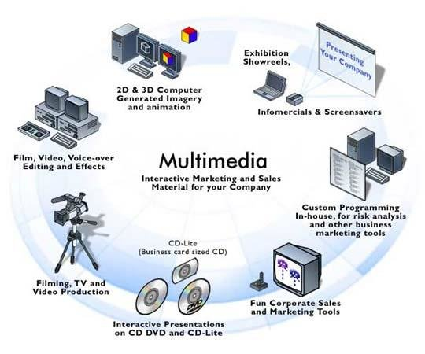
Types of Multimedia
There are many types of multimedia, including text, audio, video, animation, and graphics. Text can be used to convey information, while audio and video can be used to add emotion and atmosphere. Animation and graphics can be used to create a more engaging experience.
Multimedia can also be used to create interactive experiences, such as video games, virtual reality, and augmented reality.

Slide 4
Benefits of Multimedia
Multimedia can be used to create a more engaging and interactive experience for the user. It can also be used to convey information in a more effective and efficient way than traditional media.
Multimedia can also be used to create immersive experiences, such as virtual reality and augmented reality, which can be used for education, entertainment, and marketing.

Slide 5
Uses of Multimedia
Multimedia can be used for a variety of purposes, such as education, entertainment, advertising, and marketing. It can also be used to create immersive experiences, such as virtual reality and augmented reality.
Multimedia can also be used to create interactive experiences, such as video games, virtual reality, and augmented reality. These experiences can be used for education, entertainment, and marketing.

