Slide 1
Virtual Reality
By: Nabeel Zureiqat

Slide 2
What is Virtual Reality?
It is the use of a VR headset to give you the feeling that you are in a different place. When you wear a VR headset an interactive virtual world is generated around you.

Slide 3
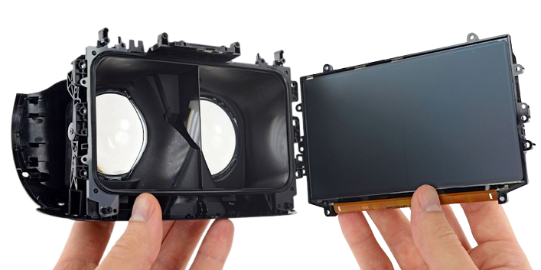
How does a VR headset work?
A VR headset contains stereoscopic lenses that reside in between an LED screen and where you put your eyes. The LED screen outputs an image which you see through the lenses. When you are in the virtual reality your field of view gets replaced but the FOV of the headset. A VR headset also contains usually 3D spatial audio speakers to increase immersion.

Slide 4
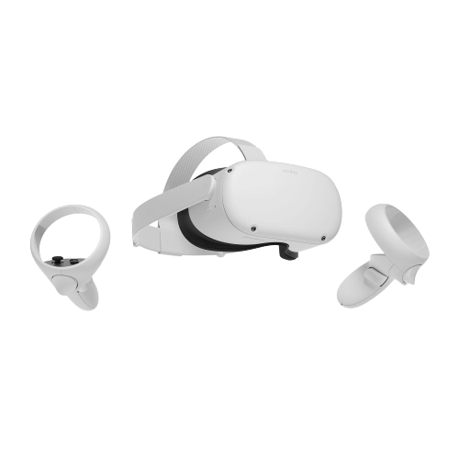
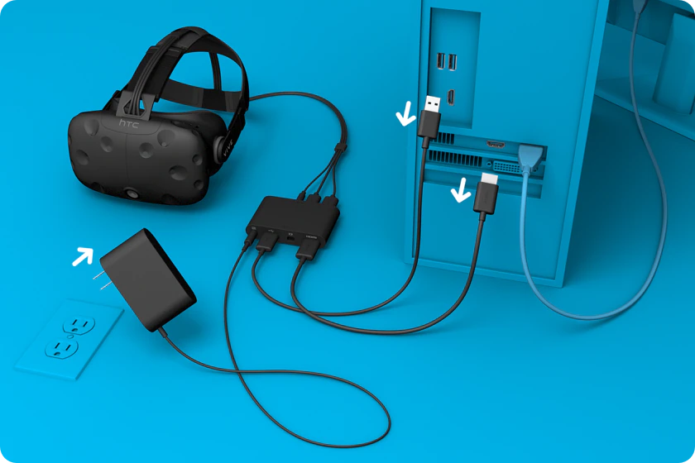
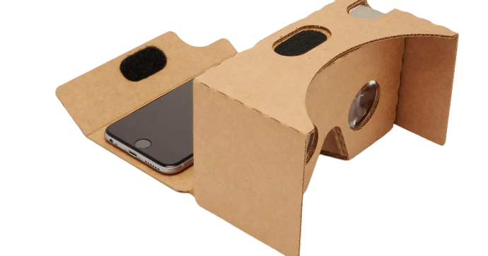
Types of VR Headsets
Tethered VR Headsets (also known as PC VR and desktop VR)
The headset is connected to a PC through a wire and they are more immersive that the other options
Smartphone VR headsets
You insert the phone into the headset which will provide the VR experience
Standalone VR headsets
The headset does not connect to the computer or smartphone because they have built-in processors, sensors, batteries, storage memory, and displays
1.
2.
3.

Slide 5
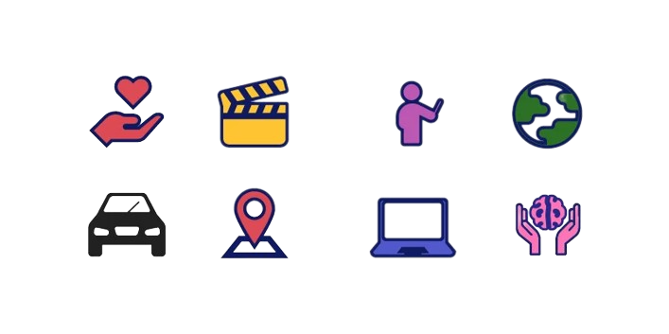
Use Cases for Virtual Reality
Some of the use cases for VR include but are not limited to:
Healthcare
Education
Entertainment
Tourism

Slide 6
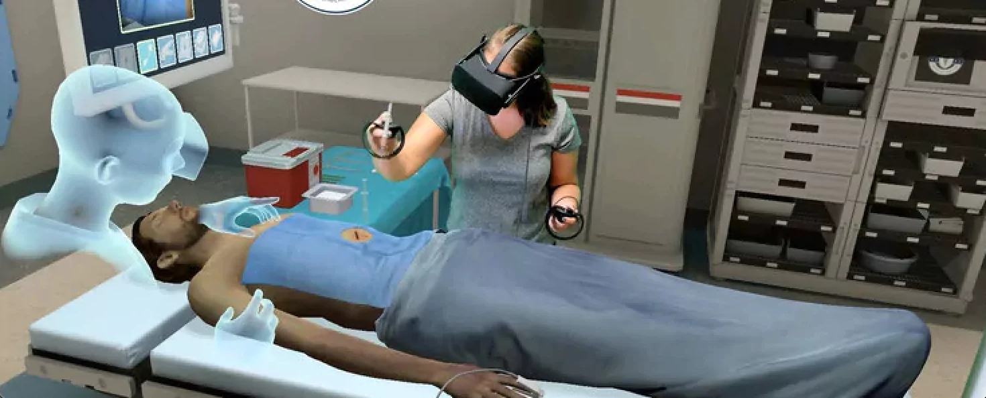
Healthcare
Virtual Reality can be used to train practitioners. It simulate an environment for learning without involving real world situations, for example: a practitioner can easily practice precise operations without being in an emergency or involving human or lives. They can also get comfortable with the hospital environment without additional stress.
VR can also be used for cognitive behavior therapy because it can give patients with phobias and anxieties a safe environment in which to work through their issues.

Slide 7
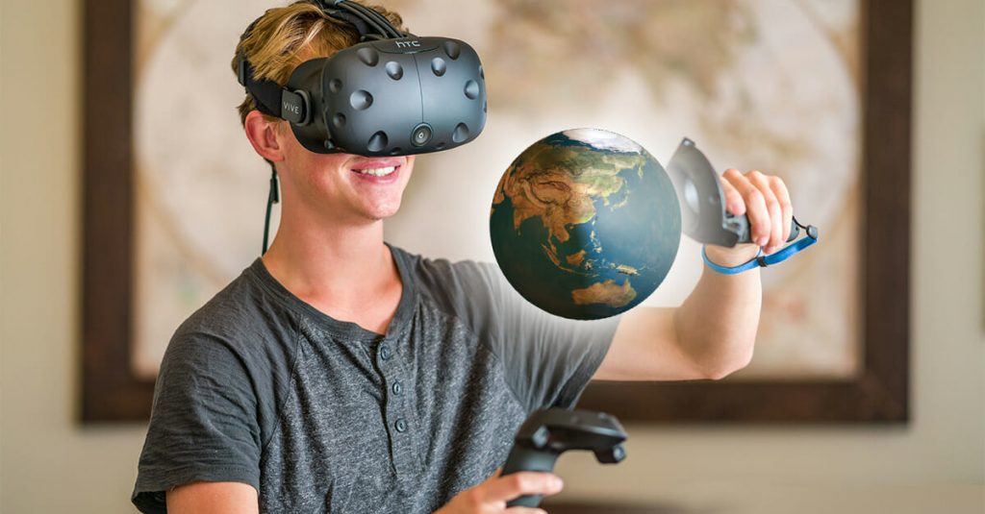
Education
A few schools have used VR for education, employing it for field trips, educational games, and world exploration.
VR can be also be utilized to provide employees with specialized training.

Slide 8
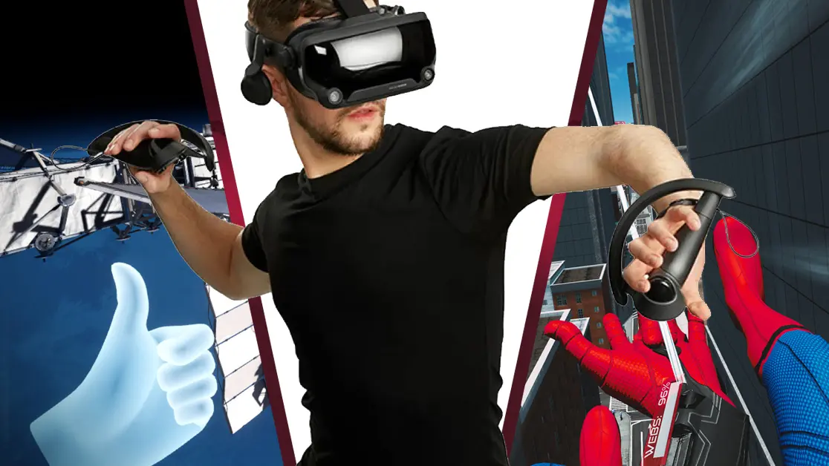
Entertainment
VR can be used to play immersive games for entertainment such as: Half-Life Alyx or No Man’s Sky.
VR can also be used to virtually meet with your friends and family by using apps such as: VR Chat or Rec Room.
VR can also be used at theaters and theme parks to recreate surreal roller coaster rides and movie-like adventures.

Slide 9
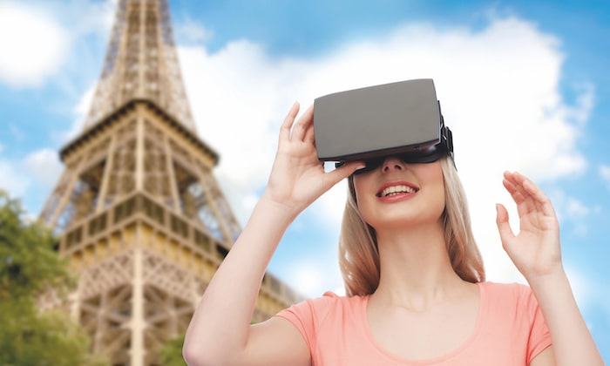
Tourism
VR can enable people to go almost anywhere in the world such as: guided virtual tours of hotels, landmarks, restaurants, countries. So you can try it out before paying to go to it, to go on field trips (as stated before), or to just enjoy the view.
VR tourism can also help disabled people travel the world.

Slide 10
Sources
“Types of VR Headsets: PC VR, Standalone VR, Smartphone VR.” Aniwaa, 6 Aug. 2021, https://www.aniwaa.com/guide/vr-ar/types-of-vr-headsets/.
What Is Virtual Reality? Types, Benefits, and Real-World Examples - G2. https://www.g2.com/articles/virtual-reality.
Daniel Alcanja • 5 min read, and Daniel Alcanja. “Virtual Reality Applications: 10 Industries Using Virtual Reality in 2023.” Trio Developers - Stop Searching. Start Building., https://www.trio.dev/blog/virtual-reality-applications.

