Slide 1
E-Learning
-----------------------------------------------

Slide 2
What is E-Learning?
E-learning, whether done in the classroom or online, is education based on modern communication tools like the computer and its networks, different audio-visual materials, search engines, electronic libraries, and online sites.
In other words, it’s the delivery of learning and training through digital resources.

Slide 3
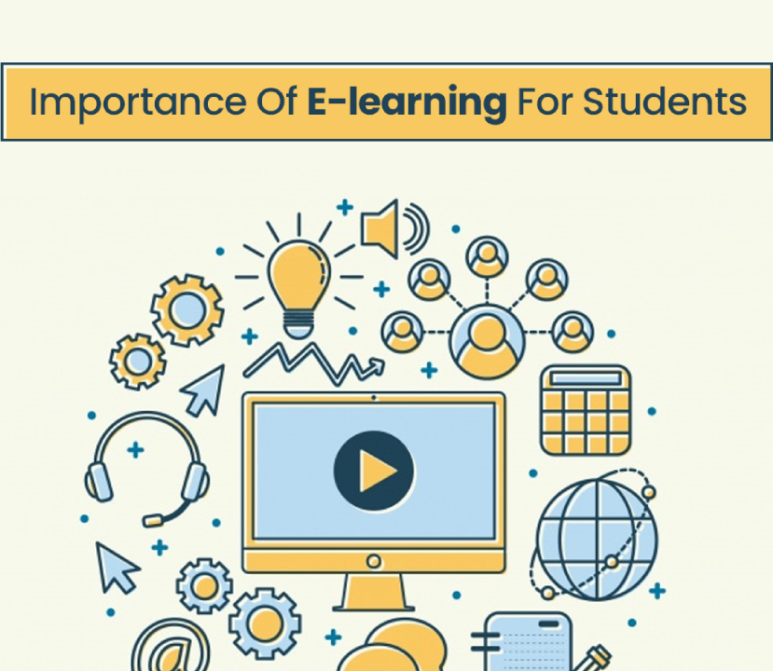
Why is E-Learning significant?
E-Learning helps students in developing and presenting fresh ideas. Students have the opportunity to expand their knowledge and abilities outside of the classroom.
One of the main benefits of e-learning is that it helps in the development of advanced skills in both students and teachers.
There are a list of examples of skills students and teachers might learn.

Slide 4
E-Learning skills
talents in time management.
confidence in your technical skills.
Personal drive and self-motivation.
Excellent communication abilities.
Leadership abilities.
able to operate well in a group environment.

Slide 5
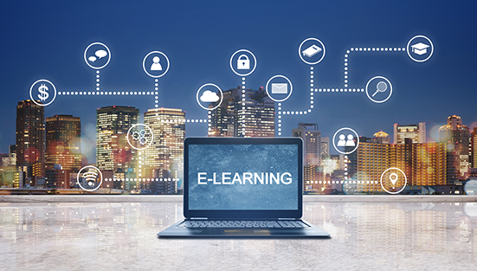
HOW WILL e-Learning impact the future?
eLearning offers complete flexibility, and users can study at their own pace. This helps the learners to set their study time for as long as they can concentrate. Along with flexibility and better time management.
Student will be able to study anywhere anytime!

Slide 6
conclusion
E-Learning is said to have more advantages and be more effective than their standard classes.
E-Learning saves money, time and adds flexibility, new knowledge and fun to any class in any school!

