Slide 1


Virtual Reality

Slide 2
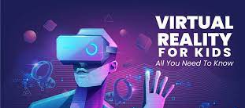

Slide 3


Content
What is virtual reality ?
History
Types of virtual reality
Hard wear used in virtual reality
Applications of virtual reality
Advantage and disadvantage

Slide 4
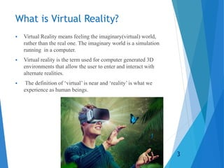

Slide 5

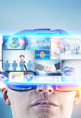
History
More than one person has been involved in the development of this technological system.
In 1950s visionary cinematography Motorn Heiling built a single user console called Sensorama,this enabled the user watch televtion in 3 dimensional ways .

Slide 6
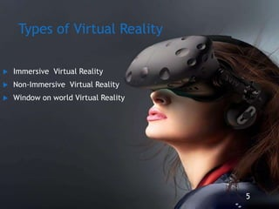

Slide 7
Immersive Virtual Reality
Immersion into virtual reality is a perception of being physically present in a non-physical world .
Elements of virtual enviroment that increase the immersivness of the experience :
-physical feedback .
- physical instracton .

Slide 8
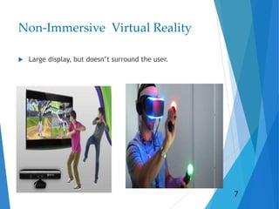

Slide 9
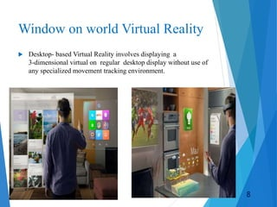

Slide 10
Hard wear used in virtual reality
-Input devises .
Output devises.

Slide 11
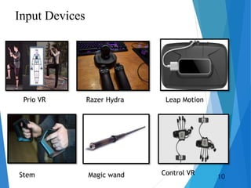

Slide 12
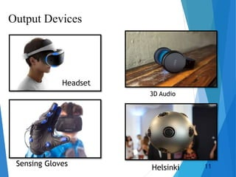

Slide 13
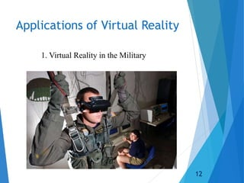

Slide 14
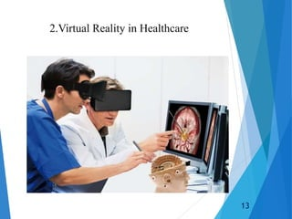

Slide 15
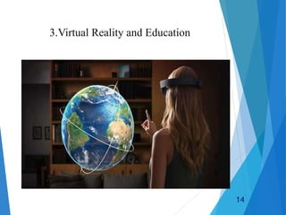

Slide 16
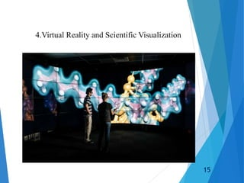

Slide 17
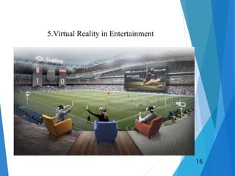

Slide 18

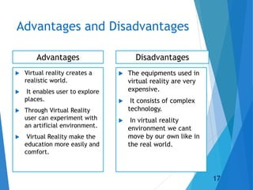

Slide 19
Created by : Abdallah Zatar
Grade :8

