Slide 1
Virtual Reality

Slide 2
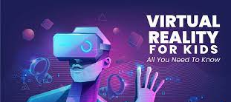

Slide 3
Content
What is virtual reality ?
History
Types of virtual reality
Hard wear used in virtual reality
Applications of virtual reality
Advantage and disadvantage

Slide 5
History
More than one person has been involved in the development of this technological system.
In 1950s visionary cinematography Motorn Heiling built a single user console called Sensorama,this enabled the user watch televtion in 3 dimensional ways .

Slide 6
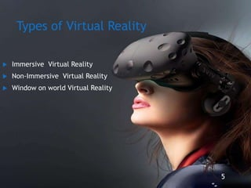

Slide 7
Immersive Virtual Reality
Immersion into virtual reality is a perception of being physically present in a non-physical world .
Elements of virtual enviroment that increase the immersivness of the experience :
-physical feedback .
- physical instracton .

Slide 10
Hard wear used in virtual reality
-Input devises .
Output devises.

Slide 14
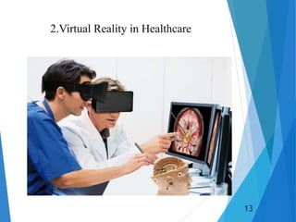

Slide 15
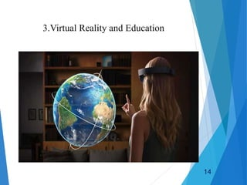

Slide 19
Created by : Abdallah Zatar Grade :8

