Slide 1
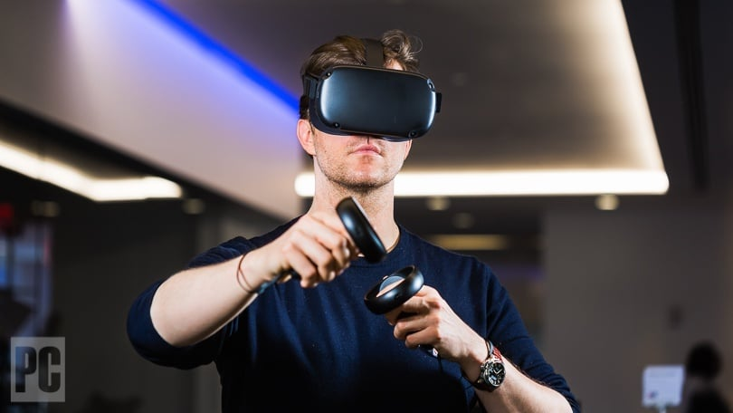
Virtual Reality
By: Kareem al Abdallat

Slide 2
What is virtual reality(VR)?
Virtual reality (VR) is an experience where you put a device on your head that makes you travel to another dimension.

Slide 3
What devices are used for VR?
Devices used for VR are oculus rift, and HTC vive.

Slide 4
What is VR used for?
VR can be used to play games, or to test surgeries for doctors on patients in the games, and driving tests.

Slide 5
Thank you so much!!!

