Slide 1
e-learning
By: Leen Kurdi 8G

Slide 2
what is e-learning?
The delivery of learning and training through digital resources is known as e-learning, or electronic learning. Despite having a traditional education as its foundation, e-learning is delivered using online-connected technological devices including computers, tablets, and even mobile phones.

Slide 3
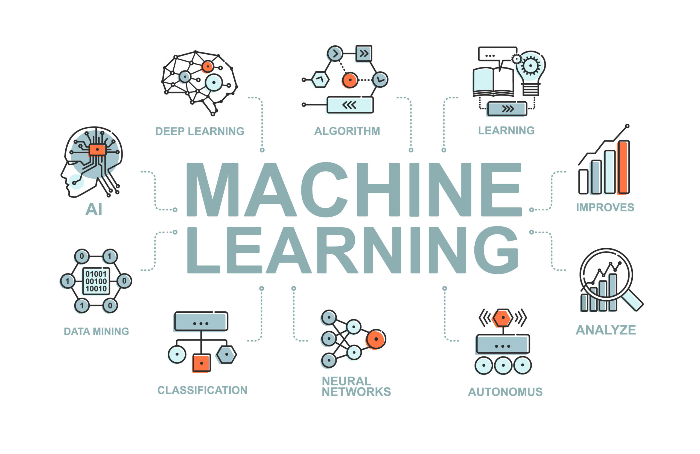
How e-learning works?
It entails self-paced learning using a CD-ROM, a network, an intranet, or the internet. It might include e-mail, online discussion groups, and access to professors through bulletin boards and discussion boards. A live instructor may not even be necessary if it is completely self-contained and includes connections to reference materials.

Slide 4
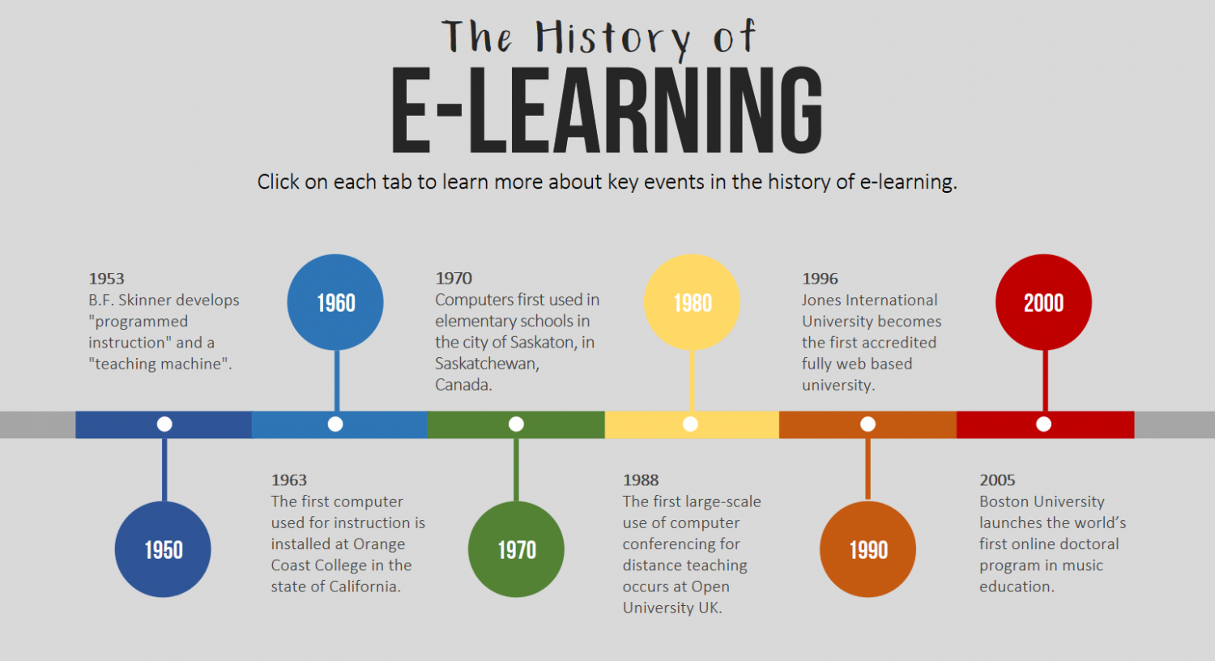
What is the effect of e-learning on the world?
Children can be greatly impacted by the difficulties of online learning; among the most significant issues they encounter are loss of motivation, lack of self-discipline, and the need to study.

Slide 5
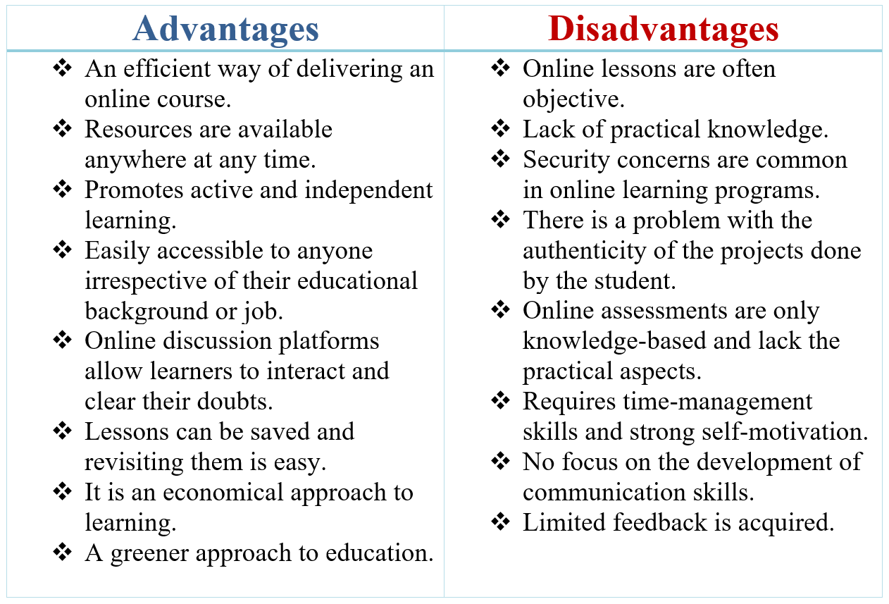

Slide 6
Sources
https://www.google.com/search?q=what+is+e-learning%3F&oq=what+is+e-learning%3F&aqs=chrome..69i57j0i512l9.5699j0j7&sourceid=chrome&ie=UTF-8
How E-learning Works - People | HowStuffWorks
Side Effects Of Online Education - eLearning Industry
Video to conclude e-learning:
https://youtu.be/YBzn1-aDvHs

