Slide 1
VIRTUAL REALITY
by : Sama Kawaach

Slide 2
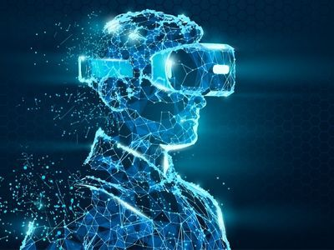
What is virtual reality?
Virtual reality is an artificial world that is computer-generated which gives the user the impression that they are completely immersed in their surroundings. Through the use of a Virtual Reality helmet or headset, this environment is experienced.

Slide 3
What is it often used for?
It is often used in work, its employed to enhance teamwork and employee training while also enabling people to practice safely beforehand.
Examples :
Doctor VR.
sport VR.
Fashion VR.
Military VR.
Education VR.
Job training VR.

Slide 4
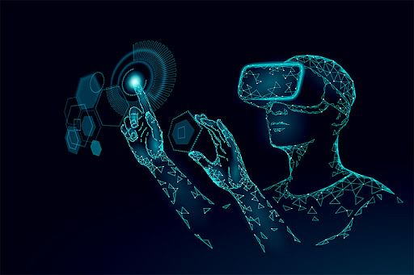
ADVANTAGES OF VIRTUAL REALITY
expand your knowledge base.
Active experience as opposed to only receiving information.
aids in the understanding of difficult concepts, ideas, or theories.
No interruptions while studying.
increases user’s originality and creativity.
increases the capacity of learners to gain knowledge.

Slide 5
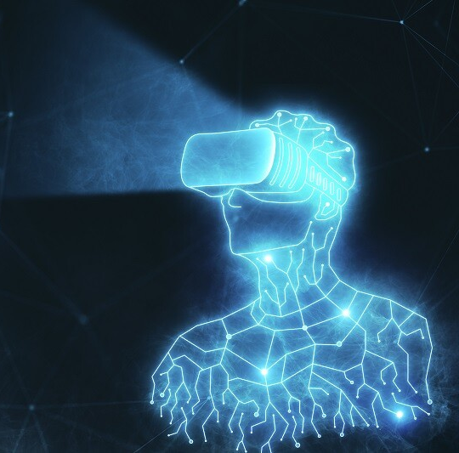
BENEFITS OF VIRTUAL REALITY
Real world surroundings are created using virtual reality. It has the potential to change how education is currently delivered. It can also be used in businesses, healthcare, security, the military, anti-terrorism, raising awareness of traffic accidents, weather forecasting, and other fields.

Slide 6
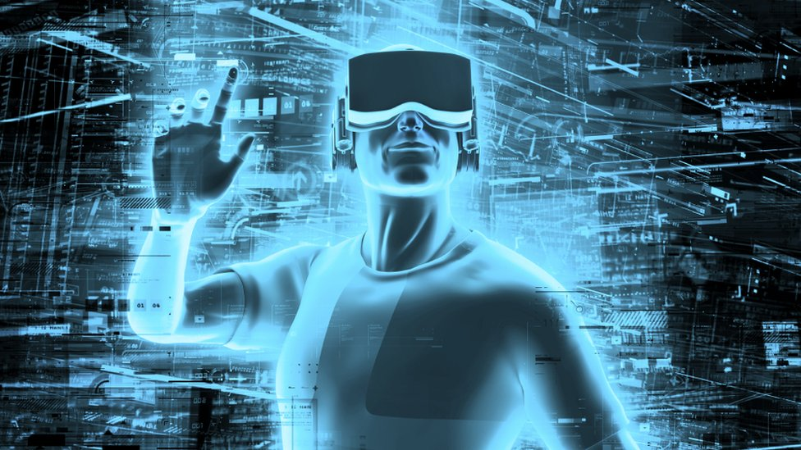

Slide 7
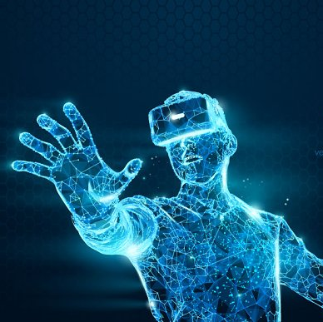
DISADVANTAGES OF VIRTUAL REALITY
Eye strain caused by the VR.
Seizures
Social isolation.
Addiction to the virtual reality.
Not engaged in the real world.
Headaches can be caused by the VR.

Slide 8
RISKS OF VIRTUAL REALITY
Your health could be at serious risk by using the VR. It can cause sensory system disruption and symptoms like nausea, dizziness, sweating, pallor, loss of balance, and more when exposed to it. which are collectively referred to as "virtual reality sickness."

Slide 9
Links used :
https://www.fdmgroup.com/blog/5-exciting-uses-for-virtual-reality/
https://www.marxentlabs.com/what-is-virtual-reality/
https://metaversevrnow.com/vr/advantages-and-disadvantages-of-virtual-reality/#:~:text=One%20of%20the%20main%20disadvantages,moving%20when%20they%20are%20not.
https://insidetelecom.com/the-risks-and-benefits-virtual-reality-presents-to-society/

