Slide 1
APOLLO GUIDANCE COMPUTER
BY: Naya alshami
8E

Slide 2
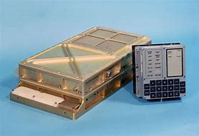
What is the Apollo guidance computer?
The Apollo Guidance Computer (AGC) was a digital computer produced for the Apollo program that was installed on board each Apollo command module (CM) and Apollo Lunar Module (LM). The AGC provided computation and electronic interfaces for guidance, navigation, and control of the spacecraft.

Slide 3
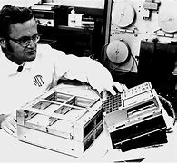
Who is the creator of the Apollo guidance computer?
Dr. Charles Stark Draper
It was developed under the leadership of Dr. Charles Stark Draper at the MIT Instrumentation Lab

Slide 4
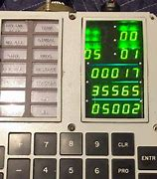
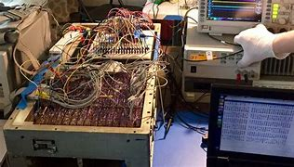
When was the Apollo guidance computer invented
The AGC and its DSKY user interface were developed in the early 1960s for the Apollo program by the MIT Instrumentation Laboratory and first flew in 1966.
Discontinued: July 1975; 47 years ago
Introduced: August 1966; 56 years ago
Manufacturer: Raytheon

Slide 5
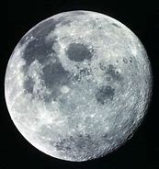
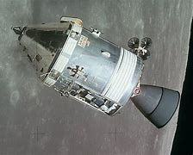
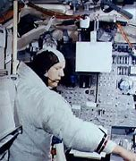
Where did the Apollo guidance computer landed?
The AGC was used during the Apollo human spaceflight program and was instrumental in Apollo 11’s landing on the moon, which is considered to be one of the greatest scientific and technological achievements of all time. Both the AGC and its user interface named DSKY were developed in the early 1960’s by the MIT Instrumentation Laboratory.

Slide 6
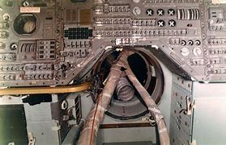
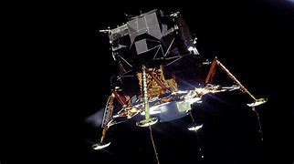
How much does the Apollo guidance computer weight?
At first glance, it appeared like a brass suitcase in two parts, measuring a total of 24 × 12.5 × 6.5 in (61 × 32 × 17 cm) and weighing in at 70 lb (32 kg). Inside, it isn't even very impressive by modern computer standards, having about as much oomph as a smart bulb with a total of about 72 K of memory and a 12-microsecond clock speed

Slide 7
How much does the Apollo guidance computer cost?

Slide 8
4 fun facts about the Apollo computer guidance
The Apollo Guidance Computer was the first computer ever built whose operation was based entirely on silicon integrated circuits.
The drive to create the Apollo Guidance Computer’s software essentially established software engineering as an autonomous field. In fact, Margaret Hamilton, one of the principal software engineers who worked on the project, is credited with coining the term “software engineering.”
The DSKY (pronounced “DIS-kee”), or display and keyboard system that astronauts used to interact with the Apollo Guidance Computer was an early version of the keyboard and GUI.
The AGC’s processor was many thousands of times less powerful than the processor in your smartphone, yet it was still able to land people on the moon.

Slide 9
Here is a video if you like to watch
https://www.bing.com/videos/search?q=apollo+guidance+computer&&view=detail&mid=&&FORM=VRDGAR&ru=%2Fvideos%2Fsear3B2AA11C76F6EAA5BF0F3B2AA11C76F6EAA5BF0Fch%3Fq%3Dapollo%2Bguidance%2Bcomputer%26FORM%3DHDRSC3

Slide 10
Thank you

