Slide 1
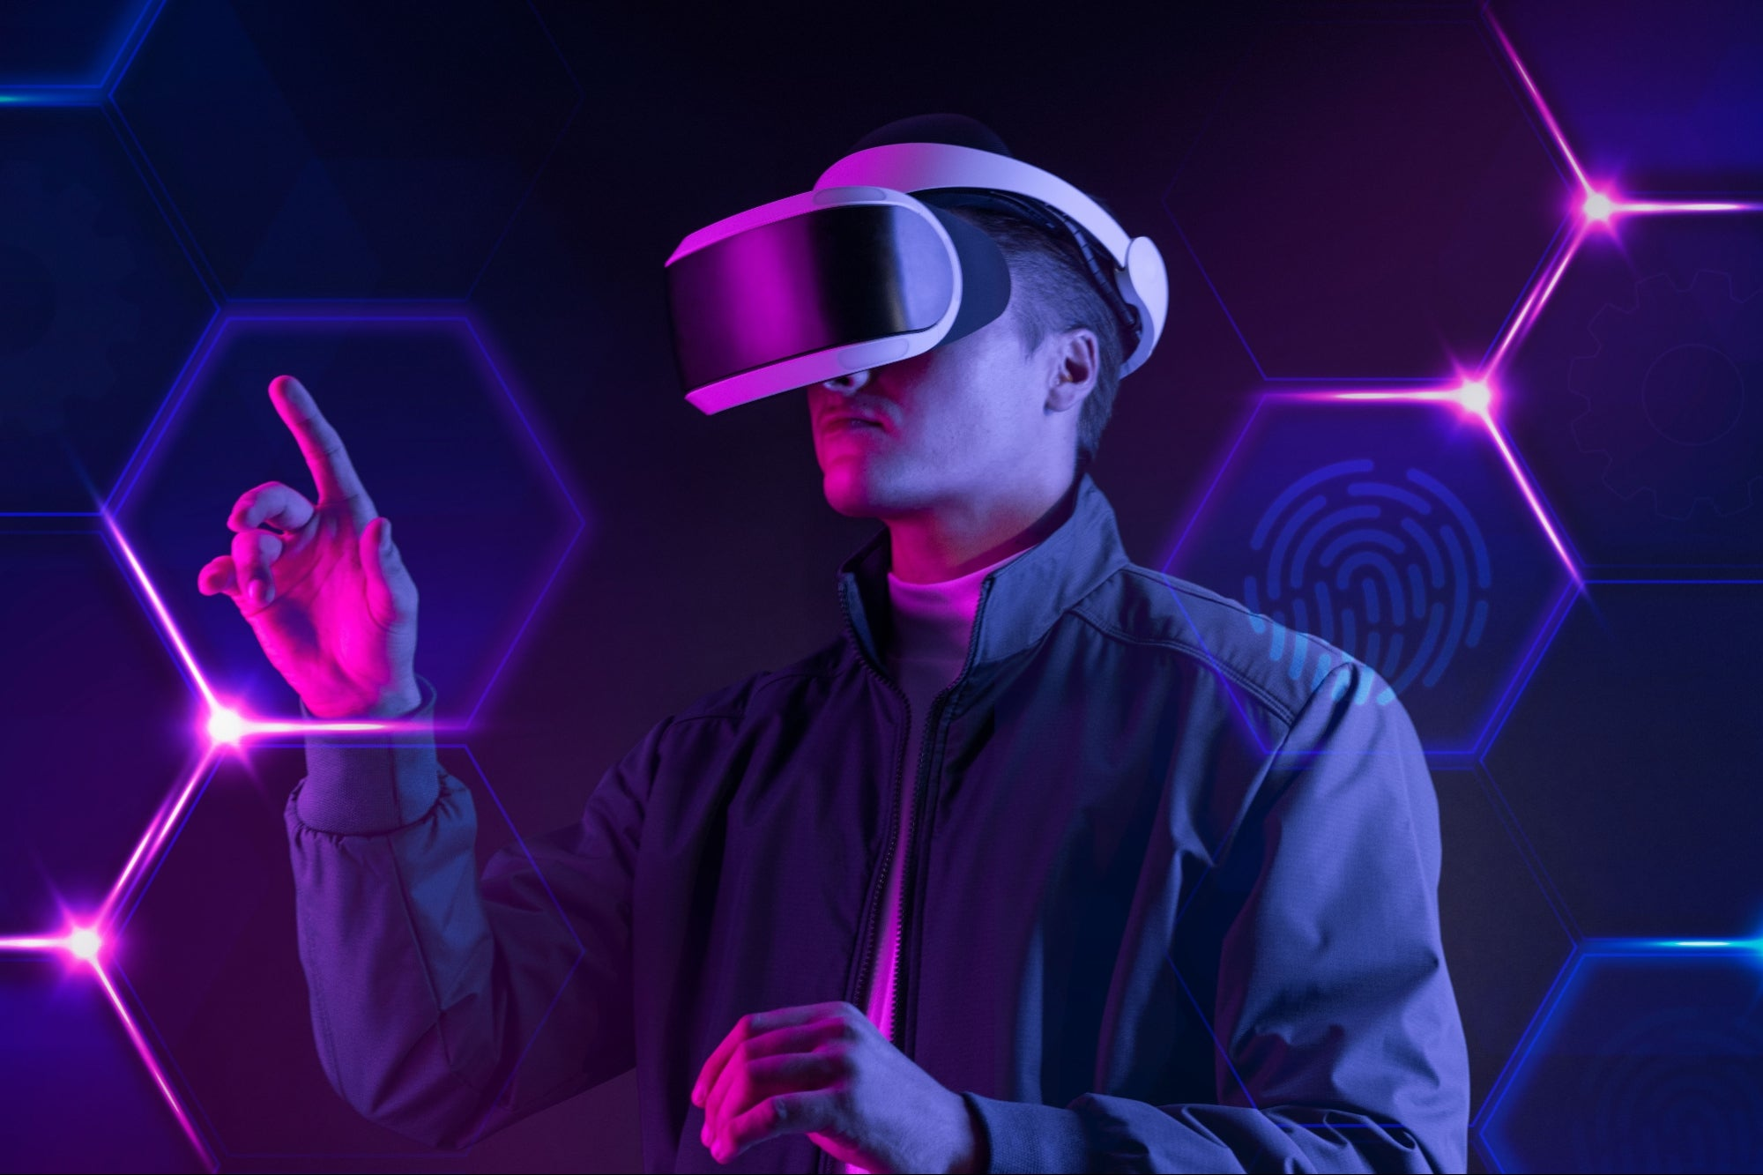
Virtual Reality
By Yahia Abu Hadba
8-C

Slide 2
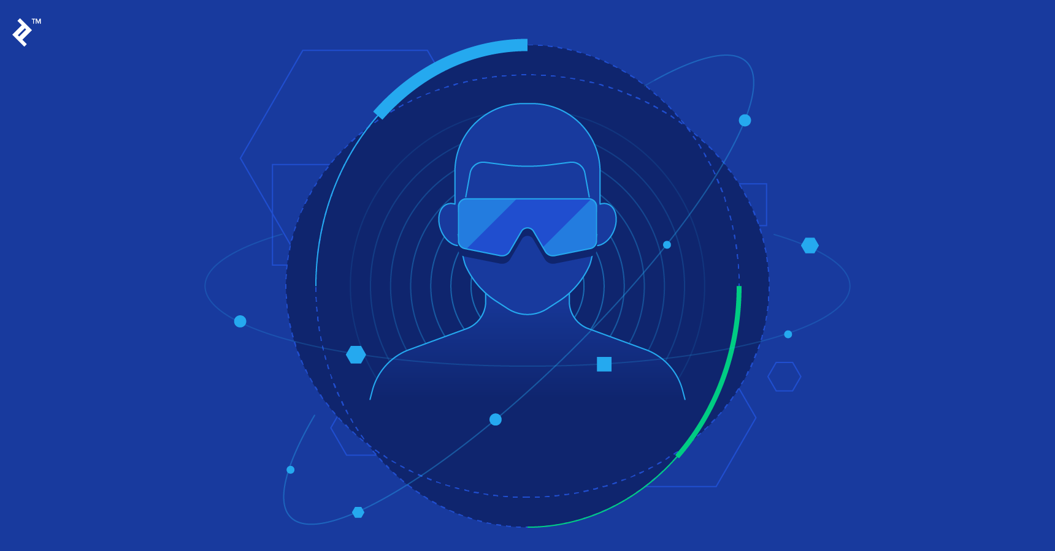
What is Virtual Reality ?
Virtual reality is the term used to describe a three-dimensional, computer generated environment which can be explored and interacted with by a person. That person becomes part of this virtual world or is immersed within this environment and whilst there, is able to manipulate objects or perform a series of actions.

Slide 3
What is Virtual Reality used for ?
Virtual reality is most commonly used in entertainment applications such as video games, 3D cinema, amusement park rides including dark rides and social virtual worlds.

Slide 4
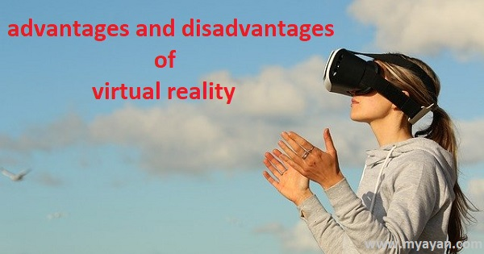

Slide 5

Advantages of Virtual Reality : :
Virtual Reality creates the real world around us. It can transform the way of education which is provided nowadays. It can be also used in industries, medical, security, military, Anti-terrorism, Traffic accidents awareness, Weather forecasting, etc.

Slide 6
Disadvantages of Virtual Reality :
One of the main disadvantages is the health risks associated with using VR headsets. These headsets can cause eye problems, such as eyestrain, headaches, and nausea. They can also cause motion sickness because they can make users feel like they are moving when they are not.

Slide 7
Sources :
https://www.vrs.org.uk/virtual-reality/what-is-virtual-reality.html
All the information is stated in this website.

