Slide 1
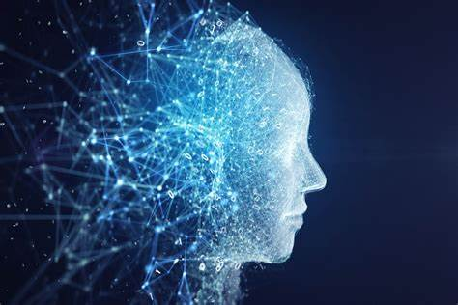
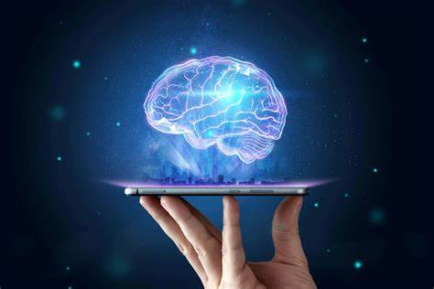
Artificial intelligence(AI)
Sanad Mraybeh
8E

Slide 2
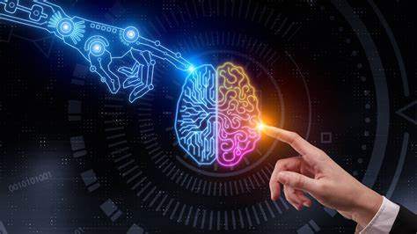
What is Artificial Intelligence?
Artificial intelligence (AI) refers to the simulation of human intelligence in machines that are programmed to think like humans and copy their actions.
The phrase can also be used to refer to any computer that demonstrates characteristics of the human mind, like learning and problem solving.

Slide 3
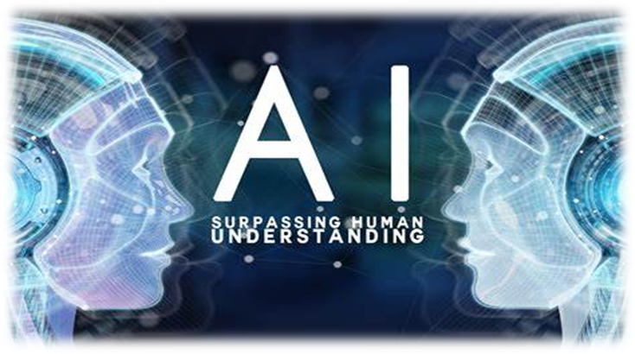
What are the 6 uses of Artificial intelligence?
voice recognition
self driving cars
chatbots
online shopping
streaming services
healthcare technology

Slide 4
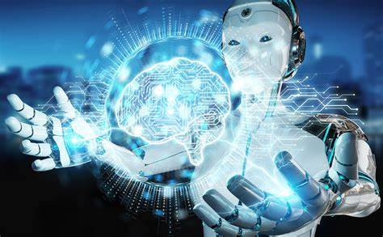
Advantages of Artificial intelligence:
1. Reduction in Human Error
2. Zero Risks
3. 24/7 Availability
4. Digital Assistance
5. New Inventions
6. Unbiased Decisions
7. Perform Repetitive Jobs
8. Daily Applications
9. AI in Risky Situations

Slide 5
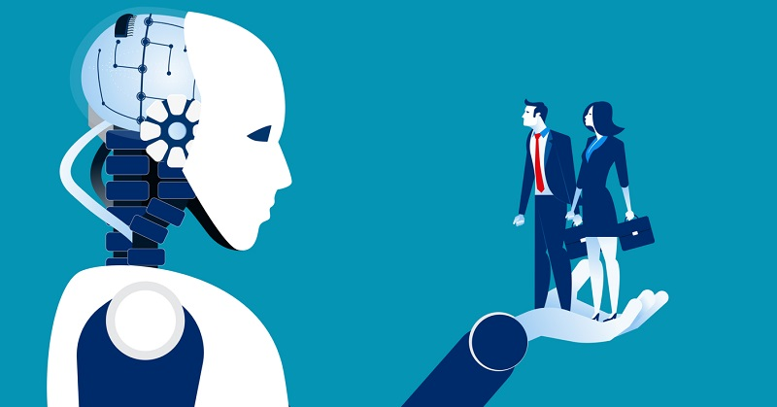
Disadvantages of Artificial Intelligence:
1. High Costs
2. No creativity
3. Unemployment
4. Make Humans Lazy
5. No Ethics
6. Emotionless

Slide 6
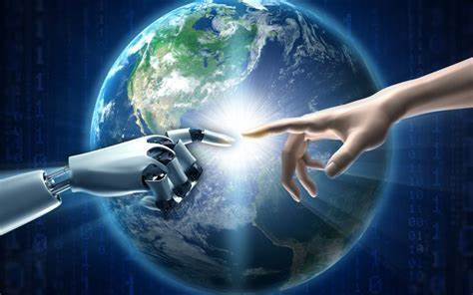
What is the impact of artificial intelligence on our life?
Every day, artificial intelligence improves the effectiveness of our lives.
Many applications and services that assist us in performing routine tasks, including contacting friends or utilizing email programs, are powered by AI.

Slide 7
Citations:
Duggal, N. (2023, January 27). Top advantages and disadvantages of Artificial Intelligence [2023 edition]. Simplilearn.com.
Admin. (2022, December 8). Top 7 different uses of Artificial Intelligence. Java Assignment Help.
Frankenfield, J. (2023, January 19). Artificial Intelligence: What it is and how it is used.

