Slide 1
Virtual reality
By: Laith Naber

Slide 2
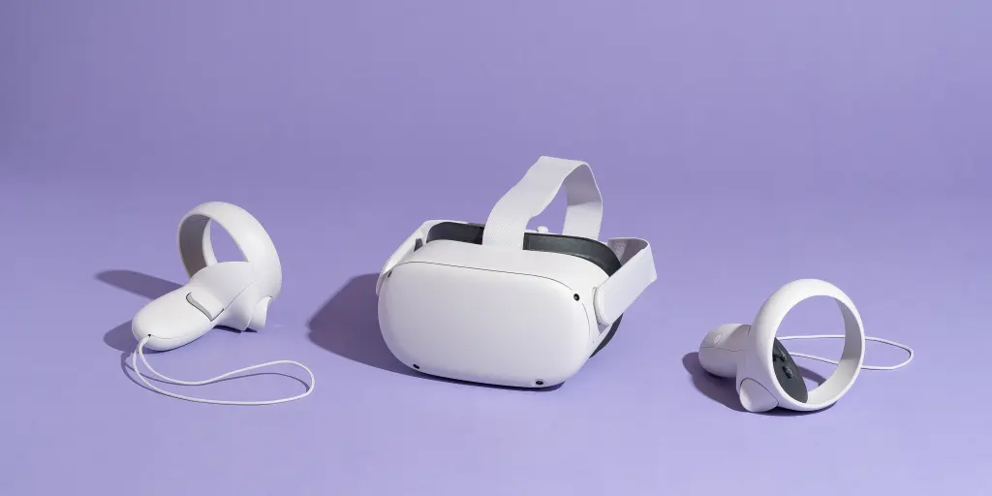
What is virtual reality?
Virtual Reality is a computer-generated environment with scenes and objects that appear to be real, making the user feel they are immersed in their surroundings.

Slide 3
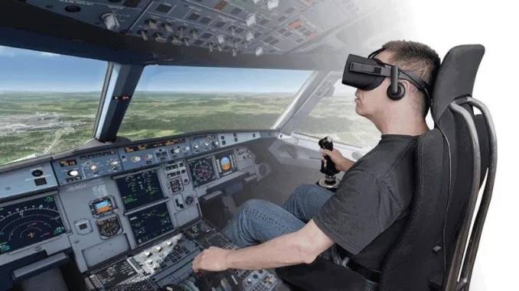
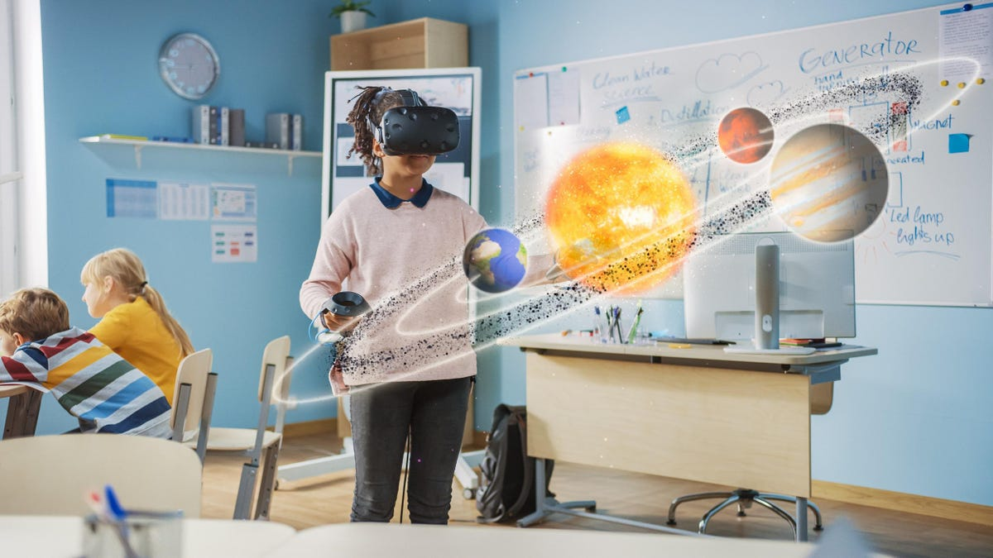
What is the importance of virtual reality?
Virtual reality can help in many jobs all around the world like being a pilot, surgeon, architect and much more.
Virtual reality is a important tool for treating people who have diseases like PTSD and anxiety disorders, dementia, and autism.
A person can use virtual reality for education or training.

Slide 4

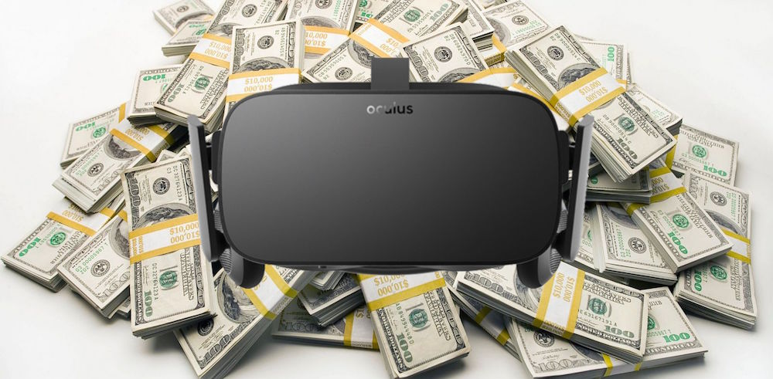
Advantages and disadvantages of virtual reality
Advantages:
Safe practice/simulation
Very detailed/looks very real
Entertaining
Disadvantages:
Expensive
Obsession
Eye strain

Slide 5
Text:
https://bernardmarr.com/the-effects-of-virtual-reality-vr-on-society/#:~:text=Right%20now%2C%20VR%20is%20being,after%20an%20illness%20or%20injury!
https://honestproscons.com/pros-and-cons-of-virtual-reality/
Photos:
https://www.nytimes.com/wirecutter/reviews/best-standalone-vr-headset/
https://www.linkedin.com/pulse/virtual-reality-future-entertainment-bernard-marr
https://uploadvr.com/community-download-virtual-reality-expensive/
https://www.forbes.com/sites/bernardmarr/2021/07/23/10-best-examples-of-vr-and-ar-in-education/?sh=98f41a1f482e

