Slide 1
Computer Simulations
By: sanad kakish

Slide 2
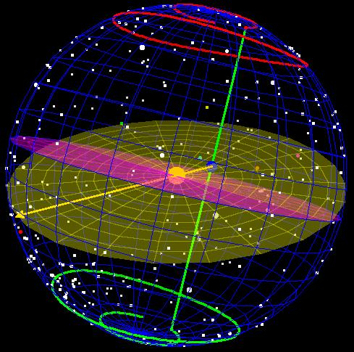
What are computer simulations?
A computer simulation is the usage of a computer for the imitation of a real-world process or system. It is a way of saying that it is like a game you play on your computer.

Slide 3
Advantages for using simulations:
Can speed things up or slow them down to see changes over long or short periods of time.
Can be safer and cheaper than the real world.
They can be done anywhere.
Experiments can be done many times.
They speed up processes that take a long time.

Slide 4
Disadvantages of using simulations:
Time may be needed to make sense of the results.
Mistakes may be made in the programming or rules of the simulation or model.
The cost of a simulation model can be high.

Slide 5
Thank you for listening
https://www.techopedia.com/definition/17060/computer-simulation
https://www.bbc.co.uk/bitesize/guides/zyqfr82/revision/3

