Slide 1
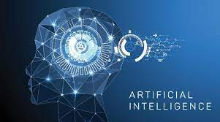
Artificial intelligence
Made By: Rajai El Ghoury

Slide 2
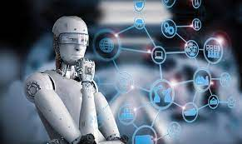
What is Artificial Intelligence?
The capacity of a machine to exhibit human-like skills, such as thinking, learning, planning, and creativity, is known as artificial intelligence (AI).
AI gives technological systems the ability to comprehend their surroundings, interact with what they see, solve issues, and take action to reach a certain objective. Data that has already been prepared or acquired by the computer's sensors is given to it, which it then analyses and replies to.
By evaluating the results of past behavior and acting independently, AI systems are able to change their behavior to some extent.

Slide 3
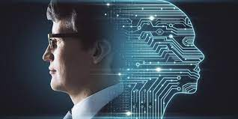
Why is Artificial Intelligence Important?
AI is significant because, in some circumstances, it can outperform people at activities and because it may provide businesses with previously unknown insights into their operations.
AI technologies frequently do work fast and with very few mistakes, especially when it comes to repetitive, detail-oriented activities like reviewing a large number of legal papers to verify key fields are filled in correctly.

Slide 4
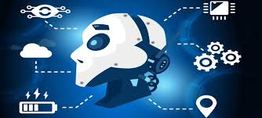
What are some examples of Artificial Intelligence?
Some examples are:
Text Editors or Autocorrect
Facial Detection and Recognition
Digital Assistants
E-Payments
Chatbots

Slide 5
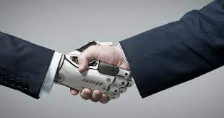
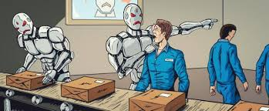
What are the Advantages and Disadvantages of Artificial Intelligence?
Some Advantages are:
Reduction in Human Error
Zero Risks
24x7 Availability
Some Disadvantages are:
High Costs
Unemployment increasing
No creativity

Slide 6
Thanks For Listening!

Slide 7
Sources
https://www.europarl.europa.eu/news/en/headlines/society/20200827STO85804/what-is-artificial-intelligence-and-how-is-it-used#:~:text=Definition%20of%20artificial%20intelligence,to%20achieve%20a%20specific%20goal
https://www.techtarget.com/searchenterpriseai/definition/AI-Artificial-Intelligence#:~:text=Artificial%20intelligence%20is%20the%20simulation,speech%20recognition%20and%20machine%20vision
https://www.simplilearn.com/advantages-and-disadvantages-of-artificial-intelligence-article
https://www.iotforall.com/8-helpful-everyday-examples-of-artificial-intelligence

Slide 8
Sources (Pictures)
https://www.srimax.com/2020/01/01/importance-of-artificial-intelligence/
https://www.mckinsey.com/capabilities/operations/our-insights/artificial-intelligence-construction-technologys-next-frontier
https://www.forbes.com/sites/cognitiveworld/2018/08/07/job-loss-from-ai-theres-more-to-fear/?sh=50b6f8e23eba
https://humanerrorsolutions.com/problems-and-solutions-ai-and-human-error/
https://corporatefinanceinstitute.com/resources/data-science/artificial-intelligence-ai/

Slide 9
Sources (Pictures)
https://worldtechjournal.com/artificial-intelligence-types-applications/

