Slide 1
E-LEARNING
MADE BY DAREEN ALFARAH

Slide 2
WHAT IS e-LEARNING
E-learning, often known as online learning or electronic learning, is the process of learning through electronic medias and technologies. E-learning is described as "learning that is enabled electronically" in plain English. E-learning typically takes place online, so students can access their course materials whenever they want. Online courses, degrees, and other forms of online learning are the most common ways that e-learning occurs.

Slide 3
BENEFITS OF e-learning
There are MANY BENEFITS FOR e-LEARNING
Here are the two MOST COMMON BENEFITS:
SPEED:
E-Learning speeds up the process for learners who go at a quicker pace, saving time and resources for the ultimate in efficiency. E-Learning can also allow learners to test out of material they've already learned, also saving time.
EXPENSES:
When E-Learning is used instead of more traditional training techniques, expenses are reduced. Because of mobile learning, participants in E-Learning can take part using their own technology at no additional expense. Additionally, you save money on travel expenses and instructors can record and share their sessions at any time.

Slide 4
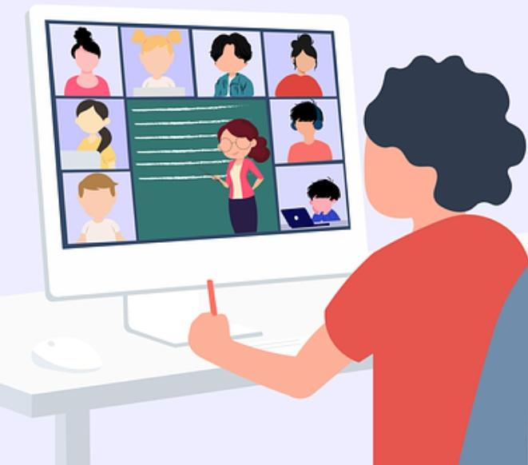
Disadvantages of e-learning
There are also multiple disadvantages of e-learning
Here are two common disadvantages:
HEALTH
Eye strain can result from focusing at a screen for an extended period of time. The blue light from a screen causes you to blink less, and the movement of the screen makes it more difficult for your eyes to focus. It can be more difficult because people frequently don't hold the screen at the appropriate distance or angle.
LACK OF MOTVATION
Lack of face-to-face interaction with the teacher makes it difficult for pupils to provide feedback, and may make them feel less under pressure. Lack of pressure is bad because it makes pupils’ motivation decrease dramatically. Even though many people dislike being constantly pressured by educators, it works wonders for increasing student commitment.

Slide 5
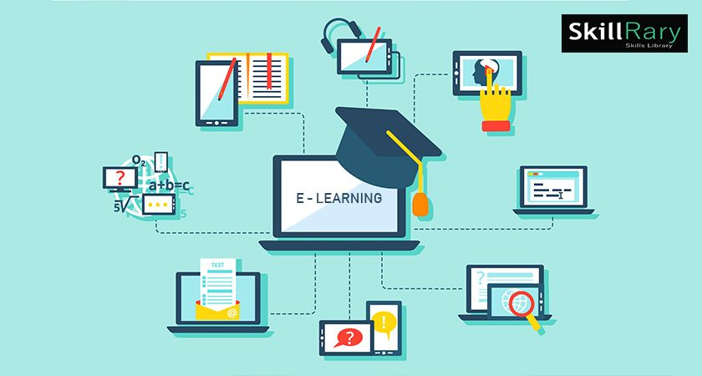

Slide 6
Links used https://elearningindustry.com/reasons-why-elearning-is-beneficial https://share.upmc.com/2019/01/screen-time/#:~:text=Spending%20too%20many%20hours%20staring,which%20can%20cause%20added%20strain https://e-student.org/disadvantages-of-e-learning https://www.montgomerycollege.edu/academics/online-learning/distance/advantages-and-disadvantages-online-courses.html https://elmlearning.com/blog/10-reasons-elearning-works/#:~:text=eLearning%20speeds%20up%20the%20process,already%20learned%2C%20also%20saving%20time https://www.learnupon.com/blog/what-is-elearning/#:~:text=eLearning%2C%20or%20electronic%20learning%2C%20is,are%20connected%20to%20the%20internet

