Slide 1
Virtual reality(VR)
Samer Alfanek 8C

Slide 2
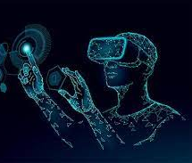
What is virtual reality
Virtual Reality (VR) is a computer-generated environment with scenes and objects that appear to be real, making the user feel they are immersed in their surroundings.

Slide 3
Advantages of virtual reality
Provides Outstanding Visualizations That Aren't Possible In The Traditional Classroom
Creates Interest
Increases Students' Engagement
Improves The Quality Of Education In Different Fields

Slide 4
Disadvantages of virtual reality
VR is a fragmented market
Content creation tends to be customized and, oftentimes, expensive
VR is often an isolating, individual experience – it takes you somewhere else, a place removed from the existing environment
VR is slow for demos

Slide 5
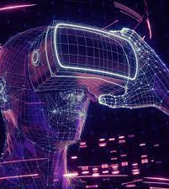
Impact of VR on the society
Right now, VR is being used to detect glaucoma, schizophrenia, and Alzheimer's disease. It has also begun to establish itself as a useful tool for treating PTSD and anxiety disorders, dementia, and autism. VR can even help people complete their physical rehabilitation after an illness or injury.

Slide 6
resources
https://www.iberdrola.com
https://elearningindustry.com
https://www.encora.com
https://bernardmarr.com

