Slide 1
Simulation
By faiz uzaizi

Slide 2
What is simulation ? A simulation is a program that imitates something you can see or experience in real life , simulation is like a game you can play on your computer

Slide 3
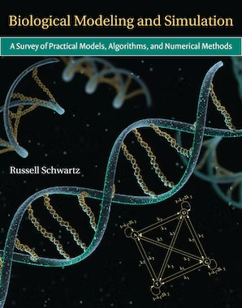
Use of simulation in biology
Biology Simulations helps students learn about biology and practice data analysis skills. These simulations allow students to experiment with concepts that may take too much time or too many resources to complete in a traditional science lab setting. While simulations cannot replace real-world experiences, they are a useful tool in both scientific research and education.
​

Slide 4
Advantages of simulations in biology
Main advantages of simulations biology include:
They can be done anywhere
Experiments can be done any where
They can be used in situations where a real experiments is difficult

