Slide 1
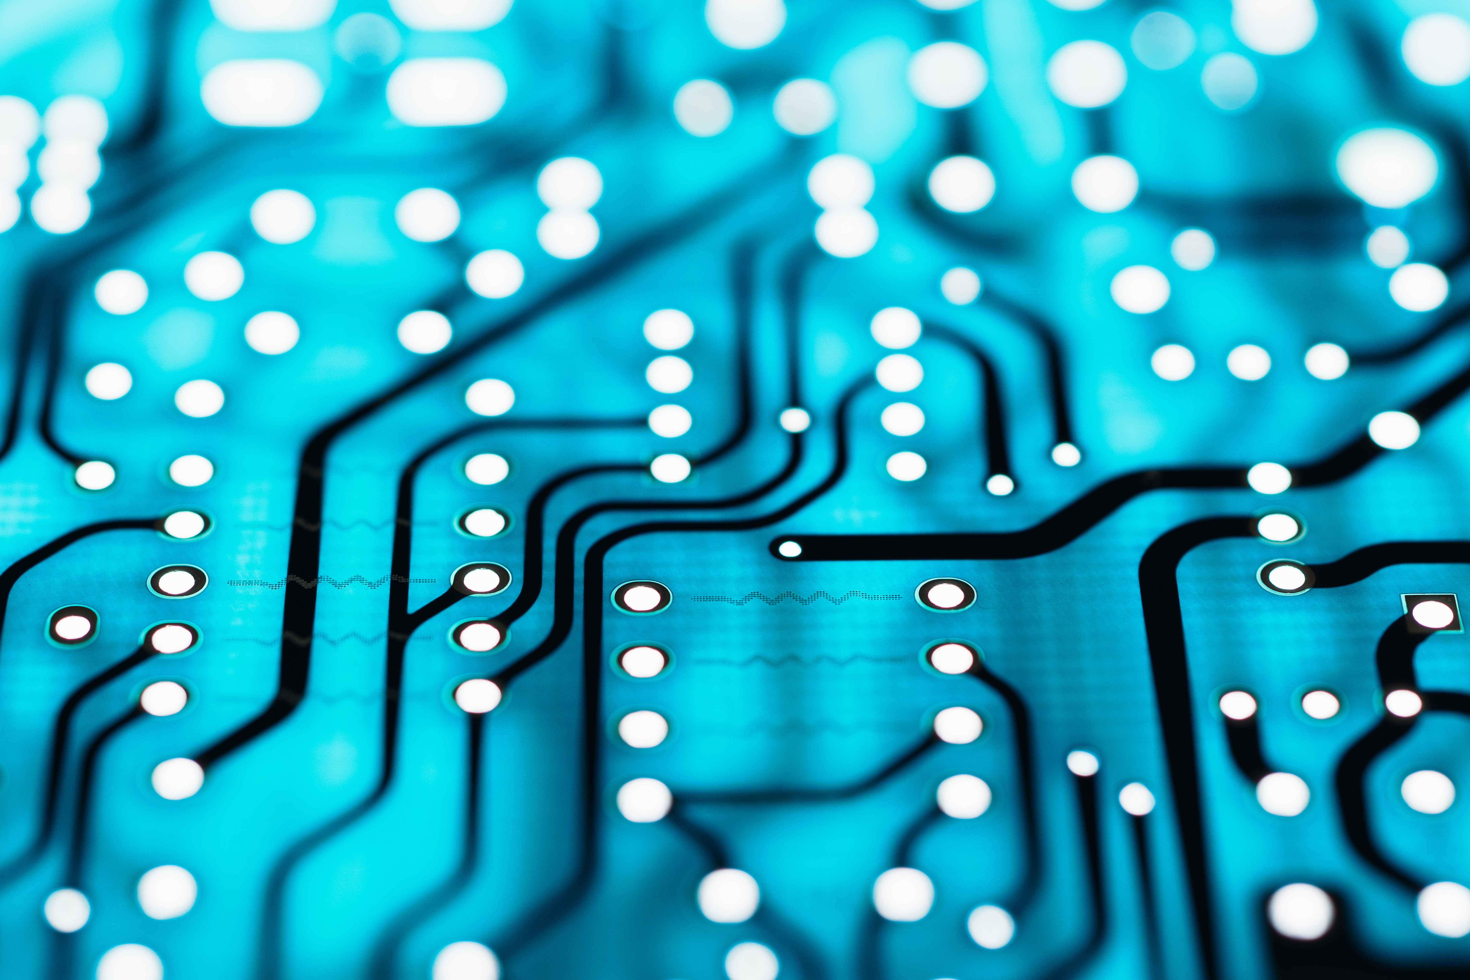
THE WORLD OF ARTIFICIAL INTELLIGANCE.
BY: FARIS SAWALHA.

Slide 2
What is artificial intelligence?
It is a clone of human intelligence processed by Machinery, mostly computer systems which help businesses and people on a daily basis with simple or hard tasks.

Slide 3
History of AI
In 1951, a man by the name of Christopher Strachey created the first working AI program and ever since then, artificial intelligence has come far and developed throughout the years until now in 2023.

Slide 4
There are a lot of good uses for ai here are some of the most important:
AI is very important in cyber security.
Education and learning of school students and university students.
Everyday applications we use on our phones, computers or any electronic device.
Ai helps prevent fraud online.

Slide 5
advantages and disadvantages of ai
Advantages
Disadvantages
Ai has 0 risks
Available 24/7
Able to create new inventions
Reduces error
Costs a lot of money
Can make humans lazier
Takes over peoples jobs leading to unemployment
Can lead to damages if given to the wrong people

Slide 6
At the end we can all agree that life without artificial intelligence would be different and for some people it would be harder, because AI is very useful in a daily basis (slide 4) even though it has disadvantages.
Thank you for listening

