Slide 1
Simulations
Rakan Nahhas

Slide 2
What are simulations?
Simulations allow us to experiment with different scenarios and test different options in a controlled environment.
Simulations are used in a variety of fields including engineering, science, finance, and medicine.

Slide 3
Examples of simulations
Engineering: Simulating the flow of fluid in pipes
Science: Simulating the movement of planets in a solar system
Finance: Simulating market trends and stock prices
Medicine: Simulating the effects of a new drug on the human body

Slide 4
Advantages of simulations
Cost-effective: Simulations are often less expensive than real-world testing.
Safe: Simulations allow us to test dangerous or harmful scenarios without putting people at risk.
Time-saving: Simulations can be run much faster than real-world tests, allowing us to gather data and make decisions quickly.

Slide 5
Disadvantages of simulations
Limited accuracy: Simulations can only be as accurate as the model used to represent the real-world system.
Complexity: Simulations can be complex and difficult to understand, especially for those without specialized training.
Limited scope: Simulations are limited by the data and information available and may not be representative of all real-world scenarios.

Slide 6
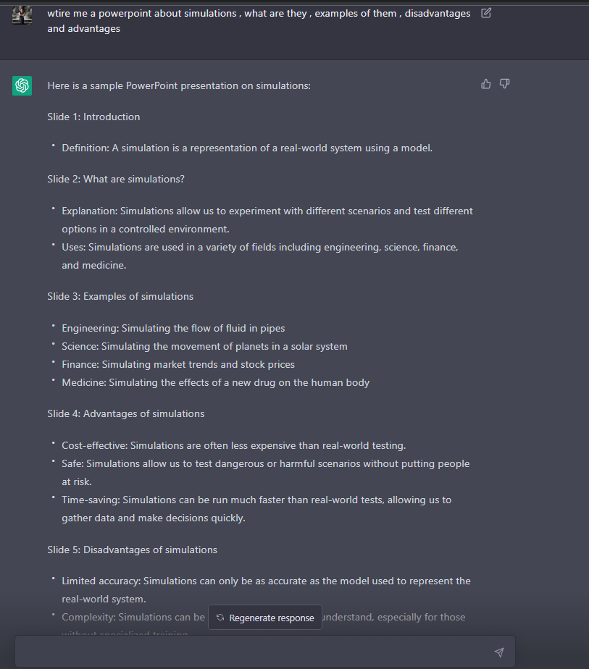
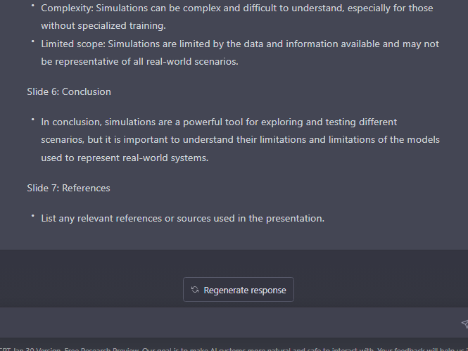
This power point was made by the ai chat gpt
https://chat.openai.com/chat

