Slide 1
Virtual Reality
By: Christina Batshone
Grade: 8D

Slide 2
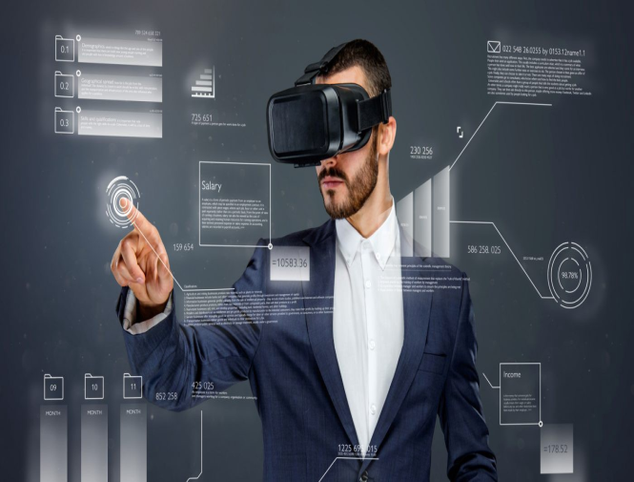
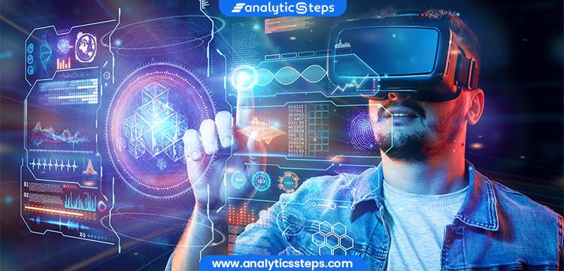
Introduction
Virtual reality is the use of computer technology to generate stimulated worlds. Virtual reality replaces a normal screen device into a three-dimensional experience, which immerses in the users to make them interact with 3d worlds.

Slide 3
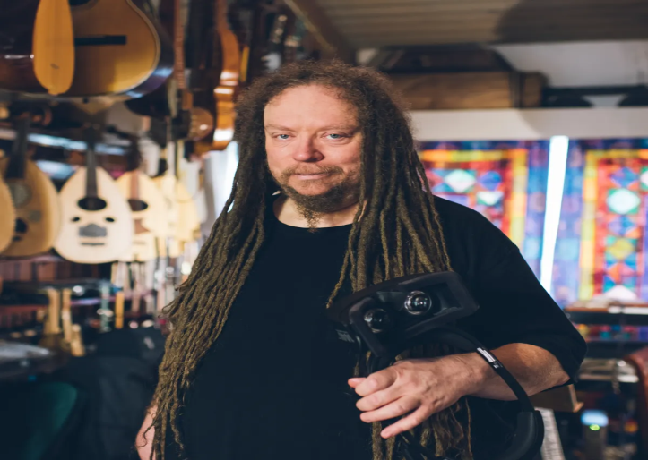
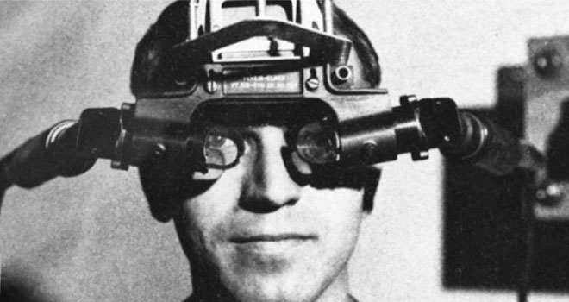
Who created virtual reality?
Ivan Sutherland created virtual reality in the century 1965, he was a computer scientist, presented his vision of the Ultimate Display. In the mid-1980s Jaron Lanier started developing the features, gears, gloves and goggles. Thats when he started using the term “virtual reality”.

Slide 4
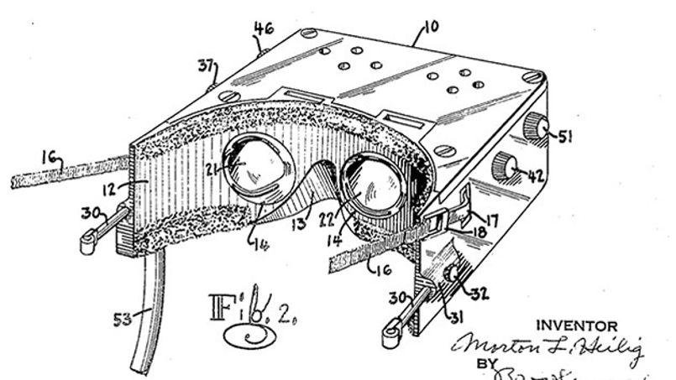
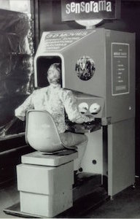
Why was virtual reality created?
device was made to help with military to help track systems linked to cameras, as well as the VR lets users explore and interact with virtual surroundings, as it perceives through users senses.

Slide 5
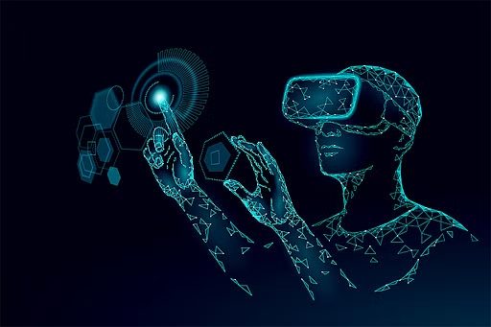
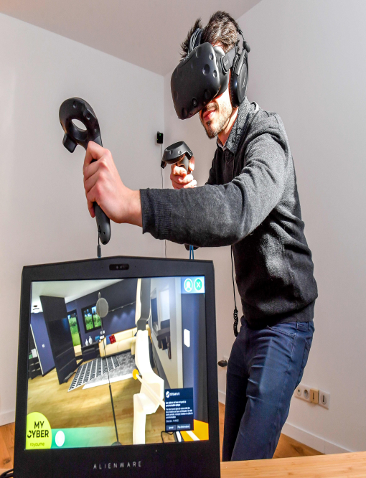
Advantages of virtual reality
Virtual reality helps in exploring places without actually being there.
Improves the education system.
It creates a realistic world.
Helps in providing knowledge.
Increases interest and engagement toward a subject.
Makes people experience different realities of life.

Slide 6
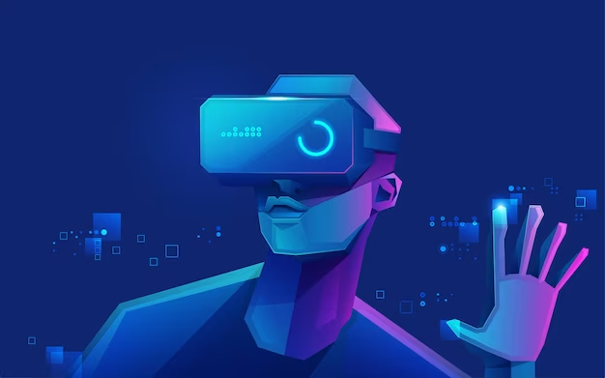
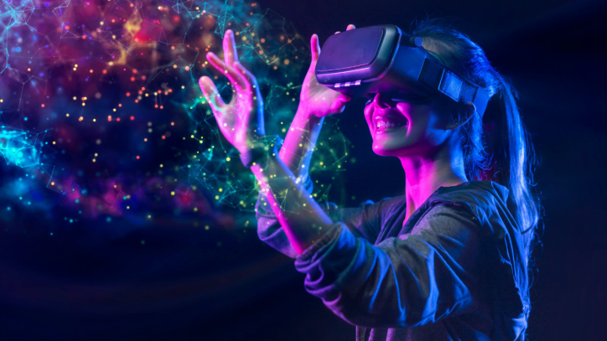
Disadvantages of virtual reality
Implementation is expensive.
Only develop technical skills no interaction is there.
You can get easily addicted to virtual reality.
Not engaged in the real world.
Psychological damage.
Impact on the real human body.

Slide 7
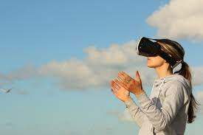
Conclusion about virtual reality
Virtual reality can be a great experience in our lives, it can enhance learning skills and more! Too much of virtual reality can be a problem where you could get addicted and may never want to leave the stimulated world.

