Slide 1
E-learning
Done by: Jad Yazbak

Slide 2
What does e-learning mean?
A learning system based on formalized teaching but with the help of electronic resources is known as E-learning. While teaching can be based in or out of the classrooms, the use of computers and the Internet forms the major component of E-learning.

Slide 3
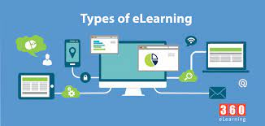
Types of e-learning:
Lesson-based learning.
One-on-one learning.
Group learning.
Course-based learning.
Video-based learning.
Article-based learning.
Self-paced learning.
App-based learning.

Slide 4
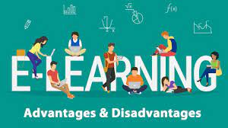
Advantages and disadvantages of e-learning:
Advantages:
You can learn where and when you want to.
You can use the type of media you prefer.
Teachers have more time to help individual students.
Disadvantages:
Some people prefer to learn in a class with other people
It can be difficult to work without a strict timetable
More work

Slide 5
Multimedia and e-learning
In your classroom you have books to learn from. Your teacher gives you information. Sometimes this information is given to the whole class using the boared.at other times, you might work in small groups around a table. Your teacher may show videos or give a presentation using projector.

Slide 6
Some of the media used in e-learning :
Video and interactive video.
Presentations and audio.
Text and images.
Games and simulations.

Slide 7
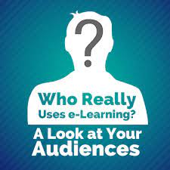
Who uses e-learning?
E-learning is often used in the workplace for training people. It is used to help people get new skills, for example, IT skill. It is also used when people need to know about new rules or ways of doing things, for example: if a government passes a new that people in a particular job must know about.

Slide 8
How is e-learning taught?
In e-learning, teachers and trainers spend less time:
Teaching classes of students.
Marking work.
Working face to face with students.
This gives them more time to:
Help students get better results.
Talk to students online and answer messages.
Help individual students.
Create e-learning media.

Slide 9
Resources
https://economictimes.indiatimes.com/definition/e-learning
https://www.fordham.edu/info/24884/online_learning/7897/types_of_online_learning
https://www.thetechedvocate.org/5-advantages-and-5-disadvantages-of-e-learning/
https://elearningindustry.com/multimedia-in-elearning-making-the-most-of-it
https://research.com/education/lms-elearning-statistics

