Slide 1
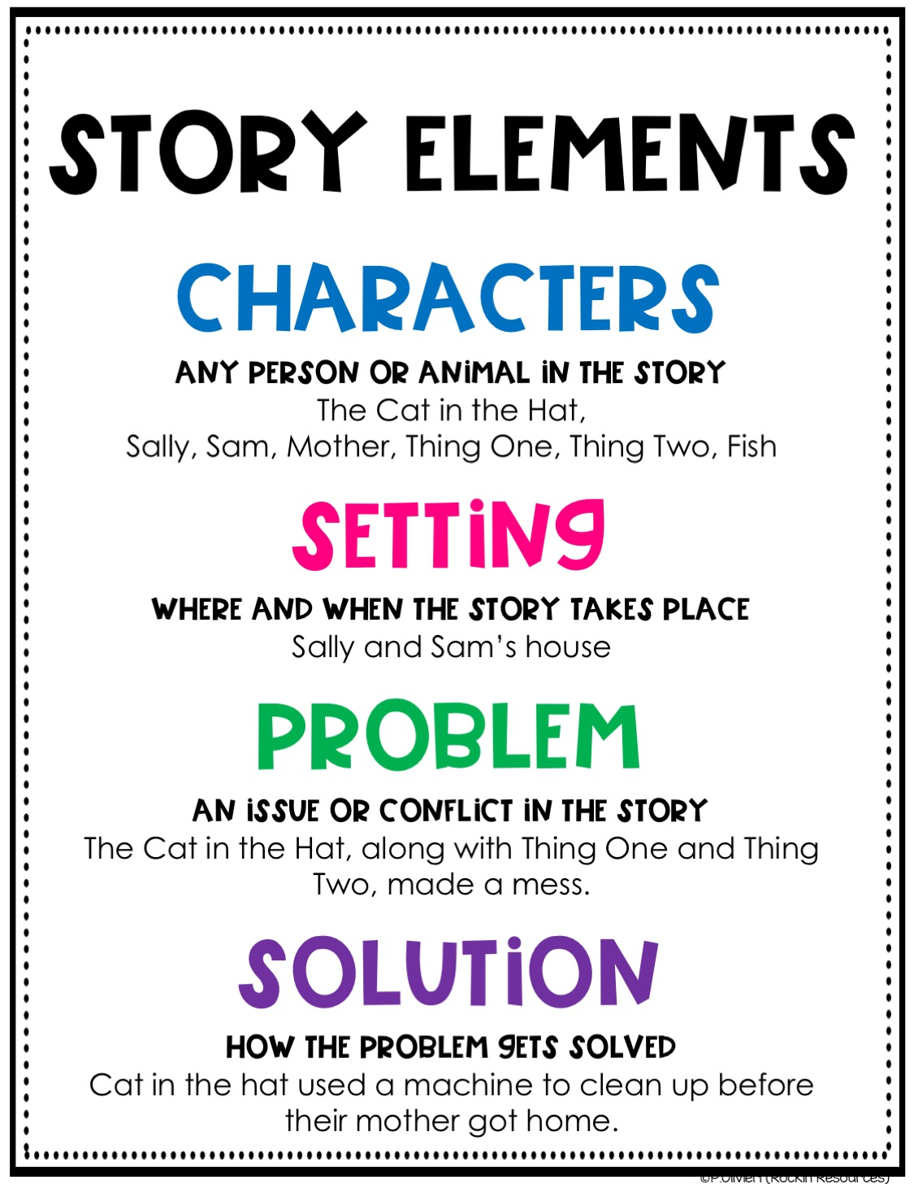
Story Elements

Slide 2
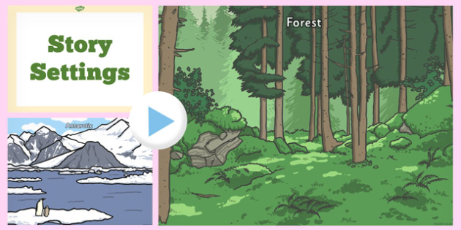
Setting
Where does the story take place?
How did the author describe the place?
How did the author describe the time?
When does the story take place?
Does the time or place affect the characters or plot of the story?

Slide 3
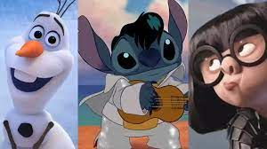
Characters
What are you learning about the way each character feels about each other?
What caused you to admire the character? or
What caused you not to admire the character?
Who is the most important character? Why?
Which character taught you the most? Why
What decisions did the characters have to make? How important were they for the story?
What scene did you like best?

Slide 4
Plot
How did the author begin the story? How did the author cause you to read more?
What are the most important events in the story? Why do you believe they are important?
What is the climax of the story?
What are the major events in the story?
How predictable is the ending of the story?
How did the author help you to understand the scene?

Slide 5
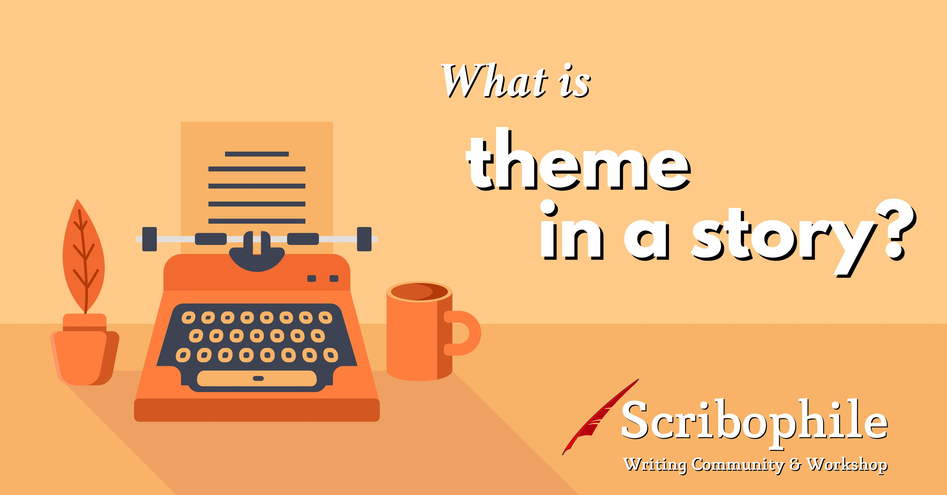
Theme
What is the author's message?
What lesson does the story have that resembles life?

Slide 6
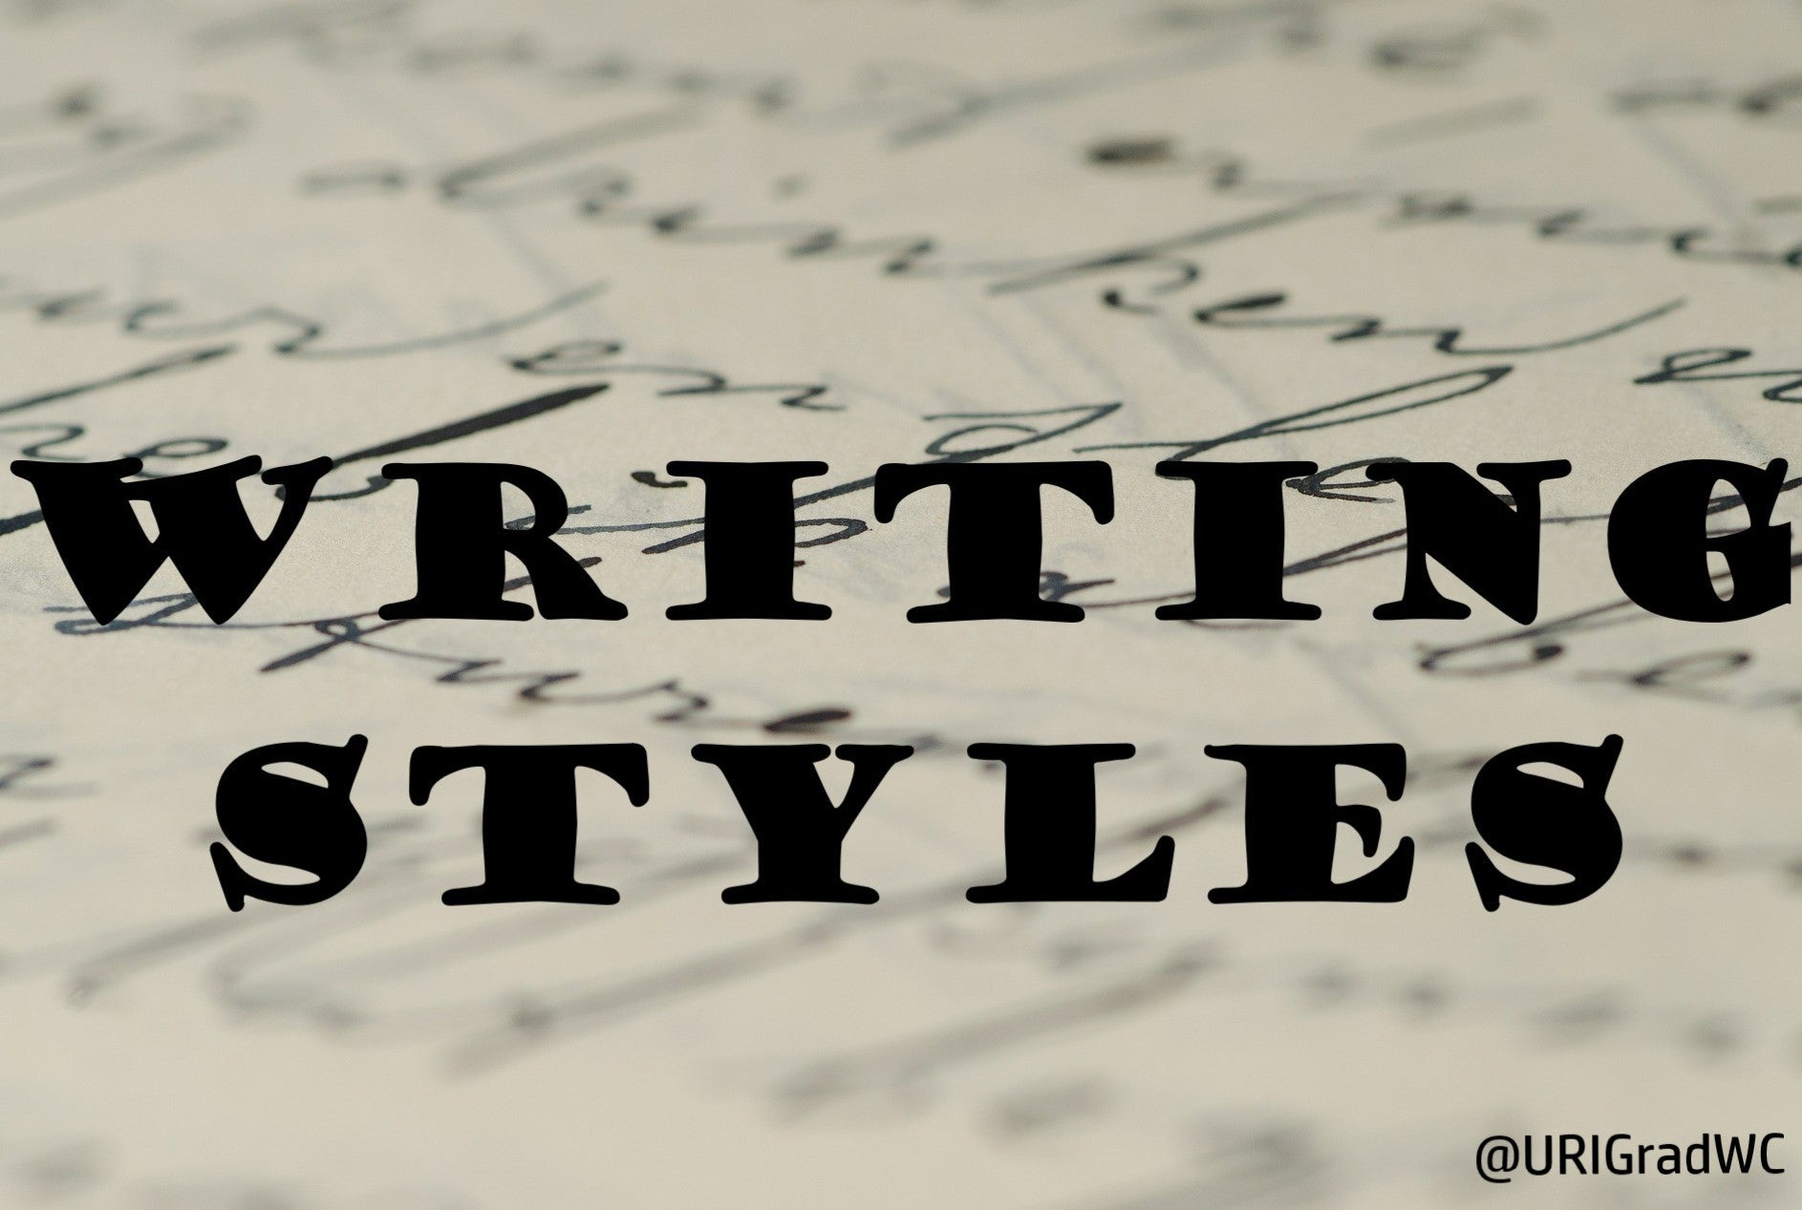
Style
What are some interesting words, phrases, and sentences?
What words created a feeling or picture in your mind? Describe the feeling or picture. How did these works evoke these images or feelings?
What are some of the strongest words used by the author?

Slide 7

Personal Connection
What does this story make you wonder about?

