Slide 1
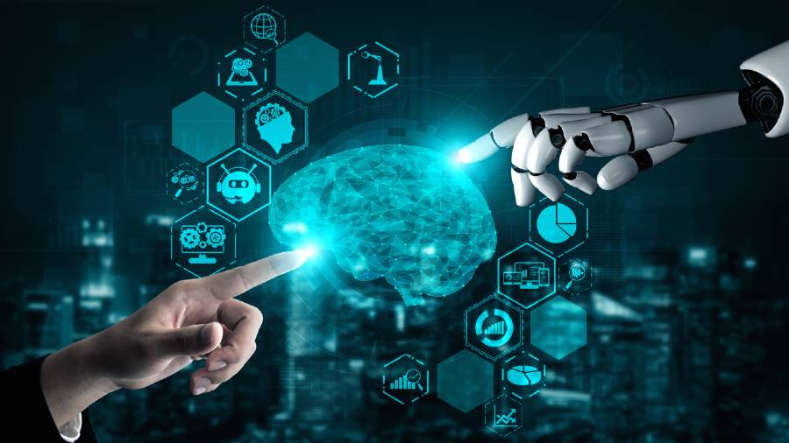
Artificial intelligence
By: Angelina sahouri

Slide 2
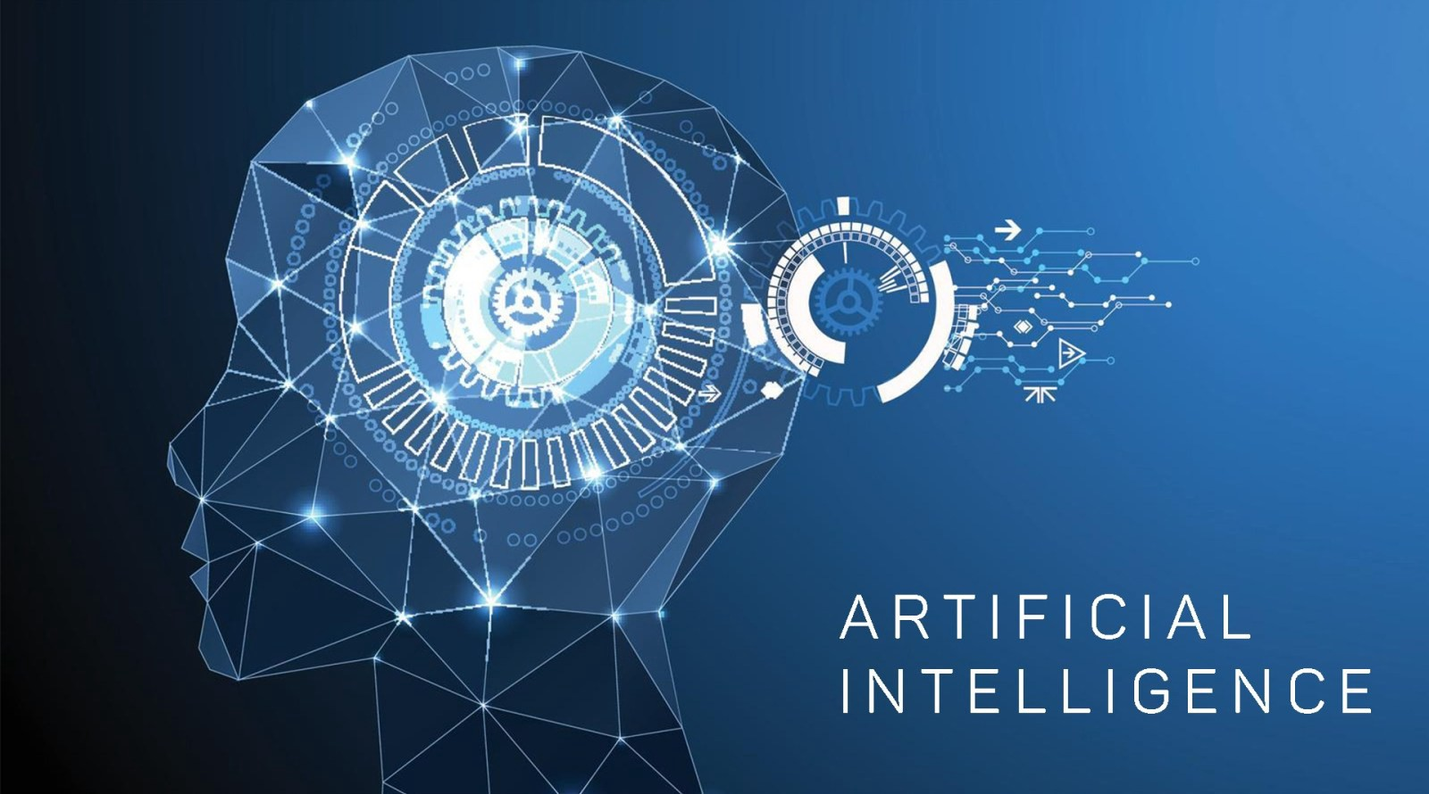
What is AI?
Artificial intelligence is the simulation of human intelligence processes by machines, especially computer systems. Specific applications of AI include expert systems, natural language processing, speech recognition and machine vision.

Slide 3
Examples of AI
Maps and Navigation
Facial Detection and Recognition
Text Editors or Autocorrect
Search and Recommendation Algorithms
Chatbots

Slide 4
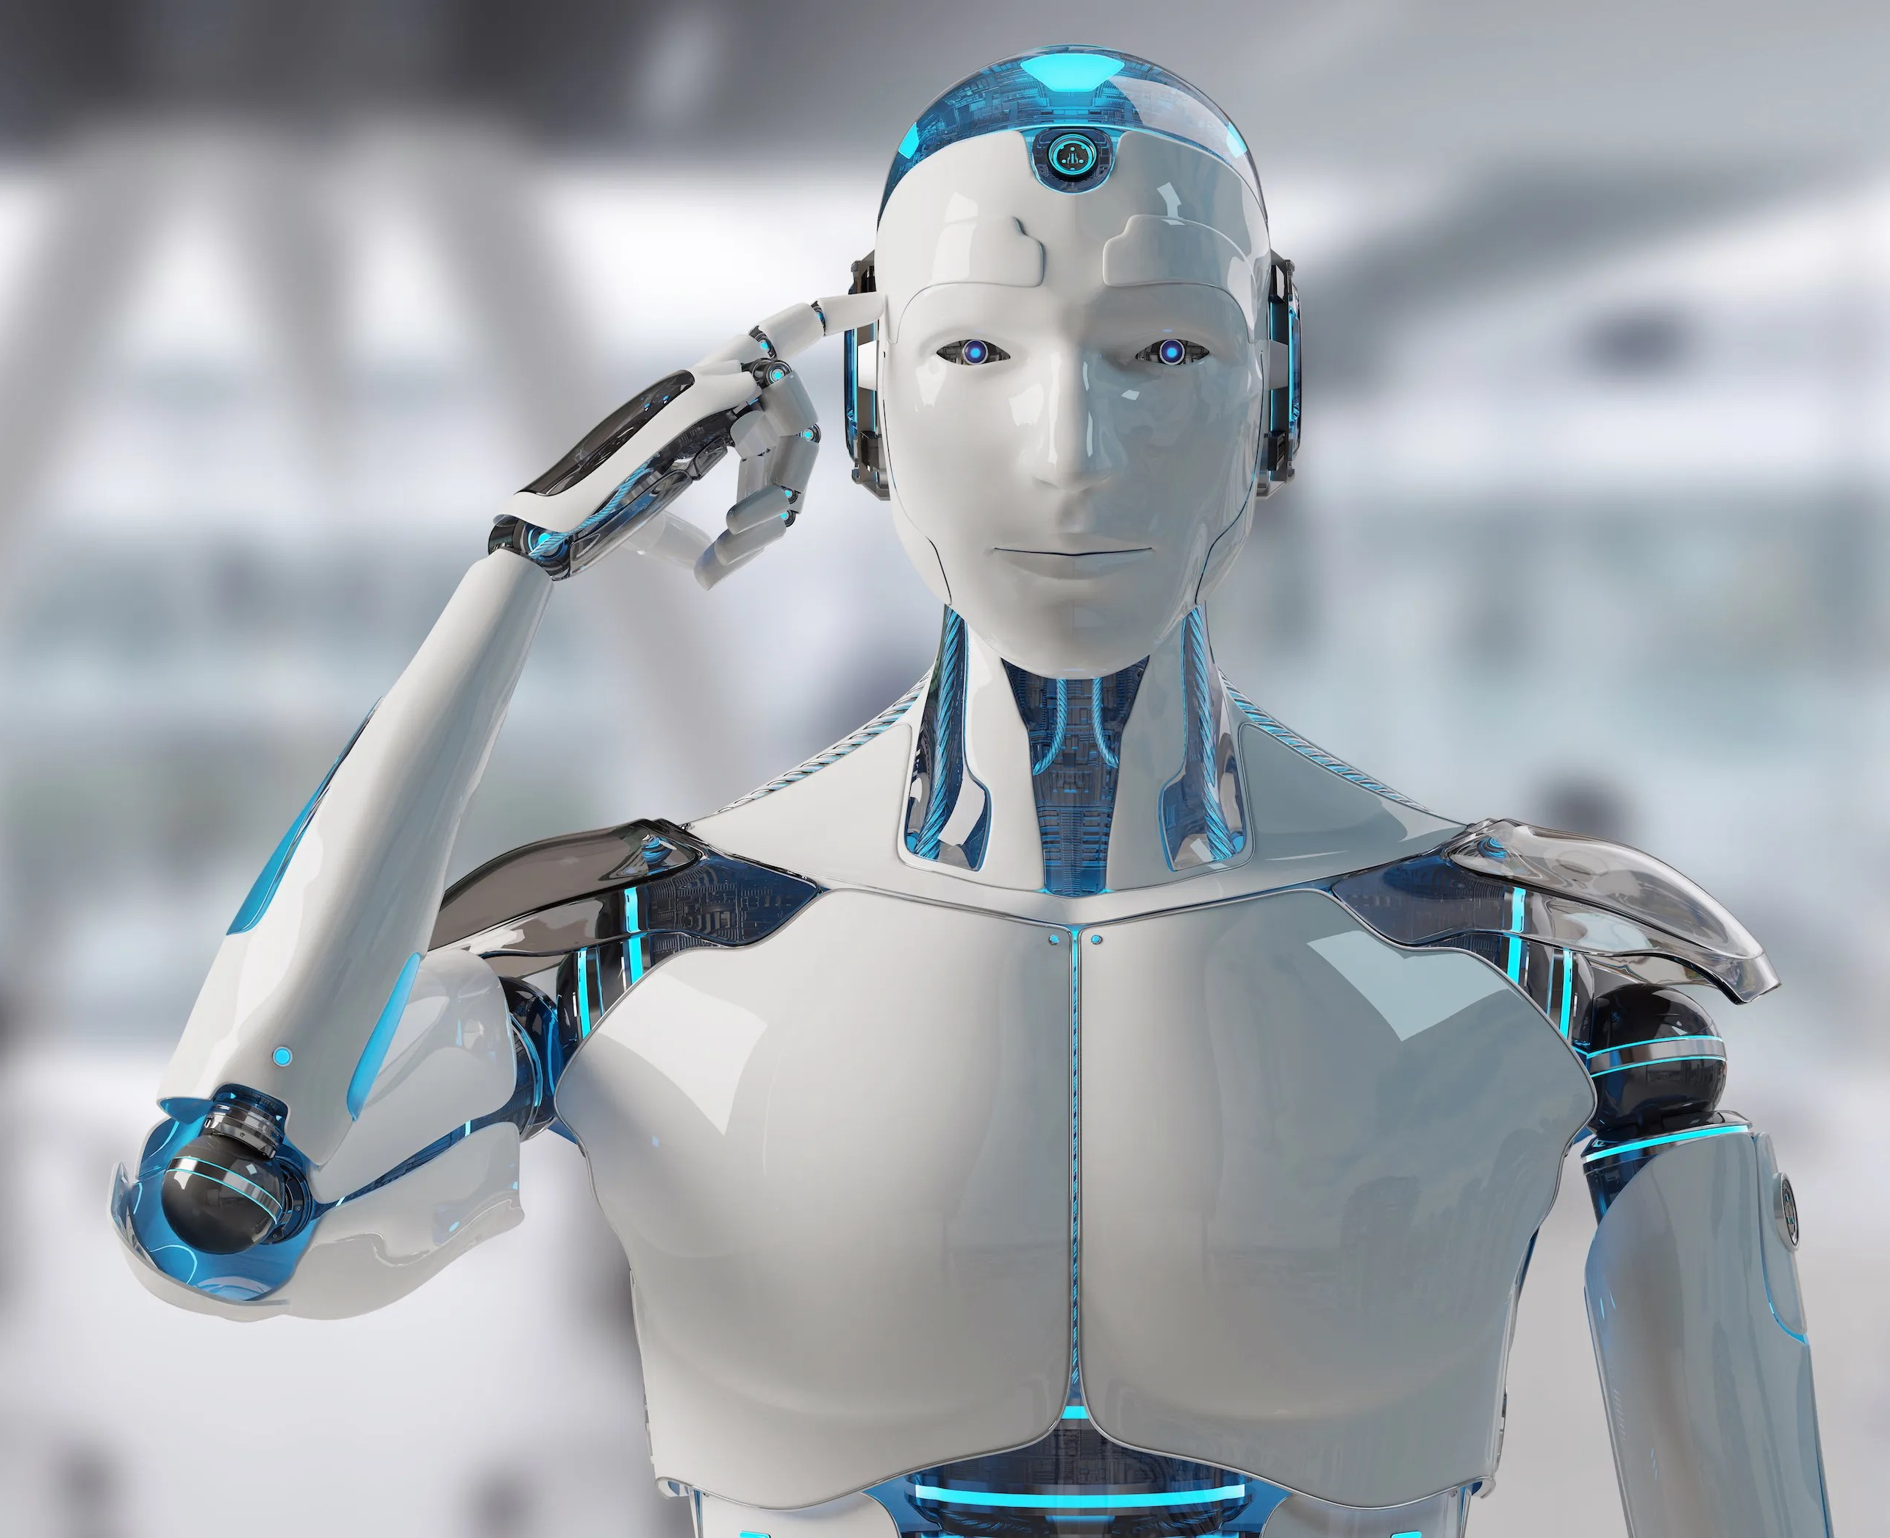
Why is artificial intelligence important
AI adds intelligence to existing products.
AI adapts through progressive learning algorithms to let the data do the programming
AI analyzes more and deeper data using neural networks that have many hidden layers.
AI achieves incredible accuracy through deep neural networks.

Slide 5
What are the advantages of AI?
Reduction in Human Error: errors are reduced and the chance of reaching accuracy with a greater degree of precision is a possibility.
Quicker decision making
Takes risks instead of Humans: We can overcome many risky limitations of humans by developing an AI Robot which in turn can do the risky things for us.
Helping in Repetitive Jobs: verifying certain documents for errors and many more things.
Digital Assistance: The digital assistants also used in many websites to provide things that users want.

Slide 6
What are the disadvantages of AI?
High Costs: It requires plenty of time and resources and can cost a huge deal of money.
No creativity: AI cannot learn to think outside the box.
Unemployment: One application of artificial intelligence is a robot, which is displacing occupations and increasing unemployment
Make Humans Lazy: AI applications automate the majority of tedious and repetitive tasks which tends to make humans use their brains less and less

Slide 7
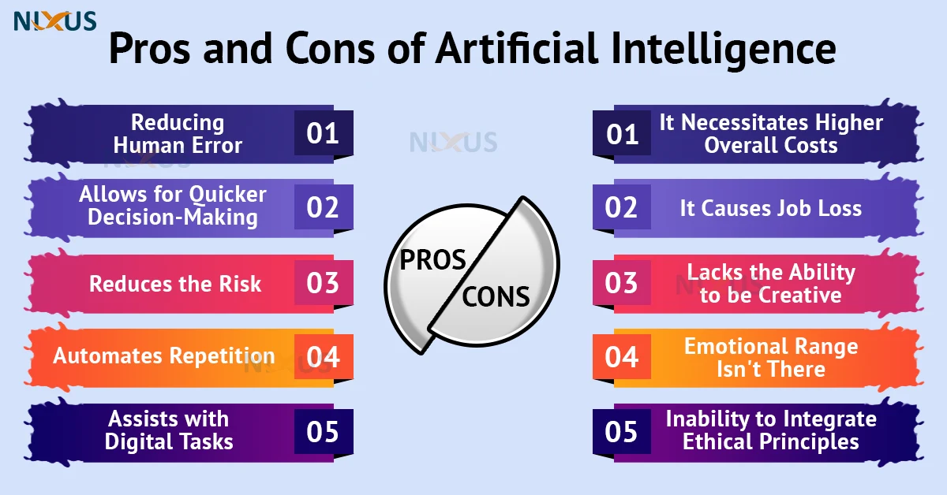

Slide 8
Resources
https://www.techtarget.com/searchenterpriseai/definition/AI-Artificial-Intelligence
https://www.sas.com/en_us/insights/analytics/what-is-artificial-intelligence.html
https://towardsdatascience.com/advantages-and-disadvantages-of-artificial-intelligence-182a5ef6588c
https://www.simplilearn.com/advantages-and-disadvantages-of-artificial-intelligence-article
https://nixustechnologies.com/advantages-and-disadvantages-of-artificial-intelligence/

