Slide 1
Artificial intelligence
What is Artificial intelligence?
Artificial intelligence is the simulation of human intelligence processes by machines, especially computer systems. Specific applications of AI include expert systems, natural language processing, speech recognition and machine vision.
https://www.techtarget.com/searchenterpriseai/definition/AI-Artificial-Intelligence#:~:text=Artificial%20intelligence%20is%20the%20simulation,speech%20recognition%20and%20machine%20vision.
Below are the various types of AI:
Purely Reactive. These machines do not have any memory or data to work with, specializing in just one field of work. ...
Limited Memory. ...
Theory of Mind. ...
Self-Aware. ...
Machine Learning. ...
Deep Learning. ...
Input Layer. ...
Hidden Layer.
https://www.simplilearn.com/tutorials/artificial-intelligence-tutorial/what-is-artificial-intelligence

Slide 2
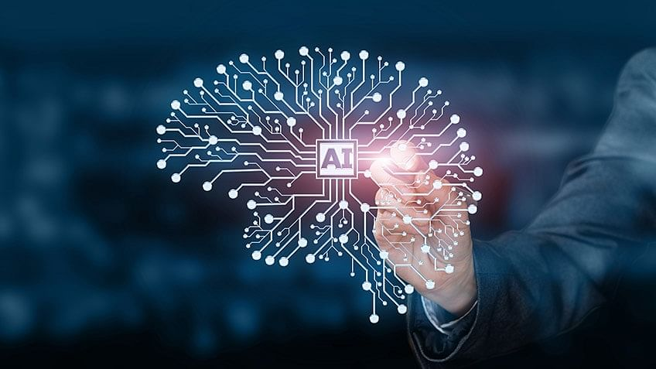
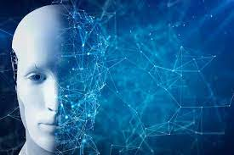
Advantages:
streamlining, saving time, eliminating biases, and automating repetitive tasks
Disadvantages:
The disadvantages are things like costly implementation, potential human job loss, and lack of emotion and creativity.
https://www.tableau.com/data-insights/ai/advantages-disadvantages#:~:text=But%20beyond%20the%20headlines%20that,lack%20of%20emotion%20and%20creativity.

