Slide 1
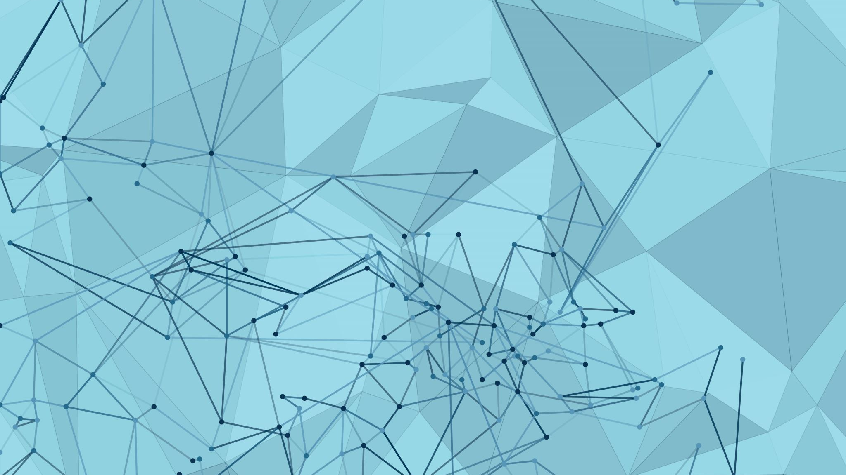
Simulations
By : Abdullah Abujaber 8D

Slide 2
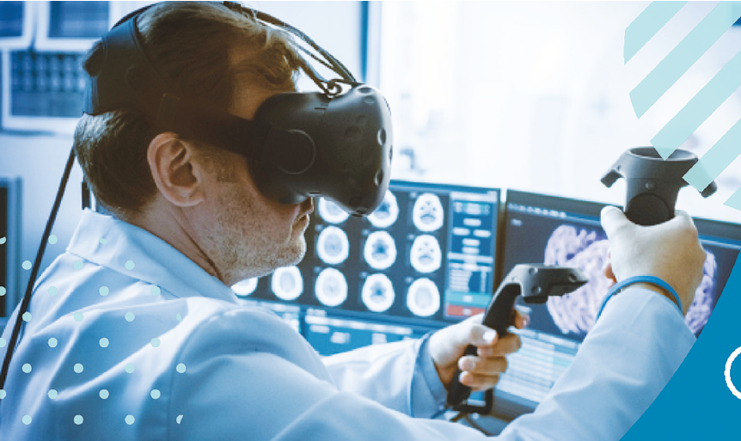
What is a simulation
A simulation imitates the operation of real world processes or systems with the use of models. The model represents the key behaviors and characteristics of the selected process or system while the simulation represents how the model evolves under different conditions over time.

Slide 3
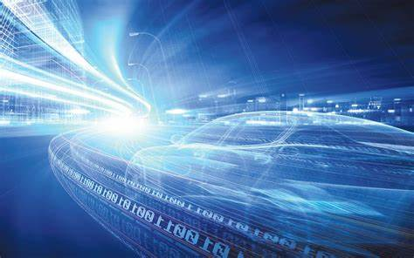
How a simulation works
Simulation works by intuitive simulation software to create a visual mock-up of a process. This visual simulation should include details of timings, rules, resources and constraints, to accurately reflect the real-world process, this can be applied to a range of scenarios, for example, you can model a supermarket and the likely behaviors of customers as they move around the shop as it becomes busier. This can inform decisions including staffing requirements, shop floor layout, and supply chain needs.

Slide 4
Some Types of simulations
1.Automotive simulations
2. and urban planning simulations
3.Disaster preparation simulations
4.Engineering systems
5.Flight simulation
6.Robotics
7.And many more

Slide 5
ADVANTAGES
Give accurate results :Most of the time the result of the simulation is accurate than doing analytical or practical testing on the actual system.
Helps students: Teachers can do a simulation of the system by computer and explain to students.
Animation and modeling : With simulation, engineers can see the actual product (e.g. car) without practically building it. They can change the look and feel of the product during modeling.

Slide 6
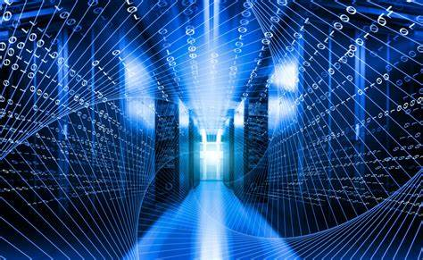
DISADVANTEGES
1)expensive: Sometimes it costs more money to do simulation then making the product.
2)Takes a long time : It takes a long time to set up and test a simulation model. This is because simulation takes a lot of data to be input.
3)computer limitation :Complex simulation involves a computer with higher memory and processor speed. This is another drawback of simulation.

Slide 7
TANK YOU

